Slide 1
WELCOME!
Please answer the following questions:
What is your job title?
What is the most significant measure of success for your job?
Complete this sentence: “My biggest worry about accessibility is…”

Slide 2
Storytime!

Slide 3
What is the moral of the story?

Slide 4
The cultural shift at an organization
can be as small and as significant
as a hex value.

Slide 5
EXCELLENCE AT SCALE
Keys to building a sustainable and cost-effective accessibility program
AccessU 2019

Slide 6
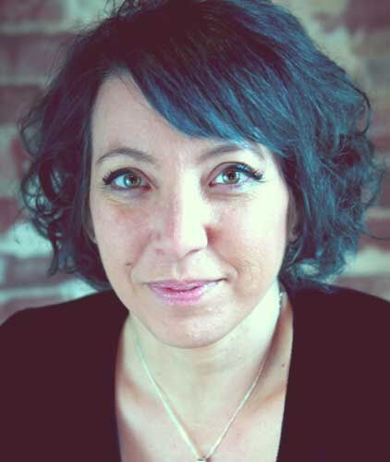
Who am I?
Elle Waters
www.lateach.es/elle
elle.waters@levelaccess.com

Slide 7
What are our goals?
Learn to approach accessibility as a strategic initiative
Get new ideas on how to do less for more value
Make plans for what you’ll put into action tomorrow
Learn to be agile-minded with what you build
Know how to make new plans when everything changes.
What else?
Notes:
WHAT CLASS IS THIS?
This workshop is about building a sustainable accessibility program at your organization. However, there is no blueprint or long-term plan that you’ll find or create that will work unless you’re willing to adapt to changes and recognize opportunities:
Being strategic
Getting ideas
Making plans
Making new plans
Being agile-minded

Slide 8

Whose class is this?
I am the master of my fate. I am the captain of my soul.

Slide 9
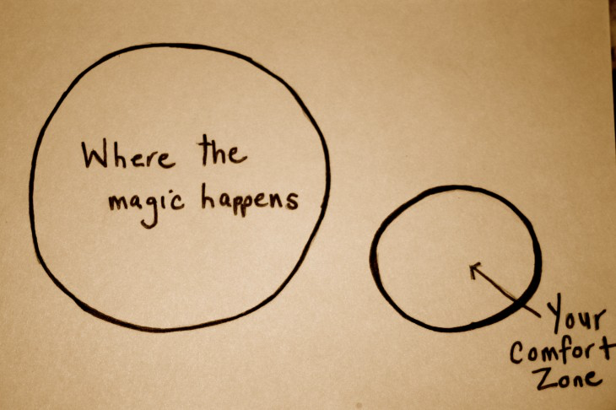
WHERE THE MAGIC HAPPENS… (and here’s your comfort zone… over here.)

Slide 10
What’s it all about?
7 things we’ll discuss today:
Promotion and advocacy
Policy
Procurement
Process
People!
Professional development
Patterns
Notes:
Winning the biz case, establishing valu

Slide 11

“Digitalus accessificorum!”
Full disclosure: No magic will occur in this workshop.

Slide 12
Boss fights you will face...
Money
Changes
Silos
Lack of ownership
Lack of giving a damn
Fear
Mediocrity
Fear of Mediocrity
The sheer size of it all
Notes:
Winning the biz case, establishing valu

Slide 13
But, after today...
Witness measurable improvement in your efforts
For some, find your moonshot moment

Slide 14
“We choose to go to the Moon and do the other things…
not because they are easy, but because they are hard.”

Slide 15
How you adapt to changes
will define your success.

Slide 16
1. PROMOTION

Slide 17
Look how delicious!
Accessibility can…
Revolutionize your business
Make you more attractive
Win friends and influence people
Change the world!
Notes:
1 billion users delicious? Maybe!
20% more market share delicious? Maybe!

Slide 18
Maybe?
Notes:
1 billion users delicious? Maybe!
20% more market share delicious? Maybe!
Trillions in discretionary income delicous? Maybe!

Slide 19

Thwack!
Without accessibility…
We will lose all our customers.
We will be sued.
Everyone will hate us.
We will be terrible people.

Slide 20
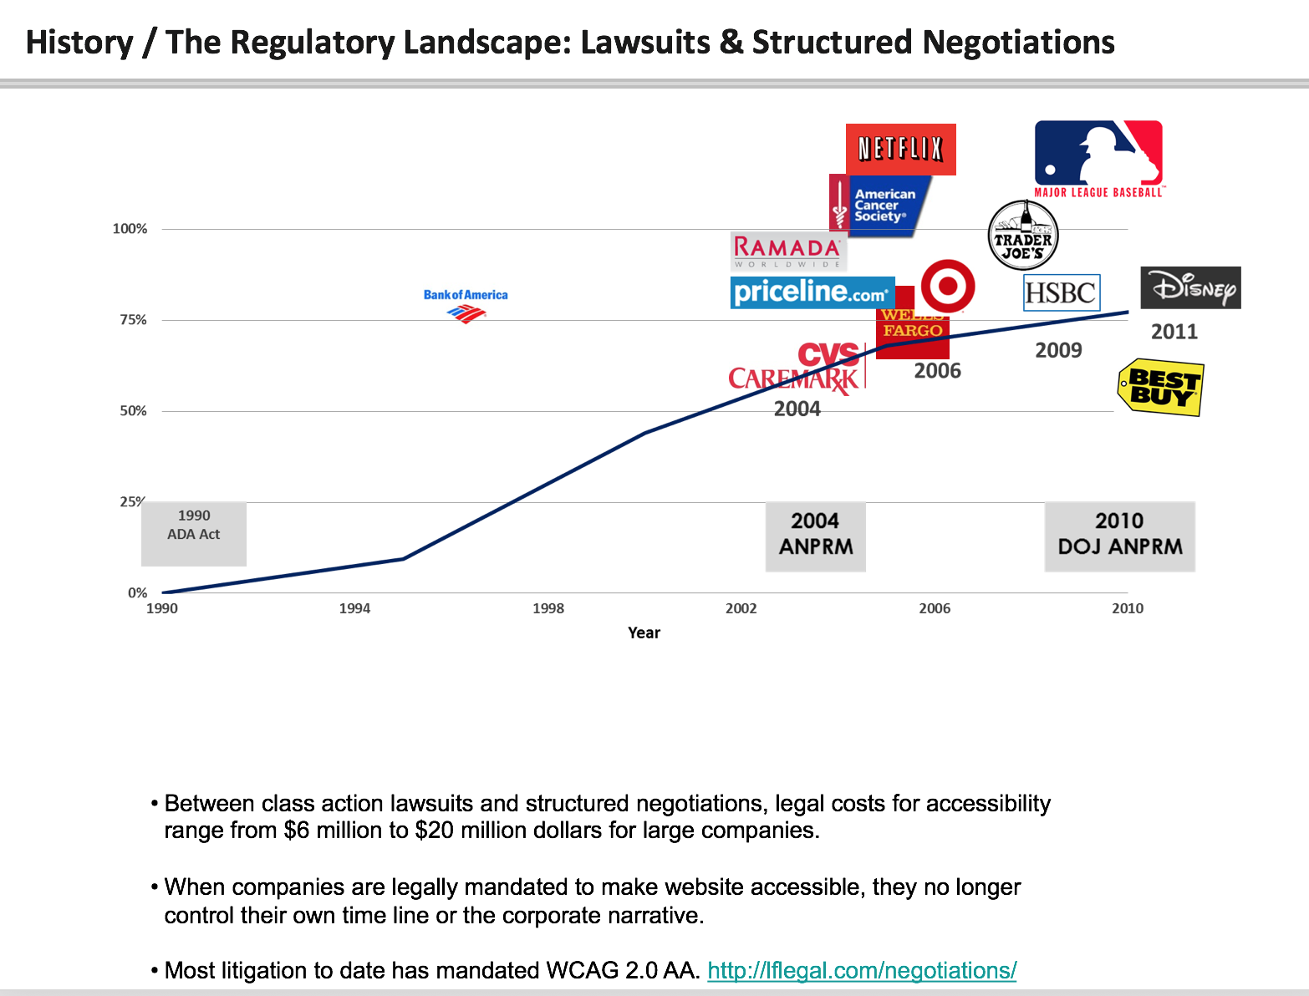
Maybe not?
Lawsuits in the United States

Slide 21

How to win the business case
Establish the VALUE of accessibility at your organization.

Slide 22
A cautionary tale...
Notes:
COST OF DELAY: Client project example with 2 month delay, design and FED moving forward, now doubling up effort near the end

Slide 23
Key points to win the business case
Accessibility should pay for itself.
This whole thing is all about relationships and trust.
You have to be a change agent.

Slide 24
Tips to win the business case
Know your organization! Know more about how it works than anyone else.
Look for opportunities where accessibility can solve someone else’s problem.
Align your business case to the largest organizational initiatives.
Adopt the same vision and tone as your executive leadership .
BE BUTTONED UP with your numbers.

Slide 25
Who does accessibility benefit?

Slide 26
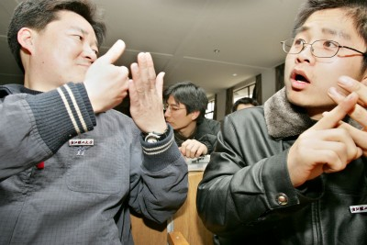
Percentage of individuals with disabilities
20%

Slide 27
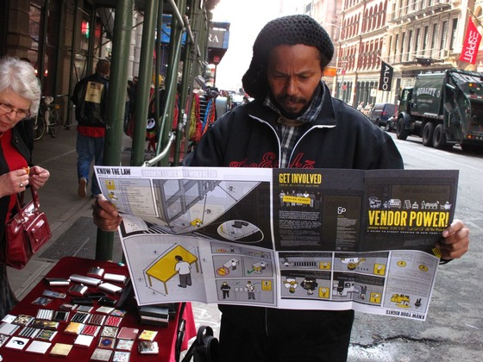
Number of individuals who struggle with low literacy (in English, in the U.S.)
30
million

Slide 28
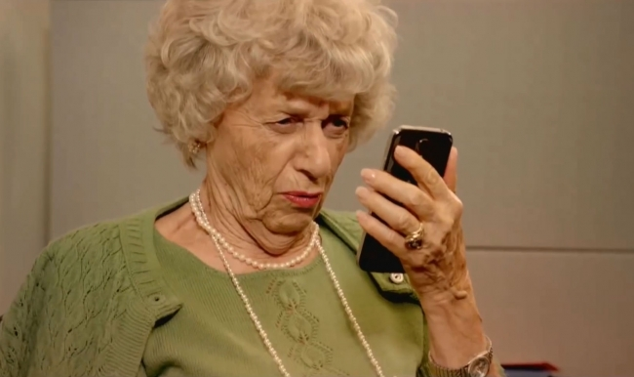
Percentage of individuals over 65 in the United States
15%

Slide 29

Tidal wave
Notes:
55 million in 2020
72 million in 2030
1 in every 5 Americans

Slide 30
Percentage of cell phone owners in the world
More people in the world own cell phones than toilets.
- U.N. study 2013
67%

Slide 31
What is the ROI of accessibility?

Slide 32

What’s the ROI of your mother?
- Gary Vaynerchuk

Slide 33

WHAT NO ONE IS SAYING OUT LOUD
Accessibility doesn’t have tremendous business benefit when viewed in isolation.

Slide 34
WHAT NO ONE IS SAYING OUT LOUD
Accessibility is dependent on a few specific preconditions to be successful.

Slide 35
WHAT NO ONE IS SAYING OUT LOUD
When those preconditions are in place,
an organization wins in many areas.

Slide 36
WHAT NO ONE IS SAYING OUT LOUD
The accessibility business case is:
accessibility +preconditions = success

Slide 37
Your job is to find those preconditions.

Slide 38
Organizational level wins
Digital governance
Risk mitigation and prevention
Standardization
Market-ready initiatives
Corporate responsibility
Professional development
Customer engagement

Slide 39

TEAM EXERCISE!
Notes:
Write down what your organization’s mission statement is.
Are there any executives or leaders who most people at your org regard as visionary?
What does s/he say? What is s/he known for?
Find three ways that accessibility can be linked to those things.
Now, what if something changes… what will you do?

Slide 40
Find the cornerstone
Write down your organization’s mission statement.
How does your org define value?
Are there any executives or leaders who most people at your org regard as visionary?
What do they say? What are they known for?
Find three ways that accessibility can be linked to those things.
Share!
Notes:
SHARE WITH US YOUR RESULTS, AND TELL US HOW THIS MIGHT DEMONSTRATE THE VALUE OF ACCESSIBILITY

Slide 41
Examples of brand promises
Target: Expect more.
Humana: Guidance when you need it most.
JetBlue: Dedicated to inspiring humanity.
Google: Focus on the user and all else will follow.

Slide 42
Always Be Closing (Alec Baldwin from Glengary Glenross, standing in front of a blackboard)

Slide 43
2. policy

Slide 44
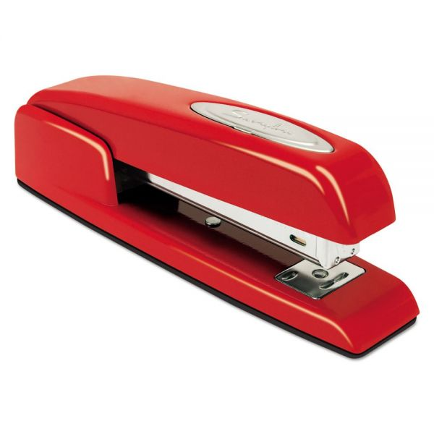
Accessibility policies
GOAL: Make this better than a TPS report...
Internal (standards)
Departmental (governance)
External (partners and vendors)
External (customers)

Slide 45
Internal accessibility policy: decisions
Universal design or multi-modal or something in-between?
WCAG? Which WCAG? Blended with company standards?
Who’s involved in creating these?
Who should maintain these?
What about the outliers?

Slide 46
External accessibility policy statement
4 key things to include:
Brand promise or mission statement that connects to accessibility
Steps taken and progress made
Examples (in plain language) and accessibility features
Feedback mechanism for your users

Slide 47
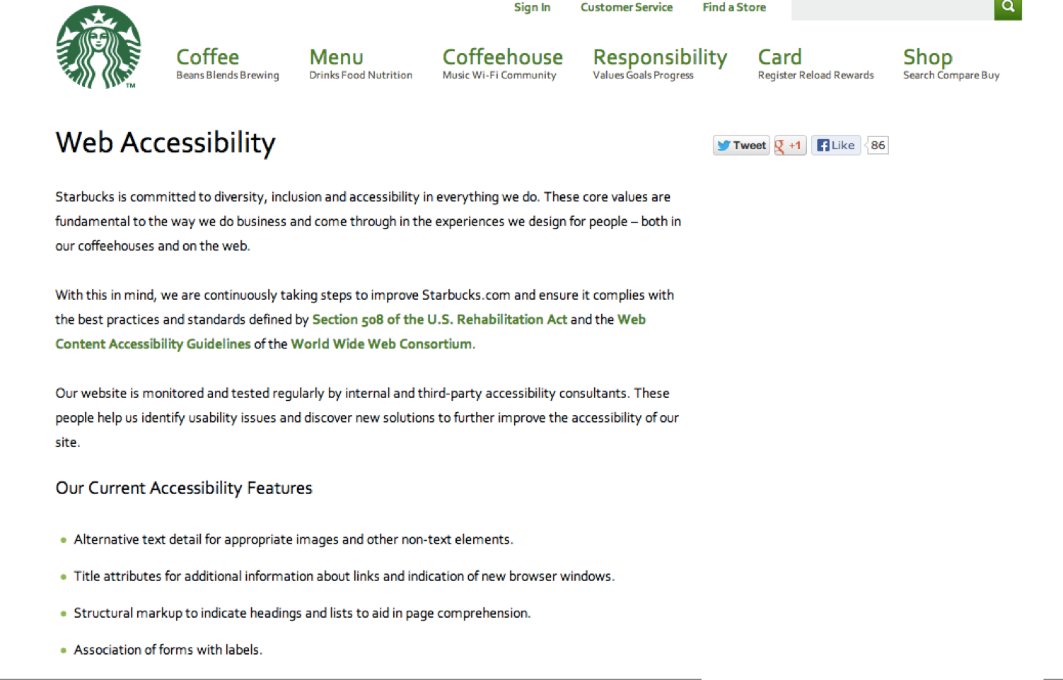
Accessibility policy statement: Starbucks

Slide 48
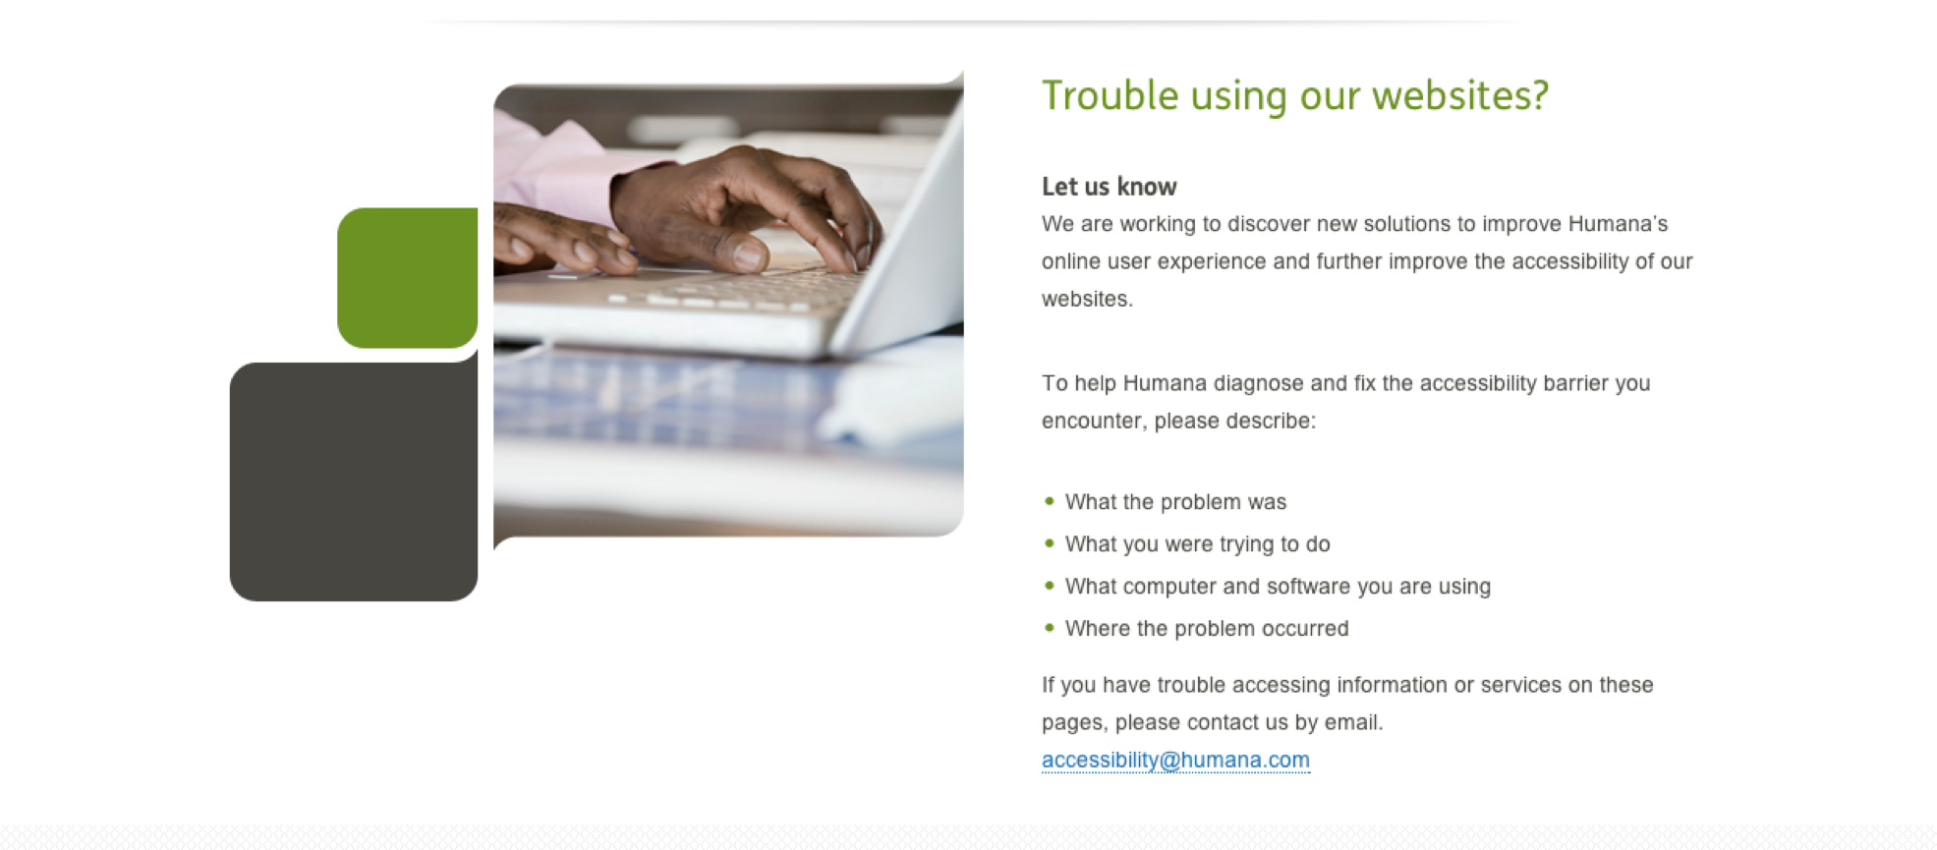
Accessibility policy statement: Humana

Slide 49
3. PROCUREMENT

Slide 50


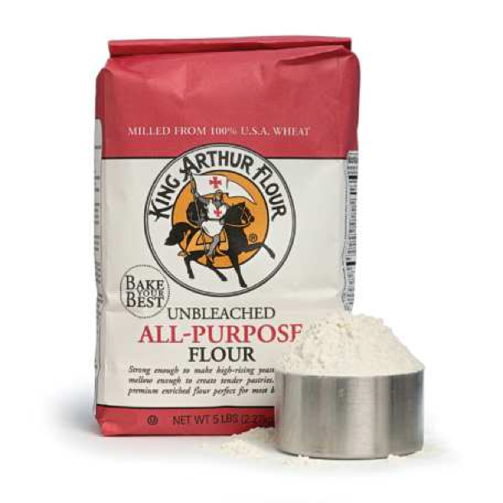

Procurement vs. Compliance
vs.

Slide 51

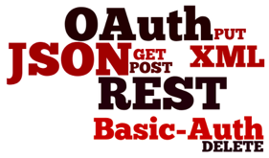
And when we say procurement
and
platforms
services
Notes:
PLATFORMS
Often white labeled, platforms are self enclosed digital experiences
May contain a more robust feature set, but it’s harder to adapt after project is underway
Gaps more easily understood
SERVICES
Usually staff augmentation and creative or professional services
Has the ability to adjust and adapt after the project is underway
More political, gaps less understood

Slide 52
The procurement toolkit
Steps to happier, more accessible procurement
Inventory of vendors
Vendor self-assessment
Live interviews
Establishing compliance time lines
Contract language

Slide 53
TEAM EXERCISE!

Slide 54

How many do you have?
VENDOR PARTNERS

Slide 55
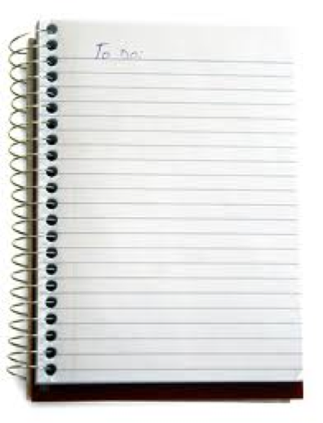
List the ingredients you “cook” with
Vendor name or name of software
Level of perceived/stated expertise
Is it a platform or service?
Which project(s)?
What success stories do you have?
What lessons learned?

Slide 56

Vendor self assessment

Slide 57
Live interviews
Held after vendor’s self assessment has been submitted and reviewed
Ideally, held as a discussion between org and vendor specialists
Used to inform Procurement in the selection of a bid winner
Conducted by a member of your organization’s accessibility team

Slide 58
Live interviews: sample questions
Please describe your understanding of web standards and progressive enhancement.
What does POUR mean to you?
Please describe your testing process, including any testing with users with disabilities, third-party accessibility consultants, and any automated tools used.
Have you ever worked on a project where accessibility standards were listed among functional requirements? If so, please tell us about your experience and the role that your team played.

Slide 59
Live interviews: more sample questions
If a platform vendor, how customizable is the platform and how separated are presentation from behaviour? Please describe your understanding of how best to support each major disability group.
Describe your process in handling customer complaints regarding accessibility, and name the primary point of contact responsible for resolution of these complaints.
If accessibility deficiencies are found in your product after purchase, who will pay for those issues to be resolved?

Slide 60
Contract language
Questions to answer:
How standardized are my contracts?
How many layers of contracting do we have?
How customizable?
Who maintains our contracts?
Who does our procurement at our organization?

Slide 61
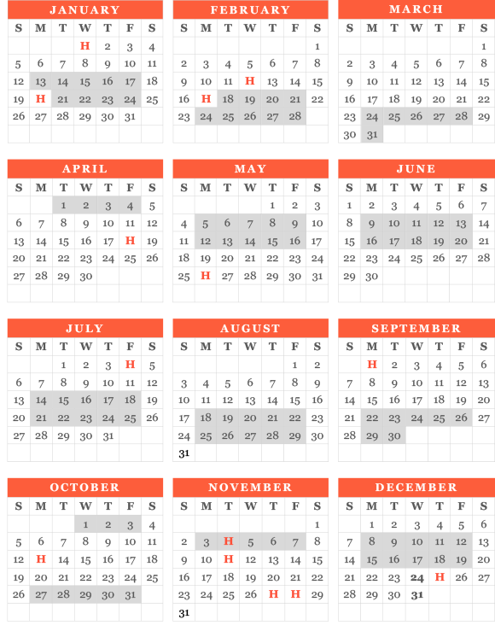
Setting compliance timelines
Use the vendor self assessment and any testing results you have and create iterative milestones
Define measures of success for each
Define consequences for vendor not meeting these milestones
Put all that into the contract

Slide 62


How important are those milestones?

Slide 63
Procurement
TIPS!
Know your procurement officers/buyers
Be detailed in any contract language you create
Get potential vendors to actively participate
Standardize all the things

Slide 64
4. PROCESS

Slide 65
Waterfall, the vision (colour photo of waterfall with rainbow at the end)

Slide 66
Waterfall, the reality (black and white photo)

Slide 67
Waterfall vs. Agile

Slide 68
WHY AGILE?
Agile enables organizations to cope with continuous change.
Agile permits them to flourish in a world that is increasingly volatile, uncertain, complex and ambiguous.
Agile is the only way to cope sustainably with today’s marketplace.
Agile allows organizations to become as nimble as the rapidly shifting context in which they find themselves.
Agile is becoming a key to the management of everything.

Slide 69
Accessibility loves Agile!
A11Y
AGILE

Slide 70
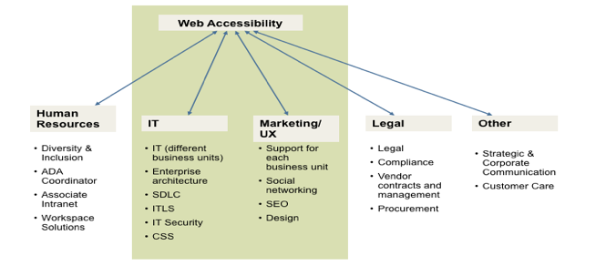
A top down accessibility model
(i.e. how to stay up late every night for work and miss every family vacation)

Slide 71
A close-up view of project stages and accessibility considerations within a project team
Project Definition
User Research
Design Iteration
Develop & Implement
Validate & Launch
Include people with disabilities in more than interviews and focus groups; use observation and walk-throughs.
Include functional needs in personas, user stories and other artifacts
Find people both in and outside your org to get subject matter expertise and perspective.
Test colours
Test concepts
Test iconography and visual language assets (particularly for low vision user)
Tend to focus on visual design, but we must examine process design.
Engage and respond to user feedback
Ensure that as part of roll-out appropriate training is given to CSRs so they can act.
On-going plans for organized learning from project, and documentation/resolution of issues that are raised
Test templates
Test functional prototypes and demos
Don’t test with people with disabilities too early (it can be very frustrating and not productive)
Fix technical accessibility issues THEN test with people with disabilities for ease of use
Any special content needs?
What support/customer service needs will this bring?
Has this been done before?
What new technology & challenges are there?

Slide 72
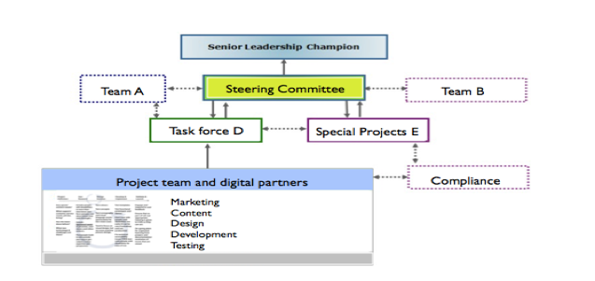
Where this really sits in your process...

Slide 73
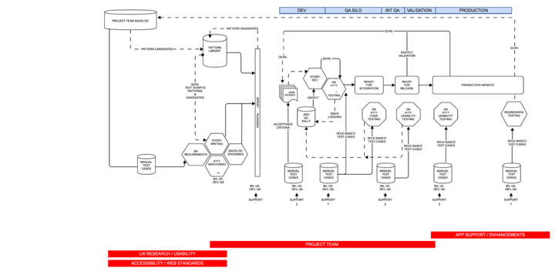
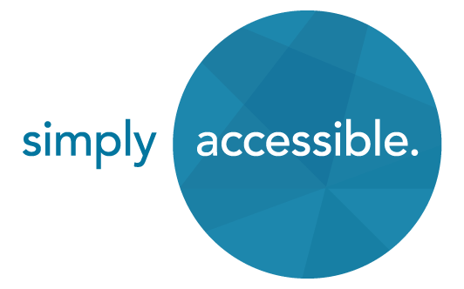
An example of an iterative real-world process

Slide 74
Should I use automated tools in my process?

Slide 75
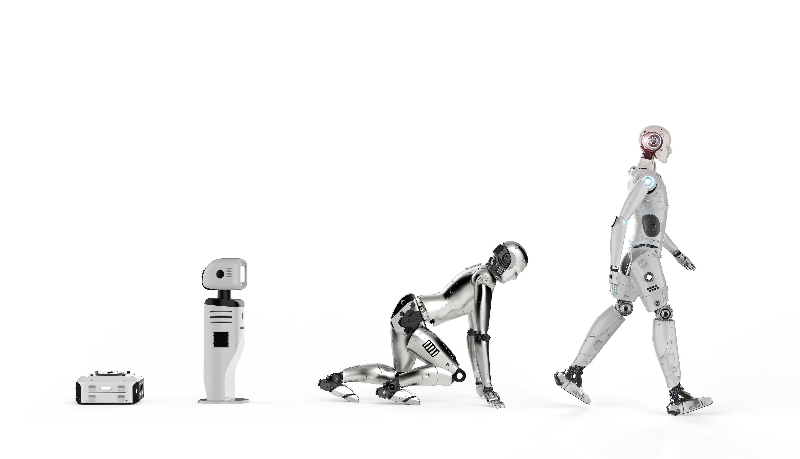
AUTOMATE ALL THE THINGS!
(or as much as you can…)
No change without training
Be lean and prioritize value
Use the smartest, best tools
Use modern methods
Consider every role
Leverage custom rules

Slide 76
A word about process and scalability
“Scale principles, not process.”
Jeff Gothelf
http://www.slideshare.net/jgothelf/scaling-lean-project-program-portfolio
Process gets you short term gains.
Principles get you long term change.

Slide 77
5. PEOPLE

Slide 78

Who are my people?
Who exactly are your allies?
What do they want?
What do they need?
What’s their relationship with your organization?

Slide 79
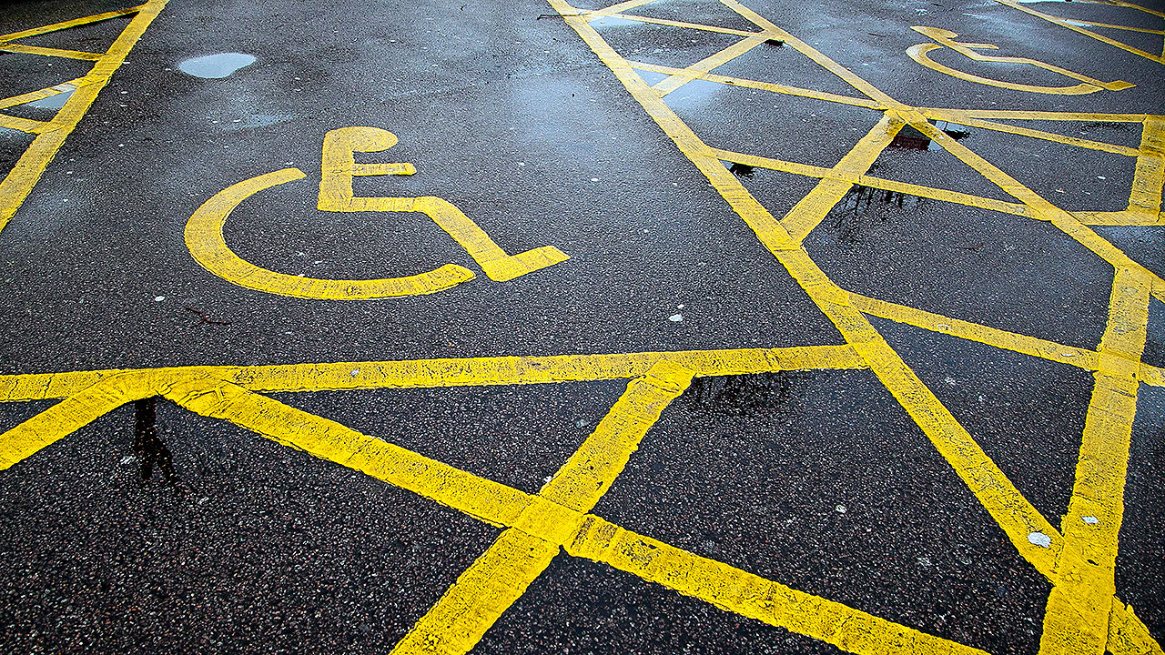
Where might things fall apart?
“Actually finding the bus stop, not the right street, but standing in the right place when the bus comes, is pretty hard.”
http://www.fastcompany.com/3059158/crowdsourced-knowledge-is-helping-people-with-disabilities-navigate-life
Notes:
These days GPS technology can get you as close as about 10 feet from your destination, close enough to see it–assuming you can see.
But those last few feet are a chasm for the blind (and GPS accuracy sometimes falls only within about 30 feet).
“Actually finding the bus stop, not the right street, but standing in the right place when the bus comes, is pretty hard,” says Dave Power, president and CEO of the Perkins School for the Blind near Boston.
Helen Keller’s alma mater is developing a mobile app that will provide audio directions—contributed by volunteers—so that blind people can get close enough to the stop for the bus driver to notice them.

Slide 80
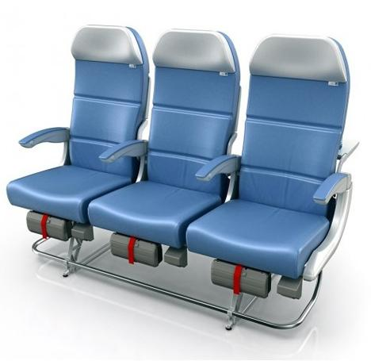
Where might things fall apart?
Selecting an airline seat

Slide 81

Let’s find out!

Slide 82
TEAM EXERCISE!

Slide 83
Journey maps
The story of your users
Personas
Key tasks
Timeline
Touchpoints
Channels
Emotions (emojis!)

Slide 84
Components of a customer journey map
Business goals
User research (use what you know today)
Touchpoints (how do your users interact with your organization?)
Channels (where / in what way?)
Emotional state for each of those activities
Sketch the journey
Apply key accessibility considerations to your user’s journey

Slide 85
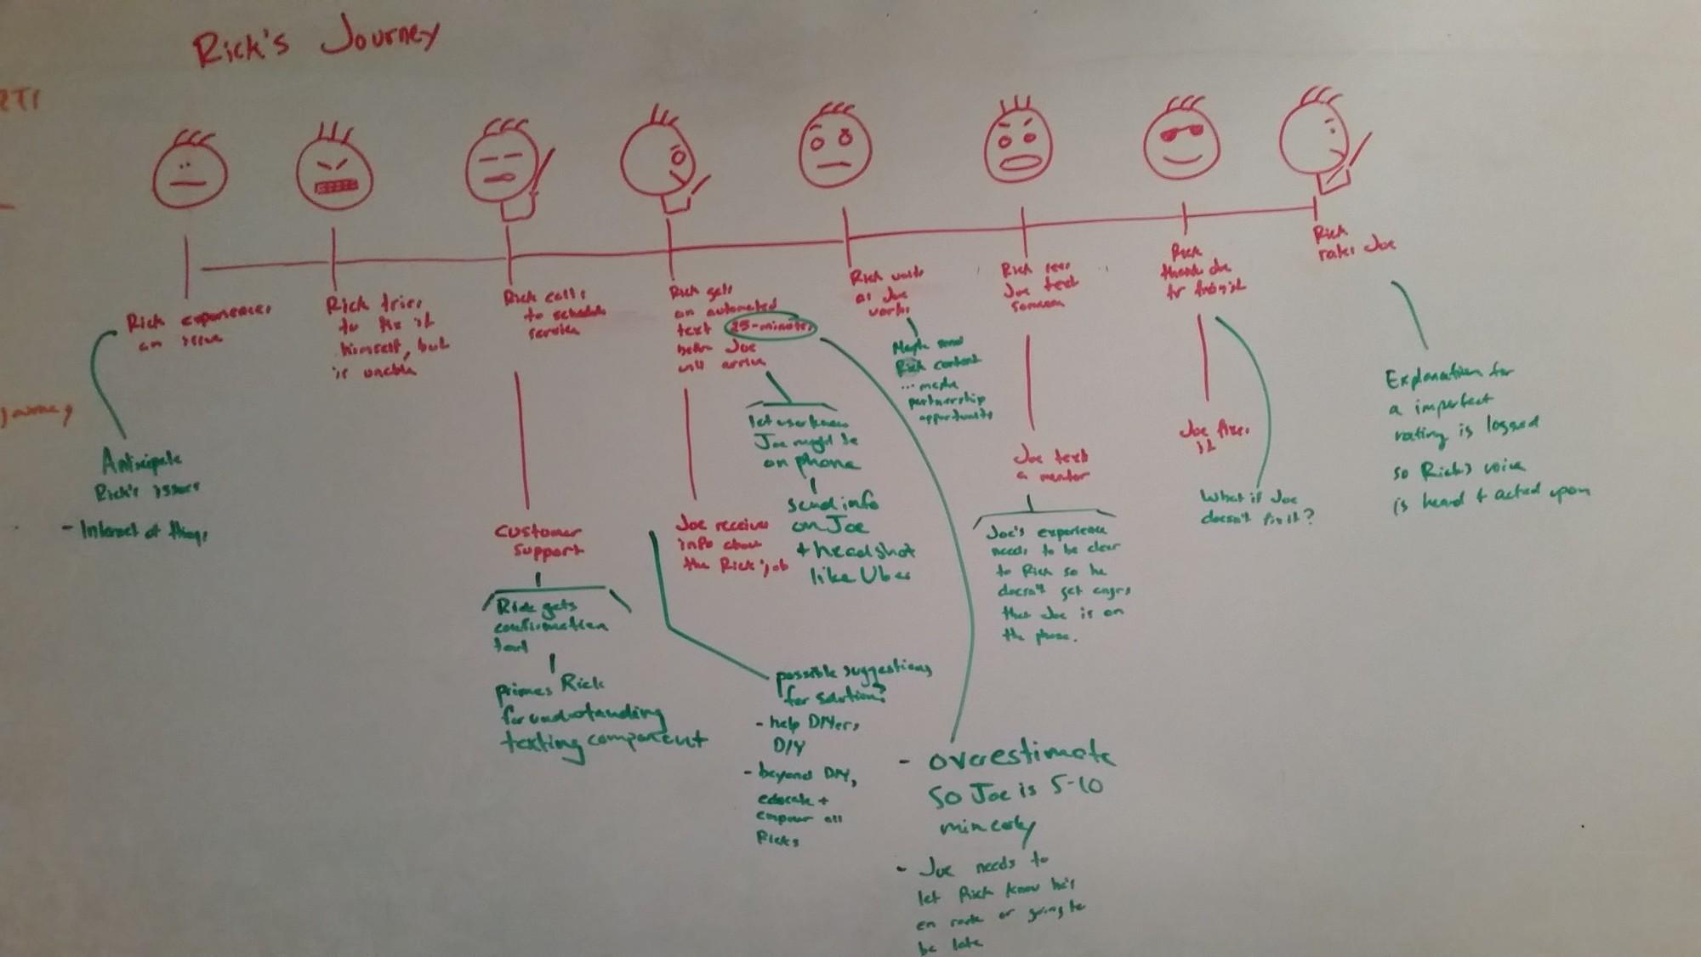
A sketch of a customer journey map

Slide 86
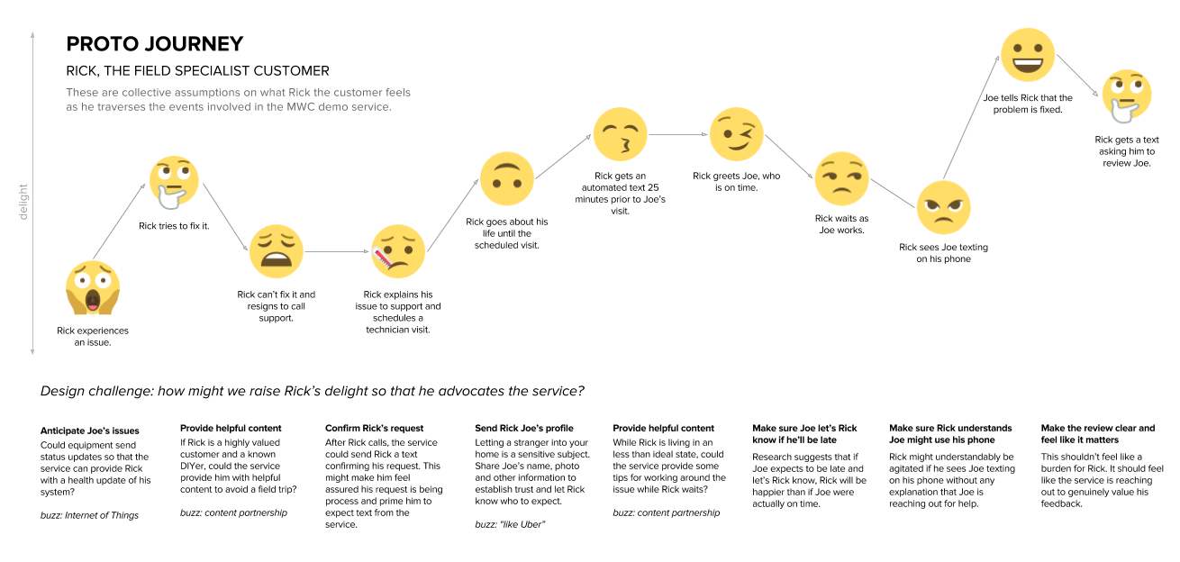
The fancier, typed out version of a full customer journey map

Slide 87
6. Professional development

Slide 88

Professional development
Your core team
Onboarding (LMS)
Bag lunch, working groups
Digital summits
Smaller teams work better
Keep them close, keep them safe, keep them empowered

Slide 89
7. Patterns
(or, more specifically, how to leverage a functioning design system to do most of this work for you)

Slide 90
Some quick definitions
STYLE GUIDE: establishes standard style requirements to improve communication by ensuring consistency both within a document, and across multiple documents.
PATTERN LIBRARY: A collection of design patterns for user interfaces. Each pattern formalizes the appearance, functionality and accessibility requirements of a specific component (e.g. a form field) or of a group of related components (e.g. a payment form), and provides all the code required for implementing it. The library as a whole will provide reusable solutions for all recurring interface requirements.
DESIGN SYSTEM: Containers for institutional knowledge with tested and proven solutions to design problems (Josh Clark). A design system represents the canon vs. the expanded universe (Dan Mall).
A living framework to manage process, user experience, and digital governance.

Slide 91
Features of a healthy design system
Represents “canon” and fosters creativity in solving design problems.
Supports both ideation and fast implementation.
Serves all areas while providing role-based guidance.
All assets are downloadable.
Each pattern has a status and version, managing change.
People are able to “subscribe” so they get updates when a pattern changes or new information is added.
Accessibility is fully integrated into each role’s guidance.

Slide 92
Design system examples
Web Experience Toolkit
BBC GEL
Code for America
Fractal (framework)

Slide 93

Consider this image before saying “don’t reinvent the wheel!”
Reinvent the wheel!

Slide 94
HOMEWORK!
Notes:
Write down what your organization’s mission statement is.
Are there any executives or leaders who most people at your org regard as visionary?
What does s/he say? What is s/he known for?
Find three ways that accessibility can be linked to those things.
Now, what if something changes… what will you do?

Slide 95
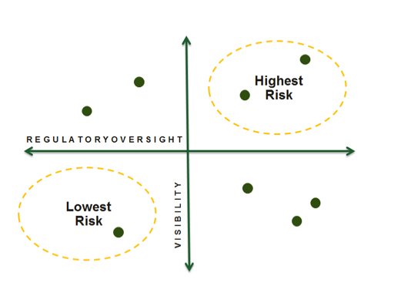
Risk prioritization matrix
VISIBILITY
NONE
REGULATORY OVERSIGHT

Slide 96
RISK PRIORITIZATION MATRIX
Steps:
  Y axis defines visibility
  X axis defines level of regulatory oversight
  Think about it in quadrants, and place each industry web property into a quadrant
Some questions to ask:
  Who is the audience for this web property?
  Does it have a secured login or is it open to the public?
  Are there marketing campaigns driving traffic to it?

Slide 97
BENEFITS OF A LIVING DESIGN SYSTEM
Everyone participates.
Everyone owns success.

Slide 98
Questions? Let’s discuss!

Slide 99

Thank you!
Slides will be available HERE: www.lateach.es/elle!

Slide 100
Who am I?
Elle Waters
www.lateach.es/elle
elle.waters@levelaccess.com

