Slide 1
Captioning in the K12 Classroom
April Sullivan, VSA Texas

Slide 2
What is Captioning
The text version of speech and other sounds that can be provided on television, DVDs, online videos, at movies, or at live theater
Captions are useful for people who are Deaf or hearing impaired, noisy environments, teaching environments, and for English language learners
Open captioned vs closed captioned
Captions vs subtitles
Notes:
Seen on tv. Or lately on phones when watching videos on facebook or youtube
Open is then they are always on the screen, burned in and can’t be turned off. Closed is when there is an option to turn them on or off.
Captions are different than subtitles. Subtitles are a translation of the dialogue or words only. Captions convey all the sounds heard and are capturing the words and tone as exact as possible. Not a translation or paraphrasing.
Includes background music and noises.

Slide 3
Why Captioning Matters
It’s the law
Clarity
Helpful to students with Learning Disabilities
Improve reading comprehension and literacy
Improve retention and focus
Improve test scores
Notes:
Legally required to provide access to people who are deaf or hard of hearing.
Helps you catch information if volume is turned down. Clarifies things if someone has an accent. Or if technical terms are used.
Students who need information in multiple formats to help them retain it can listen and read captions. Many students with learning disabilities are undiagnosed.
Great if learning a new language.
Captions are eye-catching and keep students engaged.
Oral-only instruction had an information retention rate of 10% and visual-only instruction had a retention rate of 35%. The combination of both visual and oral instruction resulted in a 65% retention rate.
Proven through studies.

Slide 4
Legal Obligations
ADA Title II – Must furnish auxiliary aids and services when necessary to ensure effective communication, unless an undue burden or fundamental alteration would result
Section 504 of the Rehabilitation Act – can not deny a student participation in education or extracurricular activities because of a disability
Section 508 of the Rehabilitation Act - This section covers access to federal programs and services in regards to electronic and information technology
IDEA – Individuals with Disabilities Education Act - ensures students with a disability are provided with Free Appropriate Public Education (FAPE) that meets their specific individual needs.
Notes:
Students with disabilities has a right to a free public school education that is equal to all other students, in a classroom environment and with the tools necessary to succeed. In an integrated setting with accommodations as needed
Equivalent alternative for any multimedia presentation shall be synchronized with the presentation. So that means if you are showing a video you need to provide captioning on it. Not show it later to the student who is deaf and give them a transcript to read.
Nobody coming to arrest you, but you are obligated to do you best effort for your students.

Slide 5
WCAG 2.0 – Web Content Accessibility Guidelines
Not a law, but a guideline
WCAG 2.0 Level AA has become the standard for compliance with the ADA
Notes:
a set of guidelines for making digital content accessible for all users, including those with disabilities.
WCAG 2.0 isn’t a law, yet many laws around the world have adopted the guideline as a standard for organizations to meet.
WCAG 2.0 has three level of compliance: Level A, Level AA, and Level AAA. If you comply with Level AA, you should also be compliant with Level A.
Under WCAG 2.0, closed captions are a Level A requirement for pre-recorded video. Closed captions must be synchronized with the media and represent all the dialogue and sounds in the video.
WCAG 2.0 Level AA requires captions for live video, and Level AAA requires an additional text alternative to videos – like a full-text transcript, in addition to closed captions.

Slide 6
State of Captioning 2019
3Play Media survey of captioning trends
https://www.3playmedia.com/resources/industry-studies/2019-state-of-captioning/
Be an advocate for accessible media at your school!
Notes:
A great resource for the trends in captioning to see how much video is being captioned, by what industries and why. How much people are spending on captioning in their companies, the barriers to captioning, the understanding of the legalities of captioning.
Useful information if you need to convince your school of why captioning is important in an easily digestible format.

Slide 7
CIY – Caption It Yourself
Best Practices
http://www.captioningkey.org/quality_captioning.html
synchronized and appear at approximately the same time as the audio is delivered
equivalent and equal in content to that of the audio, including speaker identification and sound effects
accessible and readily available to those who need or want them
Notes:
There are many companies out there you can pay a fee and they will caption your videos. Or you can CIY Caption it Yourself.
Use the best practices set forth in the Captioning Key published by the Described and Captioned Media Program.
Top three things to achieve with your captioning

Slide 8
Elements of Quality Captioning
Accurate - Errorless captions are the goal for each production
Consistent - Uniformity in style and presentation of all captioning features is crucial for viewer understanding
Clear - A complete textual representation of the audio, including speaker identification and non-speech information, provides clarity
Readable - Captions are displayed with enough time to be read completely, are in synchronization with the audio, and are not obscured by (nor do they obscure) the visual content
Equal - Equal access requires that the meaning and intention of the material is completely preserved

Slide 9
TEXT
Case – Use mixed case character for readability
Font – Consistent, sans serif, drop or rim shadow, proportionally spaced
Font Color – White in a translucent box is preferred
Lines Division – When breaking up a sentence, break at a logical point where speech normally pauses
Notes:
Use standard punctuation you do in good writing. Same for using numbers or spelling them out
Sometimes font is not an option on captioning software. But if you have options use these font guidelines.
Examples of breaking up lines

Slide 10
Caption Placement
Should be left aligned and along the bottom
If this preferred placement interferes with text/graphics in the video, place at top
No more than 2 lines per caption
Captioned dialogue should be placed under the speaker
Notes:
Placement choice may not be an option in some software, but here is what is preferred.
If two speak at once, put both on screen under speakers

Slide 11
Punctuation and Grammar
Use dashes to indicate s-s-s-stuttering
Use dashes for spelling A-B-C
Use ellipsis for significant …pauses
Use quotation marks for onscreen readings “Fourscore and seven years ago”
Use italics for voice-overs, narration, thinking, heavy emphasis, foreign words, background audio
Use the music symbol for ♪ song lyrics♪
Put sound effects in brackets [audience groaning]
Notes:
Skipping spelling and capitalization because it is the standard rules.
You want to caption not just the words but the way things are said. So if someone says they are c-c-c-old you want to use dashes to indicate that.
Put in the ums
Don’t use an ellipsis for a sentence continuing into the next caption.
Sound effects can include onomatopoeia. But put them on a separate line from the described sound. Example.
[engine rumbling]
rrr-rrr-rrr
But both lowercase
Synchronize them with the sound and use present tense

Slide 12
Speaker Identification
If you can’t place the captions under a speaker directly then identify them with their name in parentheses
If their name is unknown, identify them with the same information a hearing viewer has
(April) or (instructor)
Notes:
If someone has an accent caption using the flavor of that dialect such as You sho’ ain’t from ‘round here

Slide 13
Presentation Rate
Up to 130 to 160 words per minute
Words on screen for 1 to 6 seconds
Notes:
Depending on the age of your student their reading rate is different, so it is hard to say how many words per minute you should aim for in terms of how long to leave a caption up on the screen. At least one second though and no longer than 6 seconds is the general rule of thumb. Watch your finished product and adjust. You will notice if a caption is not up long enough to read.
Can’t remember all these rules. Just do the captioning, then refer back to rules to clean up.

Slide 14
Automatic Captions
An accuracy rate of 60 to 70 percent
Do not meet the guidelines
Convenient and a good starting place
Notes:
Need to be 99 percent accurate to be accessible

Slide 15
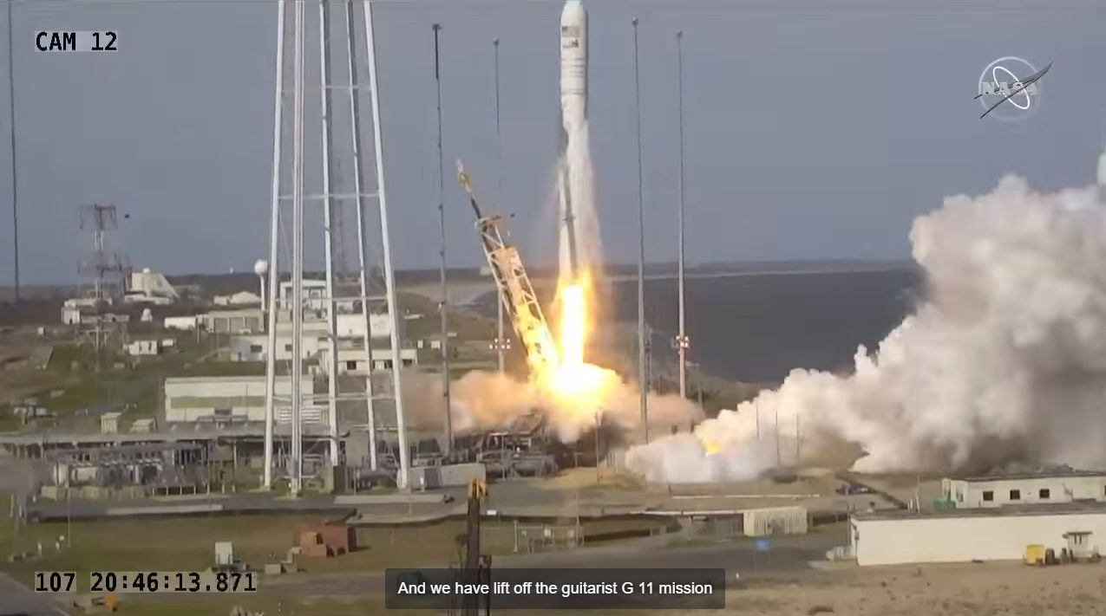
Example

Slide 16
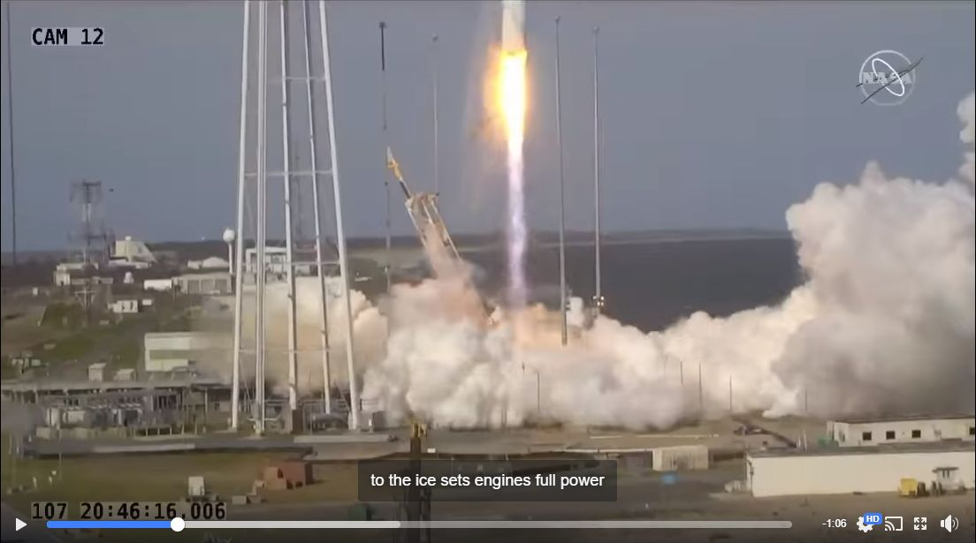
Example
Notes:
And we have liftoff of the Antares NG-11 mission to the ISS

Slide 17
YouTube Captioning – Editing Auto Captions
Sign into your YouTube account
Go to Your Channel
Click on Creator Studio (or YouTube Studio Beta, then Creator Studio Classic)
Click on Video Manager
Choose a video and click Edit Subtitles/CC
Choose the Language to view the captions
Click Edit and make changes to text
Click Publish Edits
Edit caption font, background, and placement
Notes:
Sign in and click on your icon to choose your channel. Show them around the channel. Show them Fly me to the Coffee Shop with auto captions.
vsatxinfo@gmail.com access123
Go into you tube studio beta
Edit coffee shop video by showing how to move captions around and edit font and placement, making changes to text, moving time codes, deleting and adding a caption.

Slide 18
YouTube Captioning – Creating Captions
In Video Manager, choose a video and click Edit Subtitles/CC
Click Add new subtitles or CC
Choose a language
Click Create new subtitles or CC
Type in captions as you listen to video
Click Publish
Notes:
Show with Celeste Giving Tuesday video
Discard published subtitles
Remove auto generated text

Slide 19
YouTube Captioning – Transcribe and AutoSync
In Video Manager, choose a video and click Edit Subtitles/CC
Click Add new subtitles or CC
Choose a language
Click Transcribe and auto-sync
Type in captions as you listen to video
Click Set Timings
Choose the Language (set timings)
Notes:
Use Celeste again

Slide 20
YouTube Captioning – Upload a File
In Video Manager, choose a video and click Edit Subtitles/CC
Click Add new subtitles or CC
Choose a language
Click Upload a File
Choose your File Type (transcript or Subtitles file)
Click Set Timings
Choose the Language

Slide 21
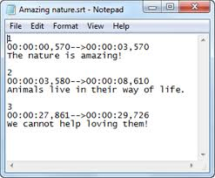
Sub Rip Text (.srt) Files
A plain text file that is formatted to include the start and end time codes of your text to match up with your video

Slide 22
Subtitle Edit
Free open source video subtitle editor
Download at https://www.nikse.dk/subtitleedit/
Only for Windows
Create SRT files to upload to YouTube or burn onto a video to create open captions

Slide 23
Create an SRT file with Subtitle Edit
Open the program
Click Video, Open Video File
Click to Add Waveform
Play video and pause where you want captions
On Create Tab, Insert new subtitle at video pos
Type text in box
Save SRT File
Notes:
Use julie video

Slide 24
HandBrake
Free open source video transcoder
Download at https://handbrake.fr
Only for Windows
Adds the SRT file to your video to create an open captioned video

Slide 25
Merge an SRT file with a Video using HandBrake
Open the program
Source Selection – Open a Video File
Click on Subtitles Tab
Import SRT
Check Burn in
Name file
Start Encode

Slide 26
Thank You!
April Sullivan
VSA Texas
april@vsatx.org
www.vsatx.org

