Slide 1
Implementing ICT Accessibility Strategically within an Organization
Jeff Kline
Program Director
Texas Statewide EIR Accessibility
jeff kline@dir.texas.gov
1

Slide 2
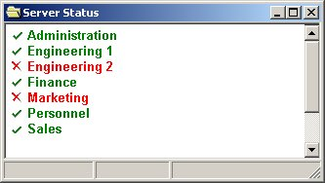
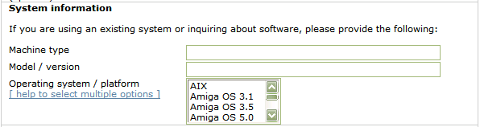
Understanding Disabilities
Blind users access software applications and the Web using a screen reader and the keyboard.
Low vision users need sizable fonts and contrast settings.
Users with limited use of arms and hands need keyboard accessibility features and alternative input methods.
Font size
Larger font size
Even larger
font size
Contrast
Poor
contrast
Contrast
Good
contrast
Alternative input hardware devices
Font size & contrast
“Machine type. Edit.
Model slash version. Edit.
Help to select multiple options. Link.
Operating system slash platform. Listbox. Not selected AIX. 1 of 30.”
Joy Sticks
Keyboards
Deaf users need alternatives for audio content (captioning); the hard of hearing need the ability to increase volume.
Switches
Mouth Sticks
Color-blind users need more than color differences.
Key Types | OS Keyboard Accessibility Features
Mouse Keys | Arrow keys control mouse pointer
Sticky Keys | [Ctrl] then [F] activates [Ctrl-F] shortcut
Slow Keys | Ignore short keystrokes
Repeat Keys | Turn off keystroke repeat Adjust delay before repeat begins Adjust delay between repeats

Slide 3

Scenario: Online Recruiting
Corporation X just completed the procurement and deployment of a large new web application for recruiting new employees and managing job candidates.
Software Company A developed the product. Both Company A and Corporation X’s studies indicated that the new system would offer significant advantages in cost savings, productivity, and candidate quality over the previous, mostly manual processes.
Then….

Slide 4
Exercise 1: Organizational Impact
Areas of Corp X impacted by ADA Lawsuit | Areas of SW Company A Impacted by ADA Lawsuit

Slide 5

A Few Example Areas of an Organization
Where ICT Accessibility Impacts Can Occur
Internet site and applications development
Intranet site and applications development
Procurement
Sales
Legal / civil rights
Executive management
Internal / external communications / PR
Department / class required IT
HR (employees)
Learning tools (hw/sw)
System admin user interfaces
Student services
Business controls / compliance office
Etc.

Slide 6

ICT Accessibility-related Complaints / Legal Inquiries on the Rise
Filed as discrimination complaints under the ADA
Number Of Federal Website Accessibility Lawsuits Nearly Triple, Exceeding 2250 In 2018
“Drive-by” lawsuits and demand lettersunder the Americans with Disabilities Act (ADA) are more prevalent than ever and continue to rise.
No plan for web accessibility technical standards from DOJ Was proposed, now “inactive” however, little impact on litigation moving through the courts, with settlements using WCAG2.0AA as the TS for compliance

Slide 7


IT Accessibility Regulations
There are IT accessibility regulations in
Many countries around the world
Most cite accessibility technical standards
US federal procurement regulations (Section 508)
Americans with Disabilities Act (TS not currently codified)
Many US states
  US Section 508 Refresh became effective in Jan 2018 for compliance by federal agencies
References WCAG 2.0 AA as the technical standard
Texas government and state funded higher ed. institutions statutes and rules
Apply to all Texas state agencies and institutions of higher education
  Texas Government Code 2054 Subchapter M
  Texas Administrative Codes
    1 TAC 206: State Websites
    1 TAC 213: Electronic & Information Resources

Slide 8

Even with Increased Regulatory Push and Litigation, Adoption Still Slow
Technical challenges
Continued investments in inaccessible legacy products and platforms
Technology gaps due to omission of accessibility criteria during the creation of new, ICT technology
Organizational Challenges
Lack of awareness of accessibility and its technical standards
Accessibility deemed unnecessary or optional
Accessibility understood too late in project / program to be addressed
Lack of knowledge, technical skills, tools, or training programs
No organizational policies or objectives related to IT accessibility
No one responsible or accountable for accessibility

Slide 9

The ICT Accessibility Governance Problem
Increased body of knowledge and tools makes ICT accessibility more attainable than in the past, however; pushing technical specifications / standards has not been an adequate adoption driver
Technical standards are execution criteria not governance criteria
Nothing in today’s technical standards address governance
No silver bullet technology solutions on the horizon

Slide 10

IT Accessibility is a Complex Topic
Requires a holistic approach with organizations
Many moving parts = many challenges
  Technical
  Organizational
  Legal
  Cultural
Touches many areas of an organization in different ways
Multi year initiative
Speed, scope, and success of strategy execution dependent on agency
  Skills and training
  Tools and processes
  Budget
  Level of management commitment / support

Slide 11
Converging Accessibility Governance Models: Examples
Type | Source | Policy Requirements | Skills &Training Requirements | Reporting Requirements | Organizational, Process & Planning Requirements
Directive | Office of Management and Budget Strategic Plan for Improving Management of Section 508 | Yes | Yes | Yes | Yes
Statute | Province of Ontario Canada Accessibility for Ontarians with Disabilities Act (AODA) | Yes | Yes | Yes | Yes
Litigation Settlement | US DoJ HR Block PeaPod | Yes | Yes | Yes | Yes
Litigation Settlement | US DoE Youngstown State University University of Montana | Yes | Yes | Yes | Yes
Could / should such governance criteria be made less “ad hoc” and more formalized?
Notes:
Note also settlements in higher ed and other government entities.

Slide 12
Policy Driven Adoption for Accessibility (PDAA)
The integration of ICT accessibility governance into organization policies in a way that enables organizations to drive themselves to improve accessibility adoption.
    Makes IT accessibility difficult to ignore
    Not prescriptive, tells what, not how
    Governed through non-technical methods
    Accelerates marketplace innovations

Slide 13
Policy Driven Adoption for Accessibility (PDAA) - Core Criteria
 | Core Criteria
Policy Creation | 1. Develop, implement, and maintain an ICT accessibility policy.
Organization | 2. Establish and maintain an organizational structure that enables and facilitates progress in ICT accessibility.
Business Process | 3. Integrate ICT accessibility criteria into key phases of development, procurement, acquisitions, and other relevant business processes.
Compliance Planning | 4. Provide processes for addressing inaccessible ICT.
Training | 5. Ensure the availability of relevant ICT accessibility skills within (or to) the organization.
Communication | 6. Make information regarding ICT accessibility policy, plans, and progress available to customers.

Slide 14
What is the value of PDAA to an organization?
Fully implemented PDAA provides:
Competitive advantage in solicitations with ICT A11y requirements
Increased market share through expansion of customer base
Increased brand equity through social responsibility
Improved Search Engine Optimization (SEO)
Improved ability to hire and retain people with disabilities
Risk mitigation if ADA complaints / litigation arises
  In ICT accessibility, effort levels count!

Slide 15
Policy Driven Adoption for Accessibility (PDAA) - Maturity Model
 | Core Criteria | Launch | Integrate | Optimize
1. | Develop, implement, and maintain an ICT accessibility policy. | Have an ICT accessibility policy. | Have appropriate plans in place to implement and maintain the policy. | Establish metrics and track progress towards achieving compliance to the policy.
2. | Establish and maintain an organizational structure that enables and facilitates progress in ICT accessibility. | Develop an organization wide governance system. | Designate of one or more individuals responsible for implementation. | Implement reporting/decision mechanism and maintain records.
3. | Integrate ICT accessibility criteria into key phases of development, procurement, acquisitions, and other relevant business processes. | Identify candidate processes for criteria integration. | Implement process changes. | Integrate fully into all key processes.
4. | Provide processes for addressing inaccessible ICT. | Create plans that include dates for compliance of inaccessible ICT. | Provide alternate means of access until the ICT is accessible; implement corrective actions process for handling accessibility technical issues and defects | Maintain records of identified inaccessible ICT, corrective action, and tracking.
5. | Ensure the availability of relevant ICT accessibility skills within (or to) the organization. | Define skills/job descriptions. | Identify existing resources that match up and address gaps. | Manage progress in acquiring skills and allocating qualified resources.
6. | Make information regarding ICT accessibility policy, plans, and progress available to customers. | Make Launch level information available. | Make Integrate level information available. | Make Optimize level information available.

Slide 16
PDAA Self Assessment Tool
The PDAA Self-Assessment Tool
Questionnaire for assessing organizational ICT accessibility policy maturity as measured against PDAA Core Criteria.
Results can be used by:
  Public / private sector organizations
    Guide the implementation of organization wide accessibility programs / initiatives
    Help achieve more accessible ICT and offerings over the long term
  Procurement staff
    Help assess a vendor’s ability to produce accessible offerings
    Gauge confidence in vendor’s VPAT or other accessibility documentation
    Track vendor progress and improvement in ICT accessibility initiatives
    Use as part of vendor selection decisions

Slide 17
PDAA Core Criteria #1
Develop, implement, and maintain an ICT accessibility policy.
Creates a foundation on which accessibility programs and initiatives can be built.
Ensures continuity of accessibility efforts by supporting strategic rather than tactical efforts.
Allows people in different roles across the organization to appropriately implement ICT accessibility as applicable to their areas / responsibilities.
 | Core Criteria | Launch | Integrate | Optimize
1. | Develop, implement, and maintain an ICT accessibility policy. | Have an ICT accessibility policy. | Have appropriate plans in place to implement and maintain the policy. | Establish metrics and track progress towards achieving compliance to the policy.

Slide 18
Exercise 2: Policy Creation
Basic questions organizations need to answer in an IT accessibility policy | Responses
Why do we need it?
What do we need to do?
Who is responsible?
Where does it apply?
When should it take effect?
How do we execute?
Other?
Other?

Slide 19
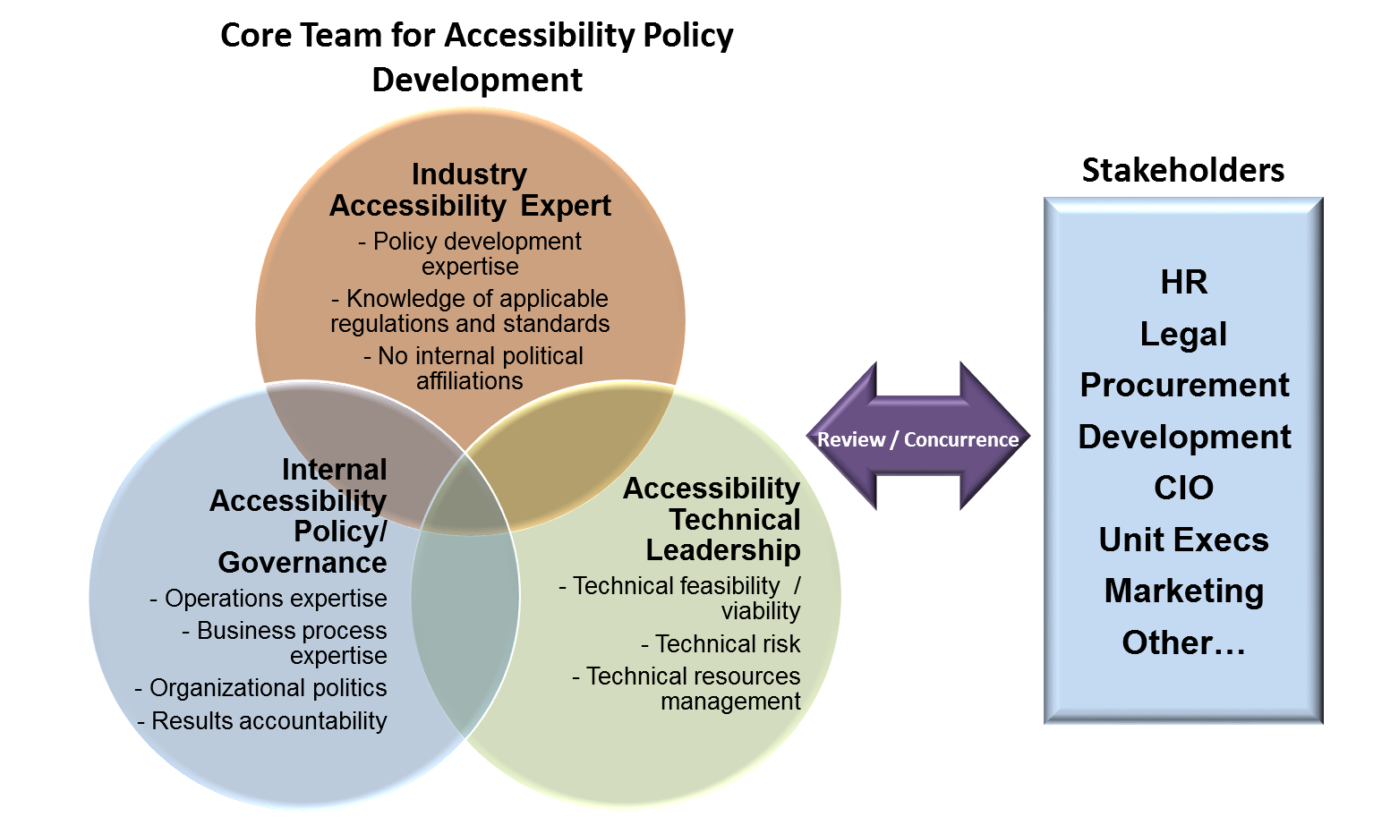
Developing an organization-wide
IT accessibility policy

Slide 20
PDAA Core Criteria #2
Establish and maintain an organizational structure that enables and facilitates progress in ICT accessibility.
Defines the placement of a “core” accessibility function within the organization
Designates an executive champion / sponsor (Ex. CAO)
Ensures that ICT accessibility focal points / SMEs are identified and positioned within key units of the organization for greatest impact
 | Core Criteria | Launch | Integrate | Optimize
2. | Establish and maintain an organizational structure that enables and facilitates progress in ICT accessibility. | Develop an organization wide governance system. | Designate of one or more individuals responsible for implementation. | Implement reporting/decision mechanism and maintain records.

Slide 21
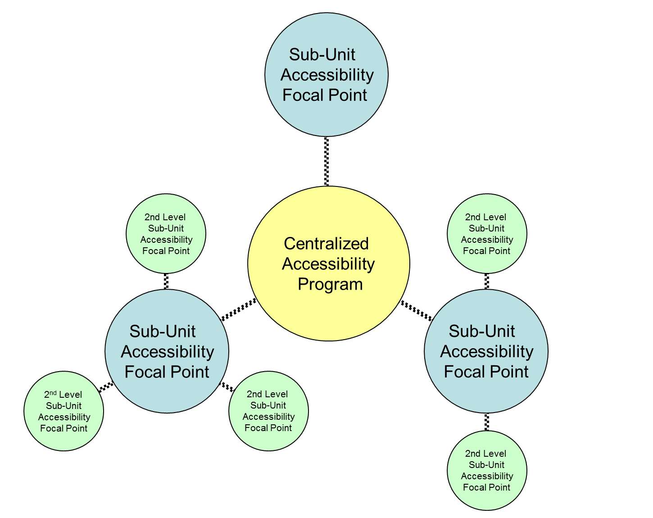
Organizing accessibility
Senior manager “executive sponsor”
“Neutral” organizational placement
  Analysis of implications based reporting organization
Centralized accessibility function
  Policy and governance
  Technical consulting
  Business development / sales support
  Project office
  Other?
Sub-Unit focal points / coordinators

Slide 22
Exercise 3: “Neutral Placement” Organization
Organization Area | Pros | Cons
IT Development
HR
CIO
Other
Other

Slide 23
Program Costs
Determining Factors
Funding Models
Speed and trajectory of the ICT accessibility initiative driven by
  Urgency based on business or other requirements
  Budget considerations
Startup and ongoing costs
Cost Type | Element | Start-up Investment Level | Ongoing Investment Level
Human resources | Enterprise/organization staffing | High | Medium
Human resources | External consulting | Medium/high | Low/very low
Human resources | Subunit/2nd-level subunit coordinators | Low | Low
Human resources | Overall Initiative management | Medium | Low
Human resources | Policy and process creation / integration | Medium | Low
Human resources | Training | Medium | Medium
Human resources | Manual testing | Medium | Medium/high
Human resources | Accessibility development | Low | Medium
Human resources | Management system development | Medium | Low
Human resources | Marketing support (private sector) | Medium | Low
ICT hardware/ software | Tracking/reporting tools | Medium | Very Low
ICT hardware/ software | Enterprise scan tool(s) | Medium | Low
ICT hardware/ software | Enterprise scan tool maintenance | Low | Low
ICT hardware/ software | Developer tools | Medium | Low
ICT hardware/ software | Test tools | Medium | Low
ICT hardware/ software | Development and test tool maintenance | Low | Low
ICT hardware/ software | ICT hardware (desktop computers, etc.) | Low | Low
ICT hardware/ software | ICT service (database hosting, etc.) | Low | Low
23

Slide 24

Prioritize the Work Effort
Priority classification hierarchy* example
Mission critical, high number of users, high revenue
Non-mission critical, high number of users, high revenue
Mission critical, low number of l users, low revenue
Non-mission critical, low number of users, low revenue
Mission critical, high number of users
Non-mission critical, high number of users
Mission critical, low number of users
Non-mission critical
low number
of users
External products, Internet and internet applications, etc.
Internal use: Intranet and intranet applications, desktop apps, copy machines, telecommunications, etc.
*Priority classification assumptions
1. New applications under development, being updated, or being procured should receive priority within the priority class
24
Notes:
Priority classification hierarchy* example
Externally facing, mission critical, high number of external users
Externally facing, non-mission critical, high number of external users
Externally facing, mission critical, low number of external users
Externally facing, non-mission critical, low number of external users
Internal use, mission critical, high number of users
Internal use, non-mission critical, high number of users
Internal use, mission critical, low number of users
Internal use, non-mission critical, low number of users

Slide 25
PDAA Core Criteria #3
Integrate ICT accessibility criteria into key phases of development, procurement, acquisitions, and other relevant business processes.
Ensures that ICT accessibility is perpetual and implemented in a consistent, repeatable fashion
Removes dependency on specific individuals who “carry the torch” for specific events or projects where ICT accessibility is required.
 | Core Criteria | Launch | Integrate | Optimize
3. | Integrate ICT accessibility criteria into key phases of development, procurement, acquisitions, and other relevant business processes. | Identify candidate processes for criteria integration. | Implement process changes. | Integrate fully into all key processes.

Slide 26
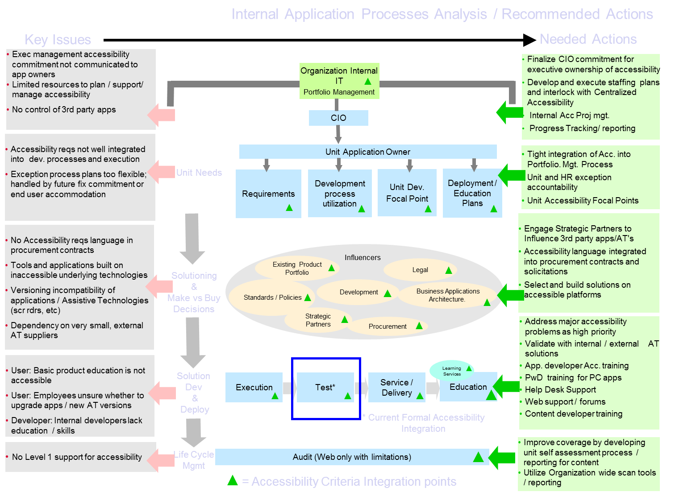
Integrate Accessibility into Key Business Processes: Analysis Example

Slide 27
Exercise 4: Process Integration
Identified Business Process where ICT Accessibility Plays a Role
Product (ICT) Development

Slide 28
PDAA Core Criteria #4
Provide a process for addressing inaccessible ICT.
Ensures that short term and long term plans are developed to address ICT accessibility issues once identified.
 | Core Criteria | Launch | Integrate | Optimize
4. | Provide processes for addressing inaccessible ICT. | Create plans that include dates for compliance of inaccessible ICT. | Provide alternate means of access until the ICT is accessible; implement corrective actions process for handling accessibility technical issues and defects | Maintain records of identified inaccessible ICT, corrective action, and tracking.

Slide 29
Exercise 5: Addressing Inaccessible ICT
Methods to Address Inaccessible ICT
800 call in (24/7/365)

Slide 30
PDAA Core Criteria #4: Examples
  Examples of addressing inaccessible ICT
  Corrective actions identification and tracking in product development life cycle
  Procurement of future, more accessible ICT
  Mechanism for providing alternate means of access until the ICT is made accessible or replaced
    1-800 numbers, etc.

Slide 31
PDAA Core Criteria #5
Ensure the availability of relevant ICT accessibility skills and other resources within (or to) the organization.
Identify necessary knowledge/skills and existing gaps
Provide training opportunities
Include accessibility skills in hiring criteria
Track and manage gaps
 | Core Criteria | Launch | Integrate | Optimize
5. | Ensure the availability of relevant ICT accessibility skills within (or to) the organization. | Define skills/job descriptions. | Identify existing resources that match up and address gaps. | Manage progress in acquiring skills and allocating qualified resources.

Slide 32
Identify Skill Gaps and Build “Role Based” Accessibility Training Plans
Course Level | Course Title | All Staff | Web Content Producers | Web & Application Testers | Web Application Developers | Procurement Staff | Contract Writers | Contract Compliance | Project Managers
Fundamentals | Introduction to Accessibility (Self) | Required | Required | Required | Required | Required | Required | Required | Required
Fundamentals | Office Documents (Internal) | Optional | Required | Optional | Optional | Required | Required | Optional | Required
Fundamentals | PDF (Internal) | Required / Optional* | Required | Optional | Optional | Required / Optional* | Required / Optional* | Required / Optional* | Required / Optional*
Fundamentals | HTML (Internal or External) |  | Required | Required | Required
Fundamentals | HTML Forms (Internal or External) |  | Required | Optional | Required
Fundamentals | Testing & Tools (Internal or External) |  | Required | Required | Required
Fundamentals | CSS (Internal or External) |  | Optional | Optional | Required
Fundamentals | Javascript (Internal or External) |  | Optional | Optional | Required
Advanced | Sharepoint / Dreamweaver (Internal or External) |  |  |  | Required / Optional*
Advanced | ASP / ASP.Net (Internal or External) |  |  |  | Required / Optional*
Advanced | Java / JSP (Internal or External) |  |  |  | Required / Optional*
Advanced | Web 2.0 Technologies (Internal or External) |  |  |  | Required / Optional*
Specialized | Accessibility Law, and its Impacts |  |  |  |  | Required | Required | Required | Required
Specialized | Accessibility in Contract Solicitations |  |  |  |  | Required | Required | Required | Required
Specialized | Understanding/validating Vendor IT accessibility |  |  |  |  | Required | Required | Required | Required
* As needed based on assignment.

Slide 33
PDAA Core Criteria #6
Make information regarding ICT accessibility policy, plans, and progress available to customers.
Encourages formalized tracking and management of PDAA initiatives
Provides customers with information for gauging organizational abilities and progress
 | Core Criteria | Launch | Integrate | Optimize
6. | Make information regarding ICT accessibility policy, plans, and progress available to customers. | Make Launch level information available. | Make Integrate level information available. | Make Optimize level information available.

Slide 34
Exercise 6: External Information Availability
Information Type
VPATs

Slide 35

The Procurement Dependency
Vendor sourced IT products and services make up the majority of government IT
  Most products and services do not meet accessibility technical standards (US 508, WCAG 2.0 AA)
  There will be continued high dependency on procured IT for the foreseeable future
Vendor accessibility documentation – how good is it?
  Commercial off the Shelf (COTS) products
    Accessibility levels documented in vendor published Voluntary Product Accessibility Templates (VPATs)
      Accuracy varies wildly from vendor to vendor, product to product
  Development services and related deliverables
    VPATs do not apply so other forms of documentation / assessment are required.
35

Slide 36
The Challenges
How can I be confident about the accessibility information provided by vendors?
To what degree are vendors are committed to future improvements in the accessibility of their products / services?
What can help vendors and other organizations meet technical standards and government regulations for ICT accessibility?

Slide 37


Fundamental Vendor Questions
How are accessibility levels validated?
  Commercial off the Shelf (COTS) products
    VPATs
  Development services (websites / web apps, app customization, etc.)
    No standard approach
How is vendor commitment to future accessibility improvements gauged?

Slide 38

Accessibility Validation of Procured Products: Validation…and by Whom?
Would you do this with your new car?

Slide 39
Validating Accessibility of Vendor Offerings
“Show me”
Burden of proof belongs to the vendor not the customer.
  Credible evidence
  Contractual language
  Statement of compliance
Can significantly reduce the customer accessibility validation efforts
  Engage accessibility professionals to assess vendor documentation

Slide 40
Exercise 7: VPAT “Red Flags”
Red Flags During Analysis
“ What’s a VPAT?”

Slide 41
Analyzing a VPAT
Be skeptical! VPATs may contain false, inaccurate, or misleading information.
  Engage qualified assistance to analyze
  Red Flags
    Vendor asks “What is a VPAT?”
    No VPAT(s) available when ICT accessibility is applicable
    No VPAT(s), but global, nonspecific accessibility statements
    Single VPAT representing all products vendor offer
    Incomplete / missing sections or the use of N/A (not applicable) in areas of the VPAT criteria that are known to be applicable. Frequently missing:
      1194.31 Functional Performance Criteria
      1194.41 Information, Documentation and Support
    VPAT(s) created by a reseller and not the offering manufacturer
    No information in the “Remarks” column that describe response in “Supporting Features” column
    “Supports” or N/A for all responses in the “Supporting Features” column
    Product name and other information missing from the VPAT form
Notes:
41

Slide 42
Initial Questions for COTS Vendors about their VPATs
Accuracy varies wildly from vendor to vendor and product by product. After reviewing VPATs, asking for additional information is key:
What tools / methods were used to test and complete the VPAT?
What client platforms (operating systems (including mobile), browsers, assistive technologies, and versions of all of those) were used as test environments?
Can the vendor provide a copy of the accessibility test plan for the product?
Can the vendor provide the results of the accessibility testing?
What issues were found and are there corrective actions in place to resolve them in this or a subsequent release…and when?

Slide 43
Vendor ICT Accessibility Development Services Info Request

Slide 44
Texas RFO IT Accessibility Initial Evaluation
Currently being used on select RFOs
  Technology Based Training
  Comprehensive Web Development
Working to integrate into all relevant RFOs
Scoring components (Scored for up to 15% of select procurements)
  VPATs, VASDIR, (as applicable)
  PDAA (required)
DIR-TSO-TMP-Sample
 | Vendor | Dev Services Rating | VPAT Rating | PDAA Score (0-100) | Accessibility Score (Up to 100%) | Overall Satisfactory Rating | Comments
1 | Vendor name | Satisfactory | 2 | 97 | 85.67% | High | Description of accessibility plans and integration into its Technical Solution appear comprehensive and well documented. VPAT submission: For the single VPAT provided, vendor should provide additional details on the exceptions listed. There also appear to be other COTS products included in the vendor response which may require VPATs and for which VPATs were not present. These include, but not limited to: XXX or its components thereof or any COTS or customized COTS products / services with user interfaces intended for Texas state employees or members of the public. Vendor should provide.
 | Acc. Value in bid | Calculation | Final Score |  |  | VPAT Scoring
 | 15% | .15 X 85.67 | 12.85 |  |  | 100pts | 3 - Credible, accessibility documentation for all or most products included in the bid response. Response shows strong understanding of accessibility by vendor
 |  |  |  |  |  | 60 pts | 2 - Questionable, incomplete or inaccurate accessibility documentation most likely not supported by testing
 |  |  |  |  |  | 15 pts | 1 - Accessibility documentation indicates very limited to no knowledge of accessibility
 |  |  |  |  |  | 0 pts | 0 - Accessibility documentation required but not provided
 |  |  |  |  |  | VADSIR Scoring
 |  |  |  |  |  | 0 | UNSAT - No completed VADSIR submitted but is applicable OR responses indicate insufficient knowledge of web accessibility to produce accessible websites / web applications
 |  |  |  |  |  | 50 | Low SAT - Responses indicate a deficiency of knowledge in key areas of website accessibility that significantly impacts the vendors ability to develop and deliver accessible websites / applications
 |  |  |  |  |  | 100 | SAT - Responses indicate an acceptable level of knowledge, skills, and processes to produce accessible websites / web applications
 |  |  |  |  |  | PDAA Scoring
 |  |  |  |  |  | 0-100 | As calculated on the PDAA Assessment form
 |  |  |  |  |  | Scoring Results | Overall Satisfactory Rating
 |  |  |  |  |  | 0 - 35% | Low
 |  |  |  |  |  | 36 - 70% | Medium
 |  |  |  |  |  | 71 - 100% | High

Slide 45
Exercise 8: Questions for Vendors to Gain Confidence in
ICT Accessibility of Products / Services
Questions
Does your organization have an ICT accessibility policy?

Slide 46
Contract Inclusions for COTS / Development Services
Contract Inclusions | COTS | Development Services
The accessibility technical standard that you want the deliverable to meet such as WCAG 2.0 AA | Yes | Yes
Review / approval of accessibility plans / designs at designated checkpoints throughout the development cycle |  | Yes
Review / concurrence of accessibility platforms used for testing |  | Yes
Delivery of accessibility test results documentation and dates to be provided |  | Yes
Corrective actions criteria (prioritization of accessibility defects / issues, and resolution plans / dates) | Yes | Yes
Accessibility related remedies and warranties | Yes | Yes
Statement that you may request additional information as needed in support of the vendor deliverables | Yes | Yes
Pre delivery letter stating that accessibility documentation (VPATs, etc.) provided during solicitation activities was accurate, supported by and testing performed in accordance with generally accepted accessibility practices (including visual inspection and with an assistive technology. | Yes
Pre deliverable letter stating that accessibility documentation provided during solicitation activities was accurate, and that the deliverable(s) development and testing were performed in accordance with generally accepted accessibility practices (including visual inspection and with an assistive technology), and that the development test results and other documentation for the contracted deliverable(s) supplied to your organization are accurate, and that the deliverable complies with the specified accessibility standards (or cites exceptions where it doesn’t with a corrective actions plan) | Yes | Yes

Slide 47

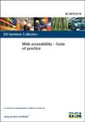



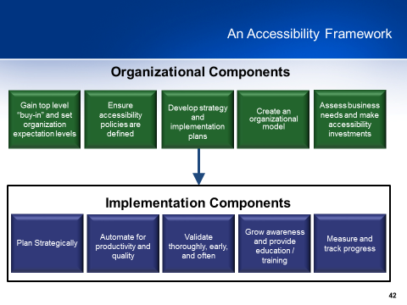
Reference Information
Techcheck – On Line Assessment Tool developed by the Partnership on Employment and Accessible Technology (PEAT) and sponsored by the Office of Disability Employment Policy (ODEP), U.S. Department of Labor
W3C – Web Accessibility Initiative - Planning and Implementing Web Accessibility
British standard BS-8878 Implementation Guide - by Hassell Inclusion - Accessibility business process integration
Strategic IT Accessibility: Enabling the Organization – Reference book on organizational accessibility enablement, strategy, and implementation
Policy Driven Adoption for Accessibility (PDAA) Papers from NASCIO
Accessibility Implementation Framework, Texas Department of Information Resources - A comprehensive framework and project plan to guide an organization’s IT accessibility program and initiatives

Slide 48
Wrap-up / questions?

