Slide 1

Understanding WCAG 2.1
Becky Gibson
Senior Accessibility Strategist
becky@knowbility.org

Slide 2
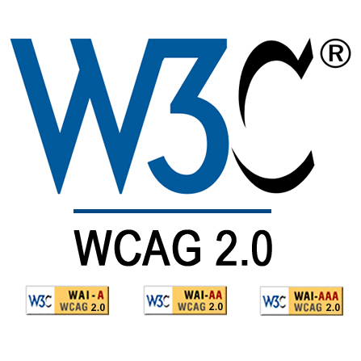
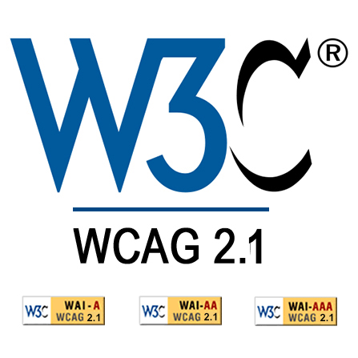

+
17 New Success Criteria
Proposed Recommendation, April 2018

Slide 3

WCAG
2.0
Notes:
basic understanding of WCAG 2 success criteria and compliance levels

Slide 4
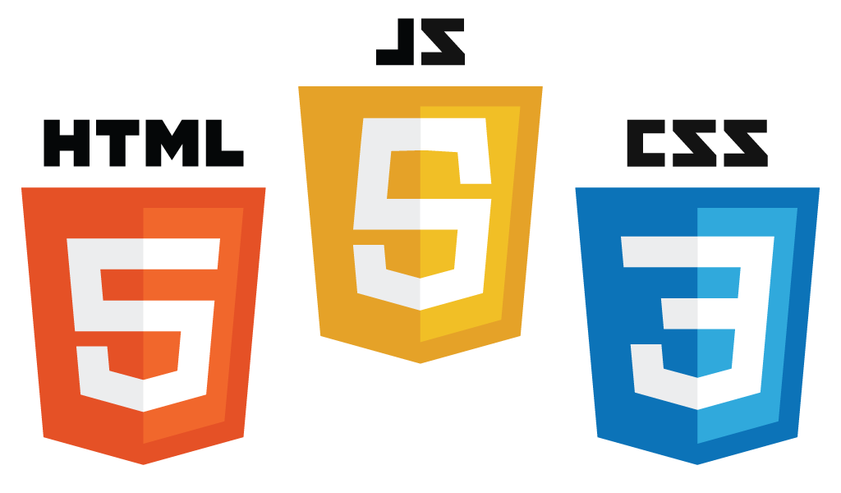
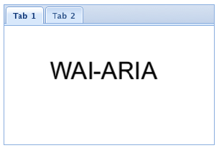



2008
Notes:
WCAG 2.0 released in 2008 - Considered HTML, JavaScript, CSS and Flash (which was still in use), WAI-ARIA was still under development, SVG hadn’t addressed a11y yet, era of smart phone just beginning.

Slide 5

Mobile
Notes:
We all know that world is changing. W3C polled different disability groups to determine the new success criteria. Focused on supporting mobile and mobility, low vision, and cognitive.

Slide 6
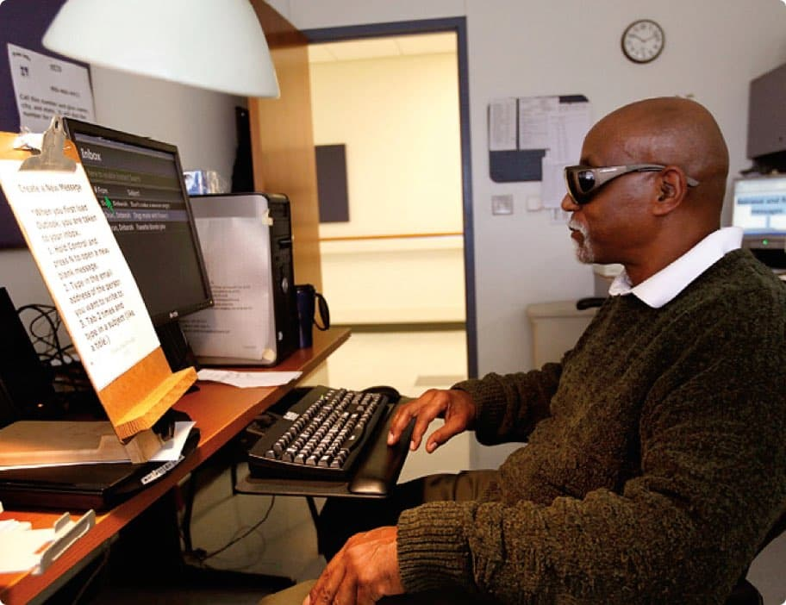

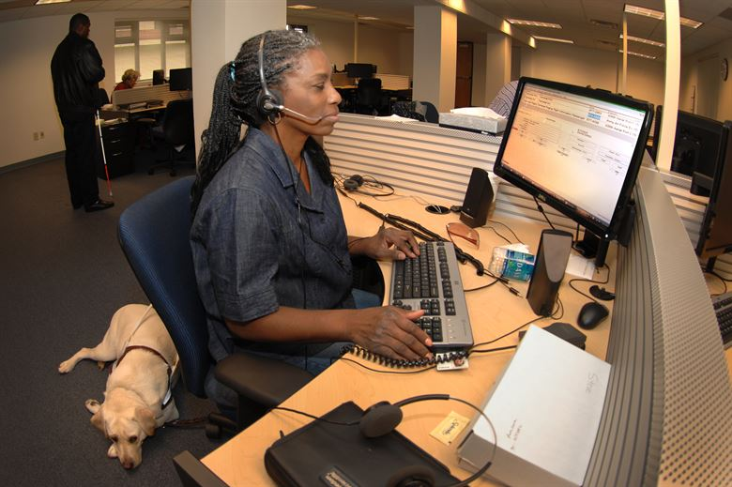
Low Vision

Slide 7
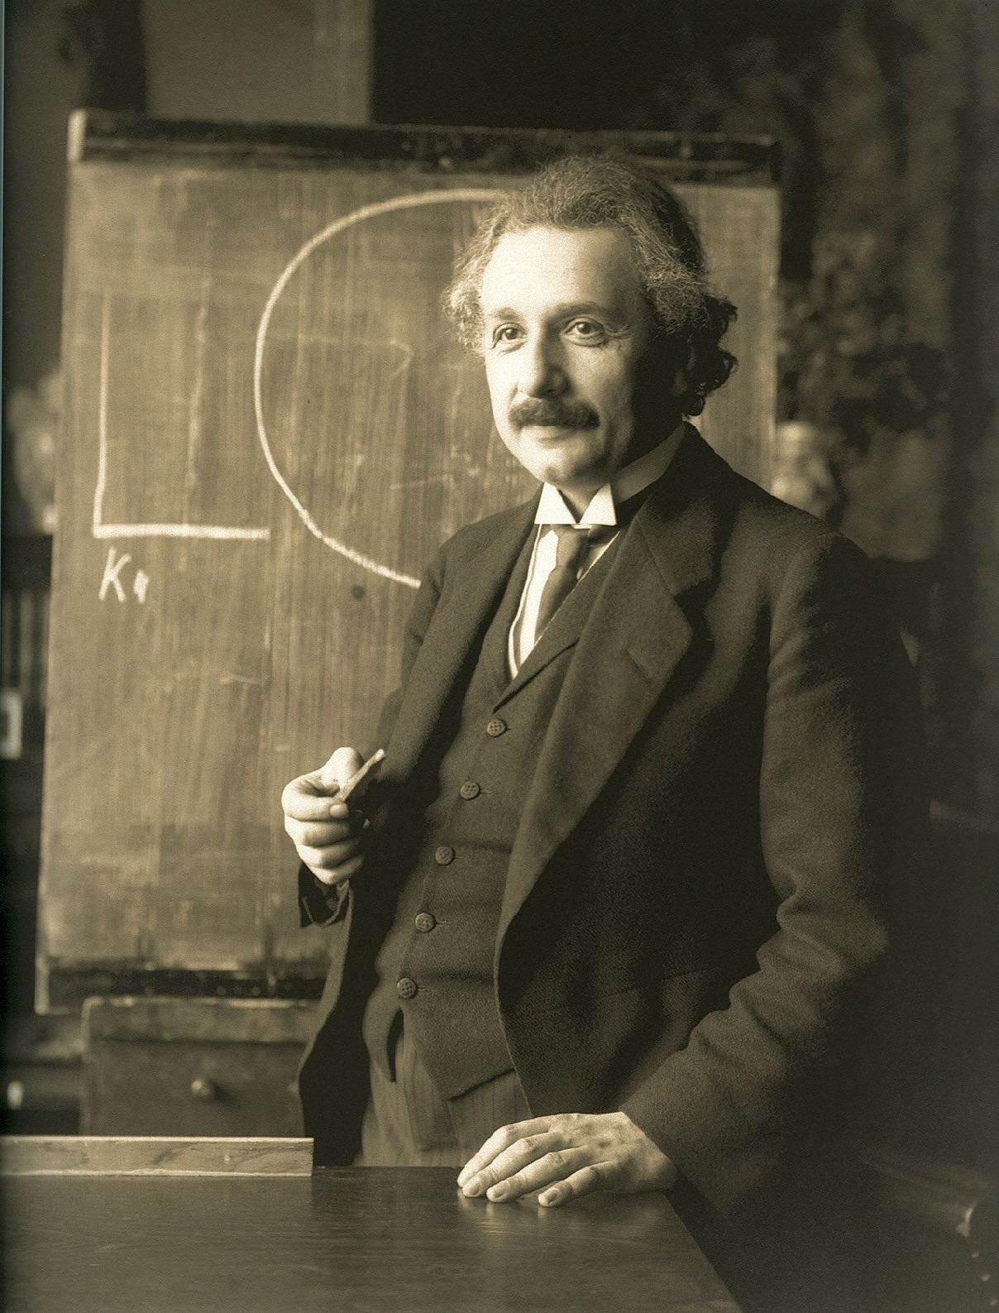
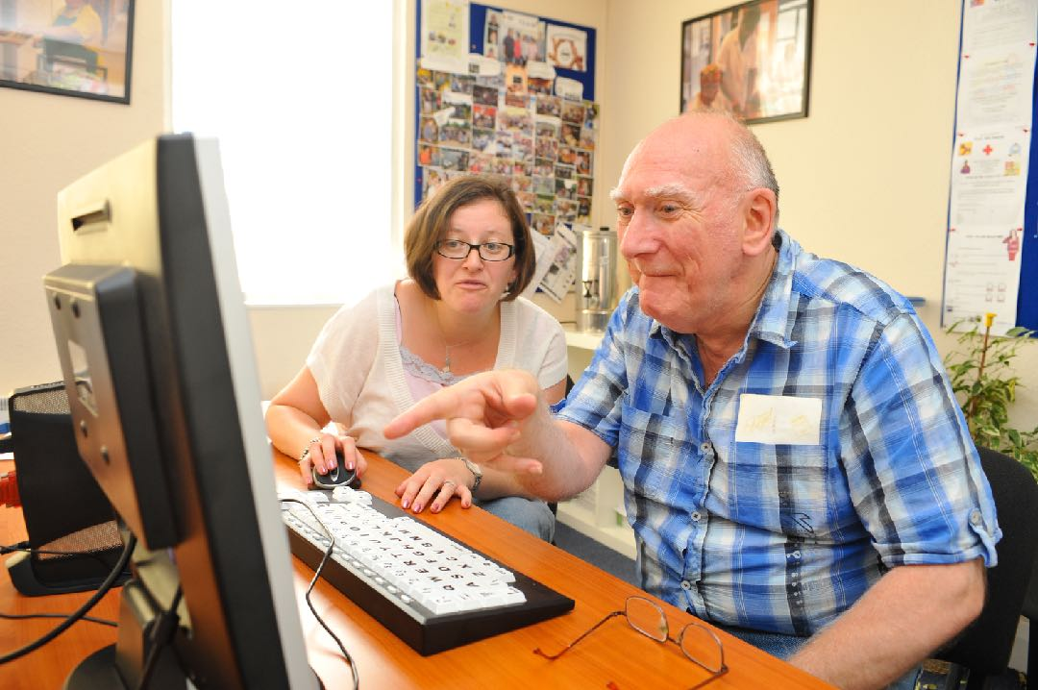
Cognitive Disabilities
Photo CC BY-SA 3.0 Norwood (charity)
Notes:
Albert Einstein, aging

Slide 8
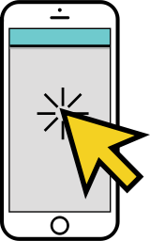


Mobile
Low Vision
Cognitive

Slide 9



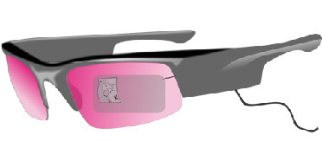


iPhone Released
WCAG 2.0
WCAG 2.1
WCAG 2.?
WCAG Next
2007
2008
…
2018
…
?
…
?
Notes:
Timeline: 2008 iPhone released, 2008 WCAG 2.0 released, 2018 WCAG 2.1 released with additions for Mobile, low vision, and cognitive, WCAG 2.? with unspecified date to include new technologies, WGAG Next with no date and is open for new ideas.

Slide 10



WCAG 2.1
WCAG 2.0
=
Notes:
WCAG 2.1 compliance = WCAG 2.0 compliance

Slide 11
A
5
AA
7
AAA
5
17
Notes:
5 level A Success criteria (SC) all in mobile space; 7 double AA SC 1 mobile, 5 low vision, 1 cognitive; 5 triple AAA SC 2 mobile, 3 cognitive.

Slide 12
8
Mobile
5
Low Vision
4
Cognitive
17
New Success Criteria
Notes:
Looking at it another way - there are 8 in the mobile/mobility space; 5 for low vision; 4 for cognitive totally 17 SC

Slide 13
Mobile
2.5 Input Modalities (new guideline)
  2.5.1 Pointer Gestures - A
  2.5.2 Pointer Cancellation - A
  2.5.3 Label in Name - A
  2.5.4 Motion Actuation - A
  2.5.5 Target Size - AAA
  2.5.6 Concurrent Input Mechanisms - AAA

Slide 14
Mobile (2)
1.3 Adaptable (existing guideline)
  1.3.4 Orientation - AA
2.1 Keyboard Accessible (existing guideline)
  2.1.4. Character Key Shortcuts - A

Slide 15
Low Vision
1.4 Distinguishable (existing guideline)
  1.4.10 Reflow - AA
  1.4.11 Non-text Contrast - AA
  1.4.12 Text Spacing - AA
  1.4.13 Content on Hover or Focus - AA
Low
Vision

Slide 16
Low Vision (2)
4.1 Compatible (existing guideline)
  4.1.3 Status Changes - AA
Low
Vision

Slide 17
Cognitive
1.3 Adaptable (existing guideline)
  1.3.5 Identify Input Purpose - AA
  1.3.6 Identify Purpose - AAA
Cognitive

Slide 18
Cognitive (2)
2.2 Enough Time (existing guideline)
  2.2.6 Timeouts - AAA
2.3 Seizures and Physical Reactions (existing guideline)
  2.3.5 Animation from Interactions - AAA
Cognitive

Slide 19

Applies to WEB
Notes:
Guidelines and SC are for WEB apps - don’t confuse with mobile apps

Slide 20



Notes:
Does not apply to apps

Slide 21
Mobile

Slide 22
2.5.1 Pointer Gestures – Level A
All functionality that uses multipoint or path-based gestures for operation can be operated with a single pointer without a path-based gesture, unless a multipoint or path-based gesture is essential.
NOTE
This requirement applies to web content that interprets pointer actions (i.e. this does not apply to actions that are required to operate the user agent or assistive technology).

Slide 23



Single Pointer
CC by 3.0 by Yannick Lung
Notes:
single tap, double tap, long press/tap and hold

Slide 24


Path-based Gestures
Notes:
swipe, press and drag, etc

Slide 25




Multipoint Gestures
Notes:
pinch/zoom
two or three finger tap or swipe
single tap then tap with another pointer/finger

Slide 26
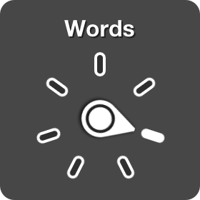
Exclusions
User agent - drag to scroll up or down
VoiceOver Rotor
Notes:
SC is for author level only gestures
Note that this is independent of 2.1.1 Keyboard (all functionality operational via keyboard interface) because a pointer based device (tablet, touchpad, etc) may not have an external keyboard available and the on-screen keyboard is only available when the control expects text input

Slide 27
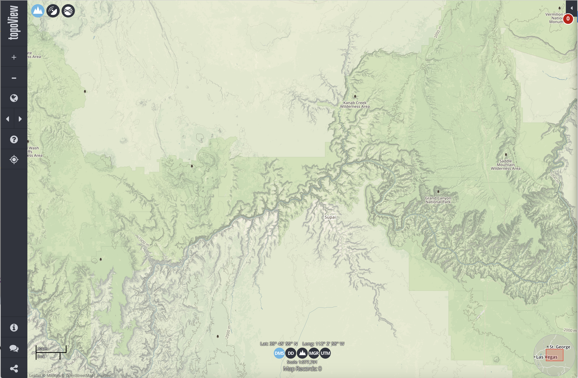
Examples
https://ngmdb.usgs.gov/topoview/
Notes:
https://ngmdb.usgs.gov/topoview/viewer/#10/36.3179/-112.7905 - has pinch and zoom and + - buttons to accomplish the same task. Screen shot has added arrows for panning.

Slide 28


Who Benefits?
Notes:
People with hand tremors
Cognitive issues / older people - can’t remember complicated gestures
passenger in a car

Slide 29
Summary - Pointer Gestures
Don’t rely on complex gestures or provide a single pointer alternative.

Slide 30
2.5.2 Pointer Cancelation – Level A
For functionality that can be operated using a single pointer, at least one of the following is true:
No Down-Event - The down-event of the pointer is not used to execute any part of the function;
Abort or Undo - Completion of the function is on the up-event, and a mechanism is available to abort the function before completion or to undo the function after completion;
Up Reversal - The up-event reverses any outcome of the preceding down-event;
Essential - Completing the function on the down-event is essential.
NOTE
Functions that emulate a keyboard or numeric keypad key press are considered essential.
NOTE
This requirement applies to web content that interprets pointer actions (i.e. this does not apply to actions that are required to operate the user agent or assistive technology).

Slide 31

Down Event
action triggered on the down event
object.addEventListener(“touchstart”, myScript);
object.addEventListener(“mousedown”, myScript);
Notes:
Example: entering phone numbers on smartphone (although that is a native app, a web app to dial would have to have different behavior)

Slide 32

Up Event
action triggered on the up event
object.addEventListener(“touchend”, myScript);
object.addEventListener(“mouseup”, myScript);
object.addEventListener(“keyup”, myScript);
Notes:
Default mechanism for keyboard - character is triggered when it is released. Example, long press action triggered when pointer is released

Slide 33
Exclusions
No down event
object.addEventListener(“click”, myScript);
Notes:
Use generic platform events – onclick event works for touch and mouse events and performs action on up event (when mouse is released or finger/pointer removed)

Slide 34
On up event + undo
Enter Security Code
1
2
3
4
5
6
  1
|
7
8
9
0
undo
enter
Notes:
Simulated credit card image with input fields to enter the security code, A number keypad is provided, numbers are entered on up event and an undo key is provided to correct any errors.

Slide 35
Up Reversal
$25
Confirmation
x
$50
Are you Sure?
Cancel
Submit
$100
drag and drop starts on down event but is canceled if release (up event)
there is confirmation before the action completes
Notes:
drag and drop - drag starts on the down event but is canceled if release (up event) before reaching target, there is confirmation before action completes, there is an undo mechanism.
3 coins, each with a different dollar amount (25, 50, 100). The $50 is started to drag to the piggy bank but the drag is released and the $50 donation is cancelled. The $100 coin is dragged to the piggy bank and the user with presented with a confirmation.
Don’t forget 2.5.1 - must also be keyboard accessible ;-)

Slide 36
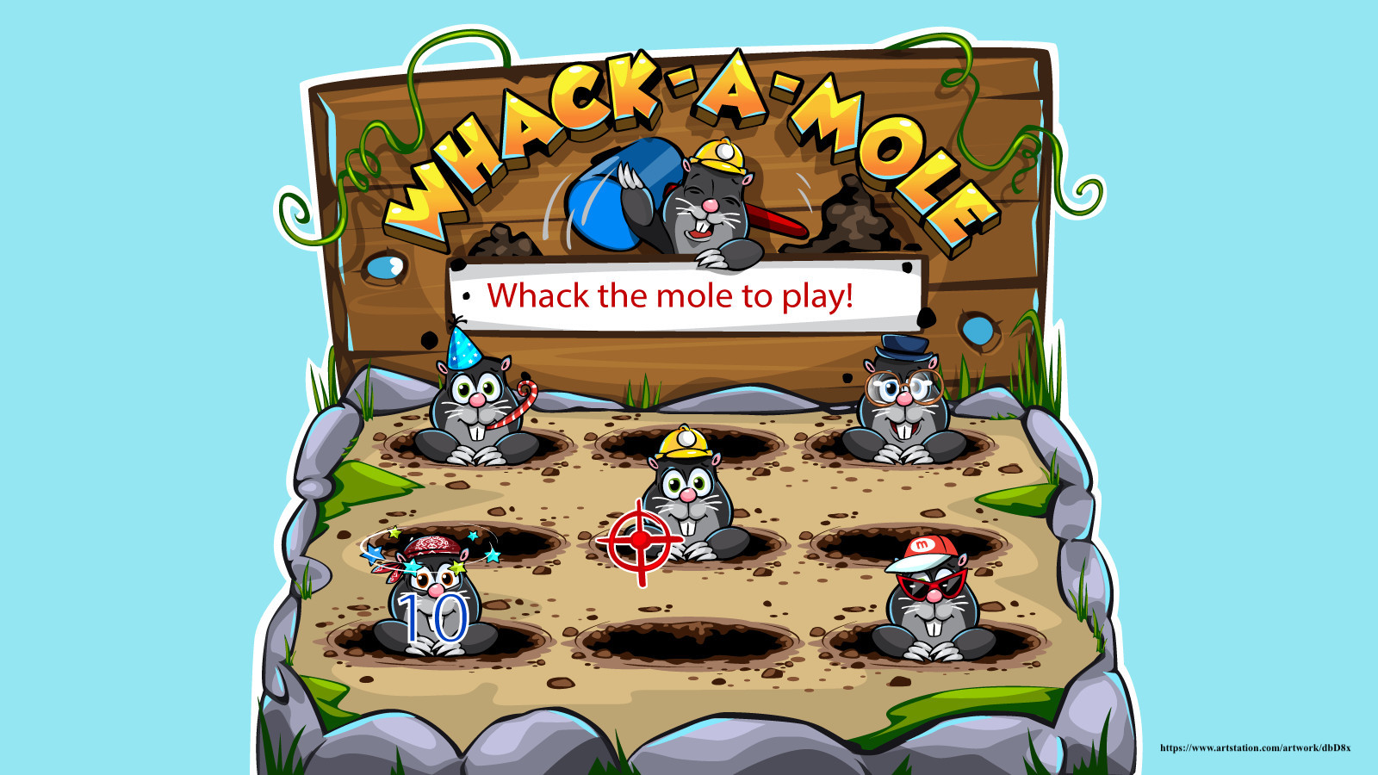
Essential
Notes:
playing a musical instrument - drums, keyboard

Slide 37

Who Benefits?
CC by 2.0 Thomas Atilla Lewis
Notes:
Motor issues - Less chance of unexpected action is accidentally touch a control
Cognitive - Not surprised when an action occurs unexpectedly when they touch a control.
Everyone benefits from availability of undo

Slide 38
2.5.2 Summary
Use built in event handlers where possible.
Custom Controls - make action happen on up event and provide a mechanism to abort or undo

Slide 39
2.5.3 Label in Name – Level A
For user interface components with labels that include text or images of text, the name contains the text that is presented visually
NOTE
A best practice is to have the text of the label at the start of the name.

Slide 40
Name
Label
NOT the name attribute
Identifies to AT
May be same as label
alt-text
aria-label
aria-labelledby
Identifies a control
Seen by all users
May be used as name
<label> element
link text
Notes:
Name is programmatically determined
aria attributes will override the label if both exist

Slide 41
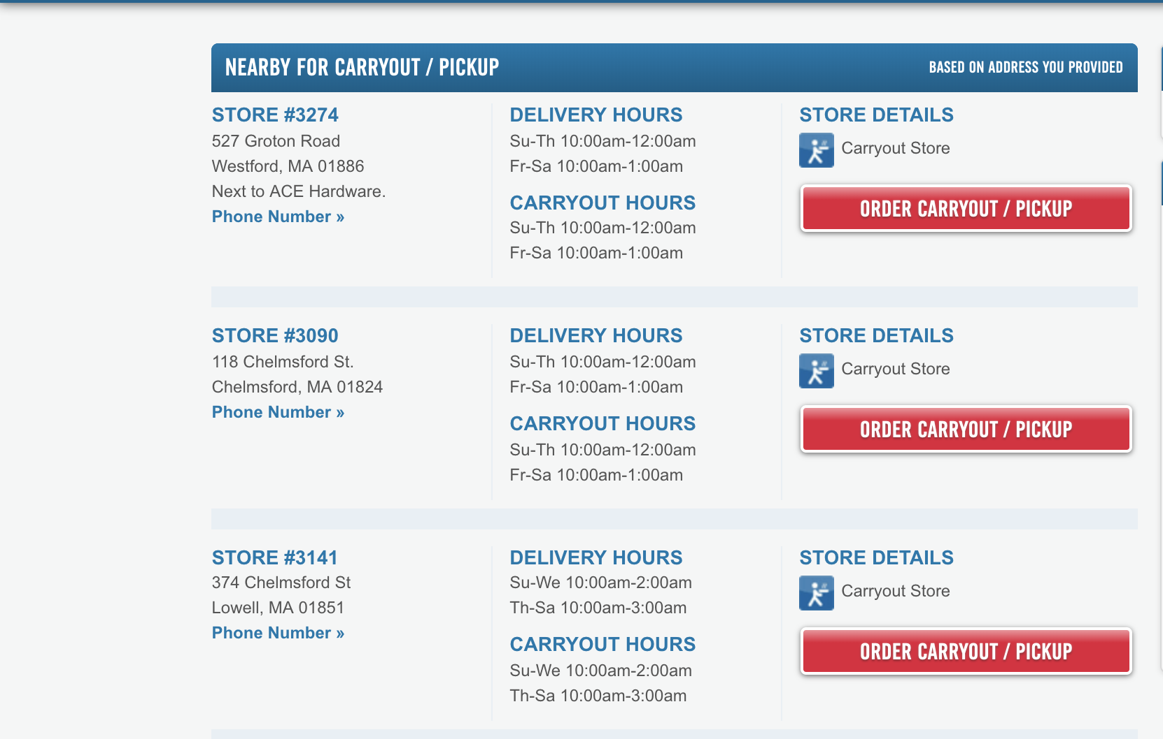
Example
Notes:
3 store locations each with a button that says Order Carryout / pickup. A voice user can’t specify which store since the button text is all the same.

Slide 42
Example Fixed
Westford Order Carryout
Chelmsford Order Carryout
Lowell Order Carryout
Notes:
3 store locations, the Order Carryout button for each is preceded by the name of the location. The unique button names make it easier for the speech input user to activate the correct button.

Slide 43

Who Benefits?
Notes:
speech input
sighted users with a screen reader - hear what they see

Slide 44
2.5.3 Summary
Have the text of the label match the start of the name

Slide 45
2.5.4 Motion Actuation – Level A
Functionality that can be operated by device motion or user motion can also be operated by user interface components and responding to the motion can be disabled to prevent accidental actuation, except when:
Supported Interface -The motion is used to operate functionality through an accessibility supported interface;
Essential - The motion is essential for the function and doing so would invalidate the activity.

Slide 46


Device Motion
Shaking or turning a device
Not geolocation
Notes:
actual movement of the device, not you moving with the device

Slide 47
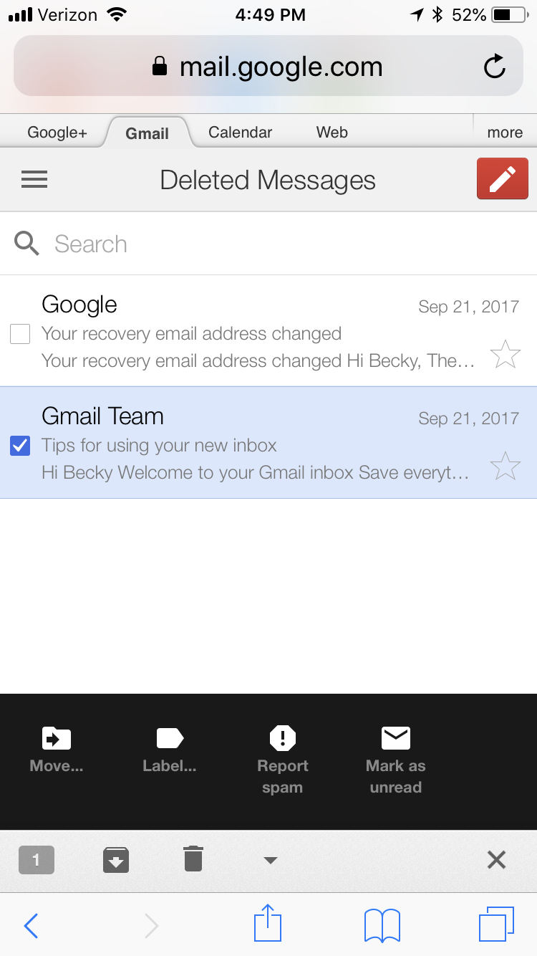
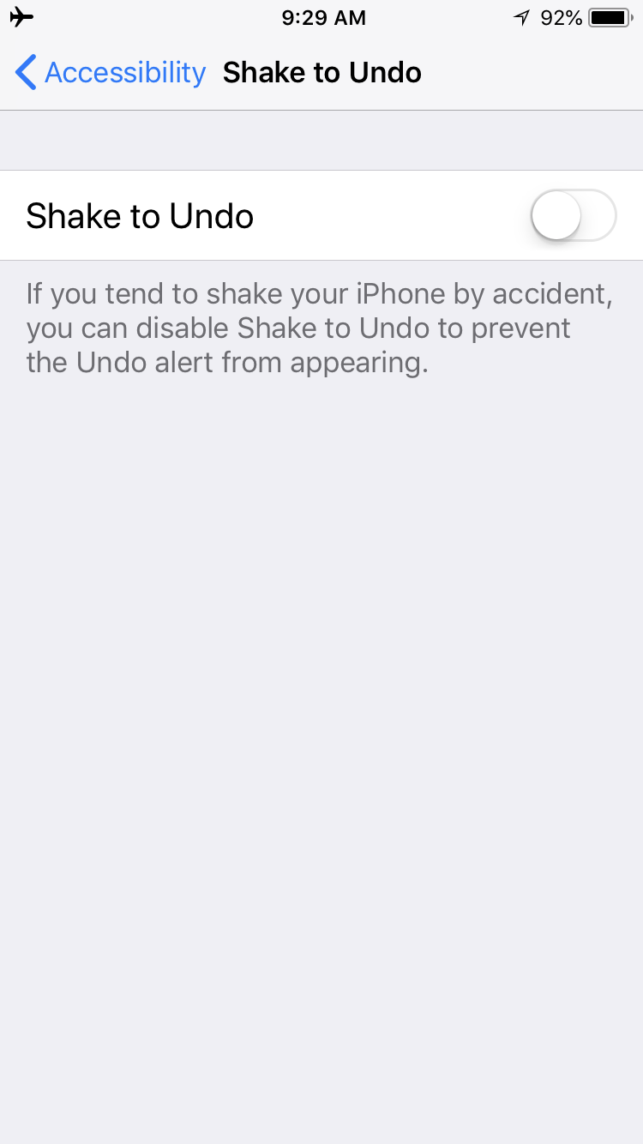
Via Controls
Turn off
Notes:
Provide another mechanism to achieve the same function. Example, google mail app a user can move an item out of the trash

Slide 48
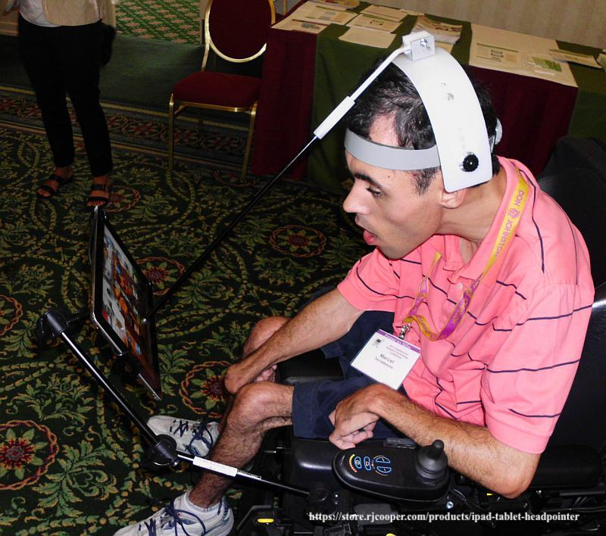
Accessibility Supported Interface
Notes:
Accessibility supported - alternative input devices that require movement. Ask for suggestions

Slide 49

Essential
Notes:
app to play maracas or cymbols by shaking device

Slide 50
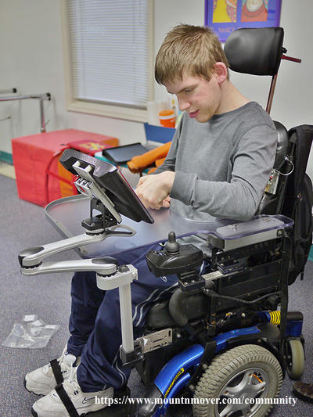
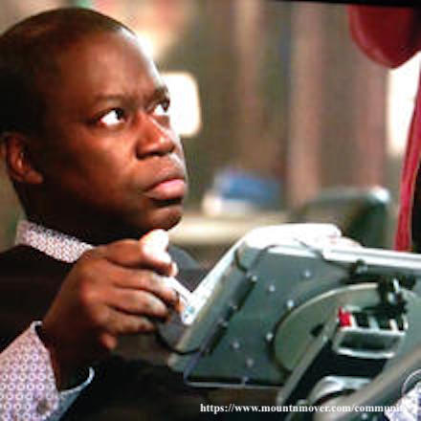
Who Benefits?
Notes:
tremors, limited motions, device held in a fixed position

Slide 51
Summary
Don’t exclusively rely on device motion for functionality
Provide an alternative user interface for the feature and allow the user to disable the motion activation of the feature.

Slide 52
2.1.4 Character Key Shortcuts – Level A
If a keyboard shortcut is implemented in content using only letter (including upper- and lower-case letters), punctuation, number, or symbol characters, then at least one of the following is true:
Turn off - A mechanism is available to turn the shortcut off;
Remap - A mechanism is available to remap the shortcut to use one or more non-printable keyboard characters (e.g. Ctrl, Alt, etc).
Active only on focus - The keyboard shortcut for a user interface component is only active when that component has focus.

Slide 53
      <a href=“help.html” accesskey=“h”><img src=“helpicon” alt=“Help”></a>
NOT accesskey
Notes:
An access key or keyboard shortcut can be assigned to any focusable element via the accesskey attribute. It is a single letter BUT is combined with an additional key that is assigned by the user agent – often alt or command. Thus, accesskey does not apply to this new success criteria.

Slide 54
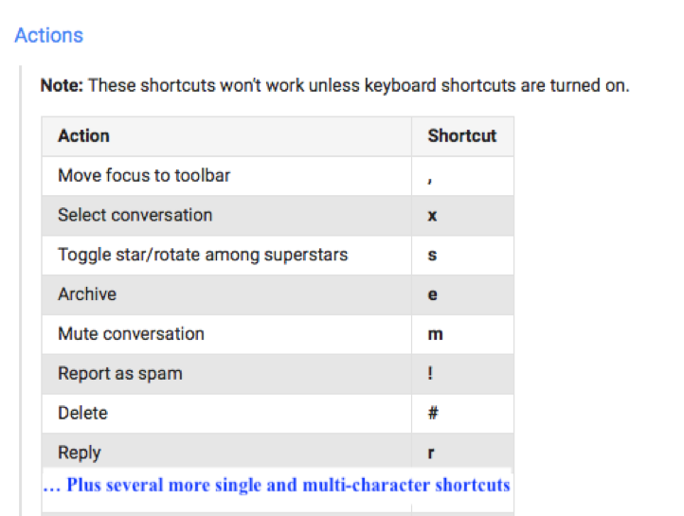
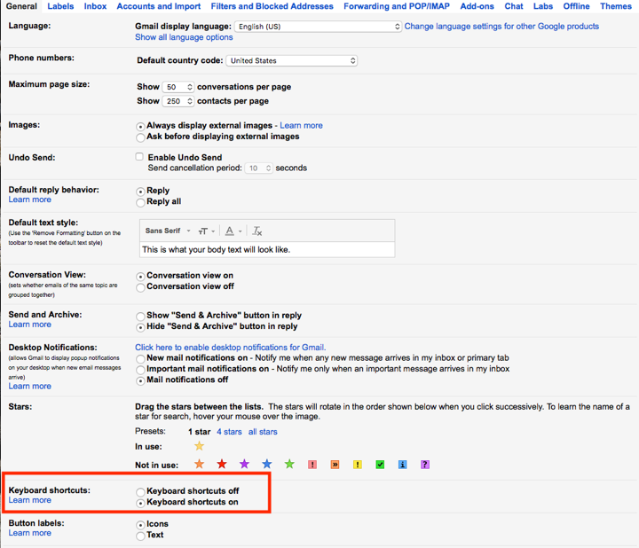
Some Google Mail Shortcuts
Can be Turned Off
Notes:
example - gmail
Can be multi character, just can’t include special characters

Slide 55
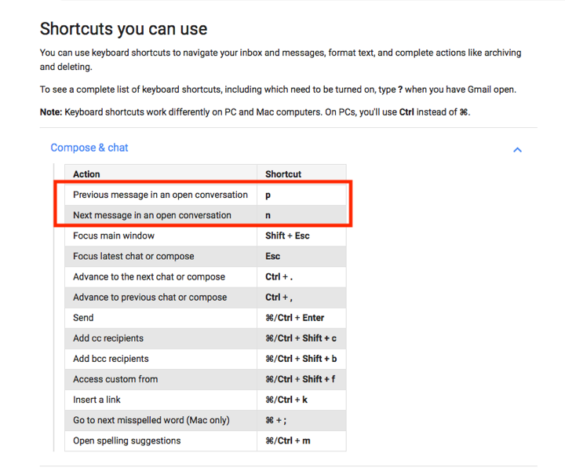
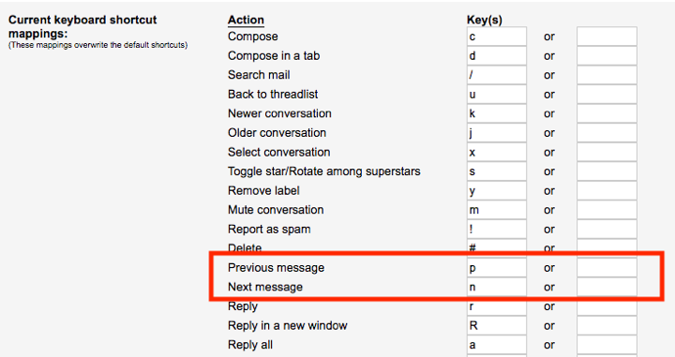
Can be Modified
Notes:
Has mechanism to change

Slide 56
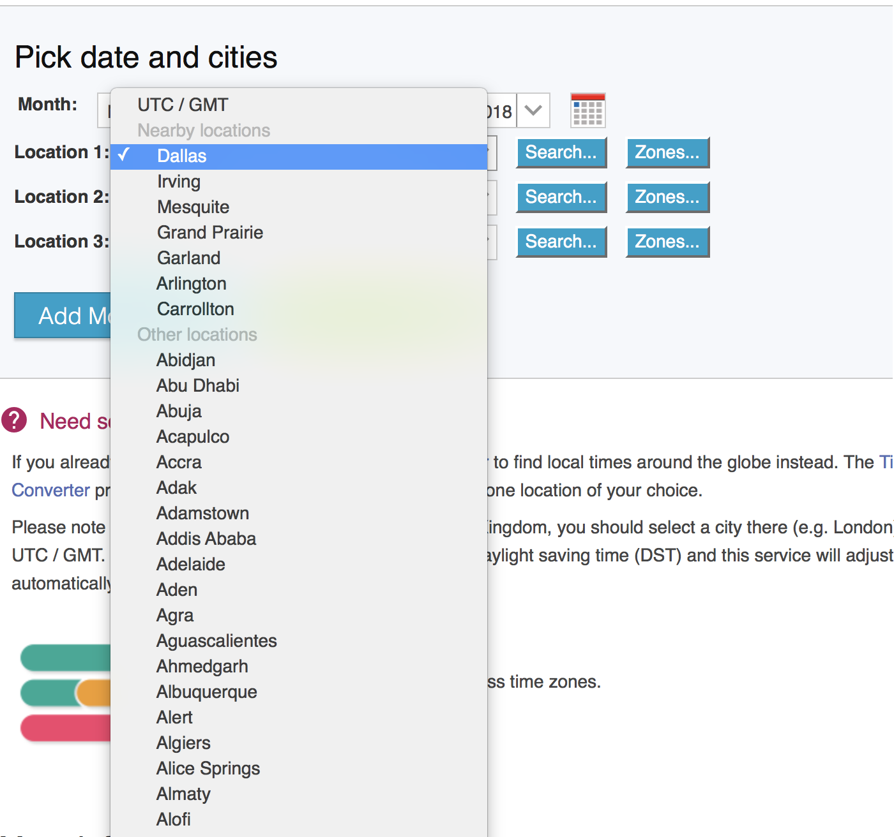
Active on Focus
Notes:
An example of a control active on focus is a select where you can type first letter to quickly move through list. That is not covered in this success criteria.

Slide 57
Who Benefits
Single character key shortcuts affecting speech input – example 1
Single character key shortcuts affecting speech input – example 2
Notes:
people with motor issues, people who use speech input
If a user needs to spell out a word or input characters one at a time the spoken character could inadvertently trigger an unwanted or unexpected action.
From the understanding document – these are videos on youTube by Kim Patch:

Slide 58
Summary
When creating adding shortcut keys try to avoid using character only keys without a modifier or provide a mechanism to turn them off or remap them.

Slide 59
1.3.4 Orientation – Level AA
Content does not restrict its view and operation to a single display orientation, such as portrait or landscape, unless a specific display orientation is essential.
NOTE
Examples where a particular display orientation may be essential are a bank check, a piano application, slides for a projector or television, or virtual reality content where binary display orientation is not applicable.
Notes:
Ask for examples of web apps that don’t rotate?

Slide 60
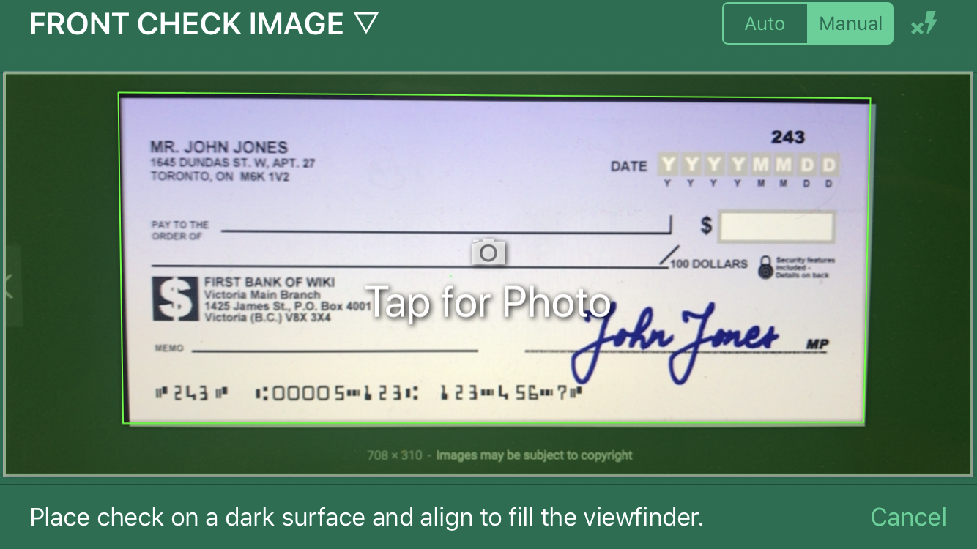
Essential

Slide 61
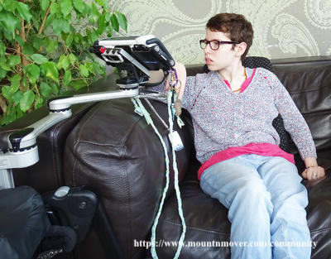
Who Benefits?
Notes:
minimal dexterity; fixed device mount

Slide 62
Summary
Don’t force a specific orientation unless essential. If a specific orientation is essential, notify the user. Implement responsive design
Notes:
Support responsive design – it will help meet other new 2.1 SC:
1.4.10 Reflow
1.4.12 text spacing.

Slide 63
2.5.5 Target Size – Level AAA
The size of the target for pointer inputs is at least 44 by 44 CSS pixels except when:
Equivalent: The target is available through an equivalent link or control on the same page that is at least 44 by 44 CSS pixels;
Inline: The target is in a sentence or block of text;
User Agent Control: The size of the target is determined by the user agent and is not modified by the author;
Essential: A particular presentation of the target is essential to the information being conveyed.

Slide 64


9 mm
9 mm
not to scale!
44 x 44
48 x 48
Notes:
9x9mm is average finger touch - corresponds to 44x44 px

Slide 65
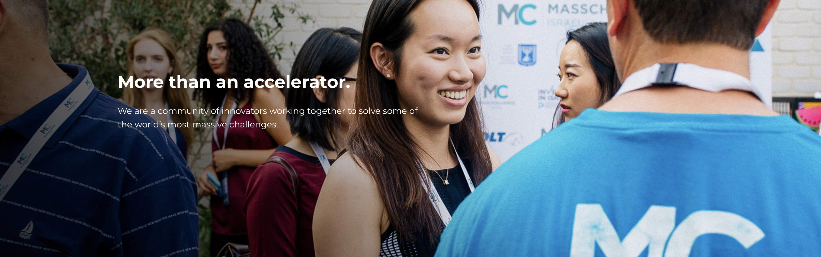
Equivalent
boston.masschallenge.org
Notes:
FYI - carousel is not considered a good user interface element

Slide 66
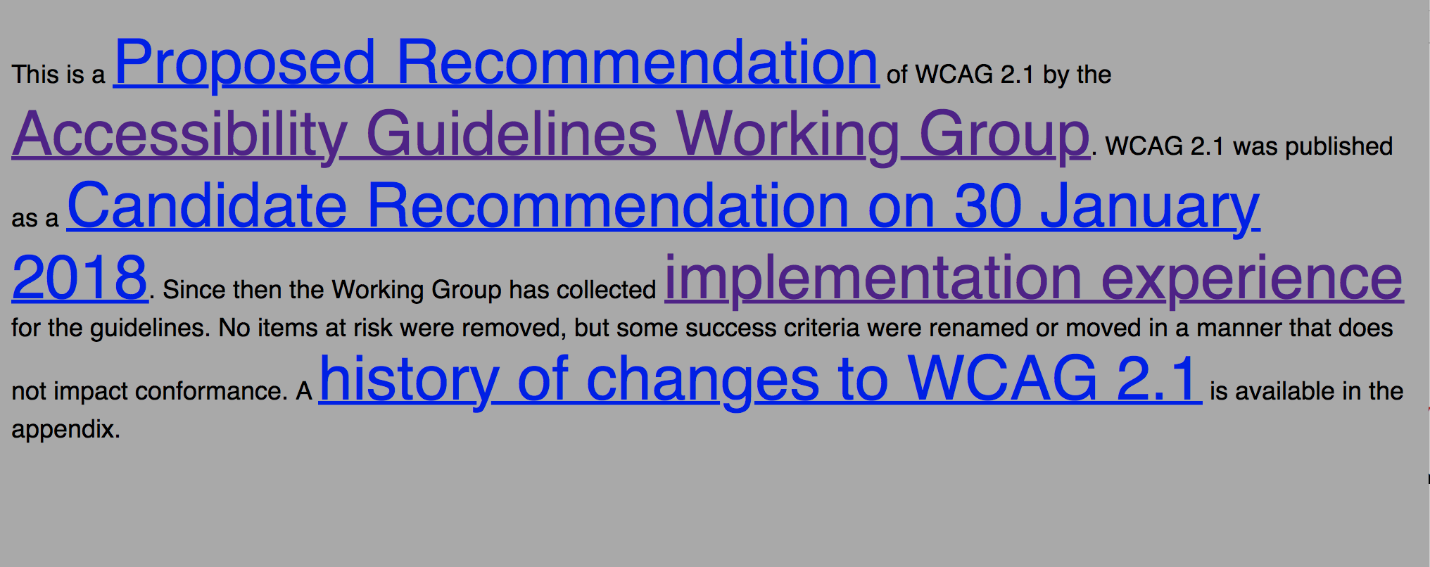
Inline Exception
Notes:
Icon at the end of sentence – falls under first bullet (inline within a sentence) - Help icon at the end of a sentence.
But, this SC would apply to an icon at the end of a control since that isn’t a sentence or block of text.

Slide 67
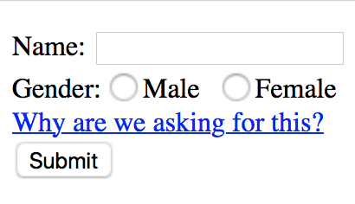
User Agent Control
Notes:
use default controls - restyle if necessary

Slide 68
Essential
Notes:
Or an app that helps users increase dexterity/selection accuracy by slowing decreasing target size for the user to activate.

Slide 69
Who Benefits?
Notes:
tremors, head pointer, or other assistive pointing device

Slide 70
2.5.5 Summary
Make sure target size is at least 44x44px. Bigger is better.
Don’t have to worry about links within a sentence or block of text.

Slide 71
2.5.6 Concurrent Mechanisms – Level AAA
Web content does not restrict use of input modalities available on a platform except where the restriction is essential, required to ensure the security of the content, or required to respect user settings.

Slide 72

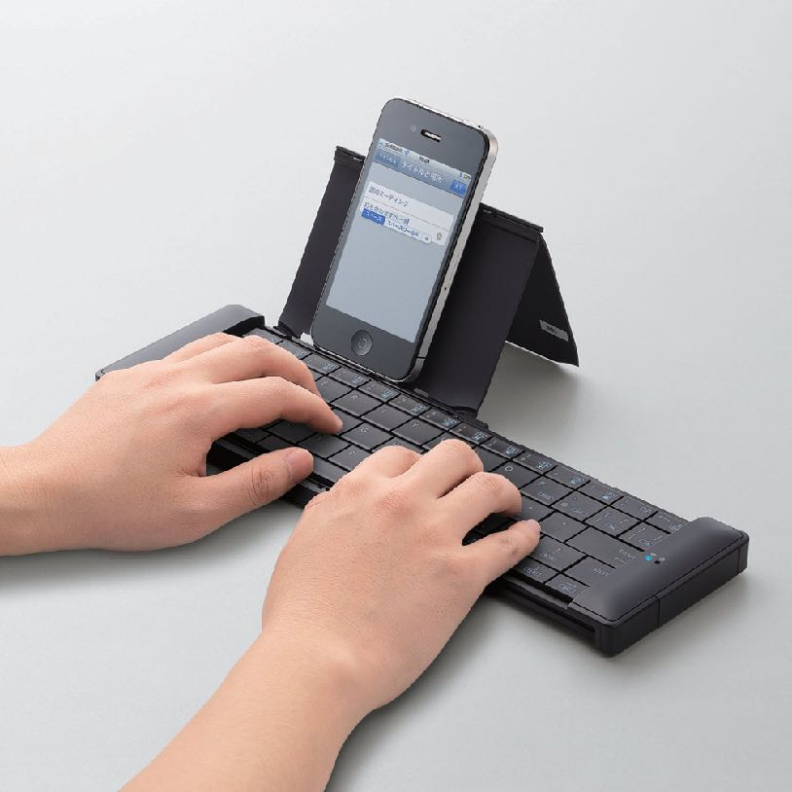
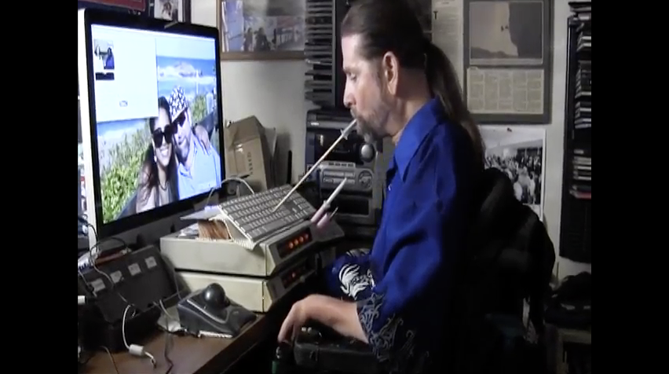


Input Modalities
Notes:
User must be able to switch between input modalities – switch between mouse and pointer or mouse and keyboard
Touch/pointer/stylus, Mouse, keyboard …
don’t assume only touch events or only mouse events and to also code for keyboard events.

Slide 73
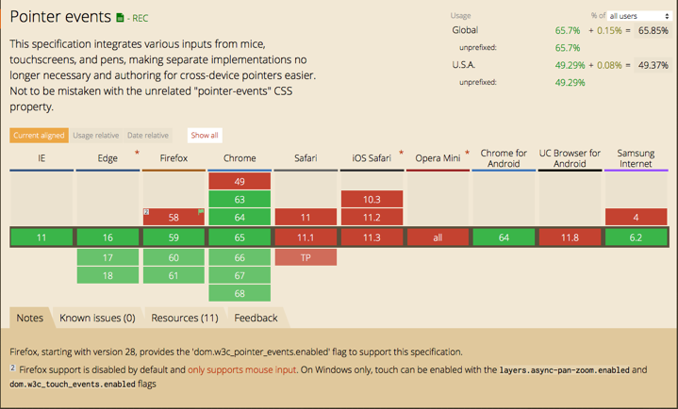
Notes:
There is a W3C spec - for pointer events that would be generic but it isn’t yet well supported in browsers. See https://caniuse.com/#search=pointer V1 of the Pointer Events spec was published in February, 2015 so it is discouraging that it isn’t yet adopted by all browsers. IE, Edge, Firefox, Chrome, Chrome for Android, and Samsung internet support pointer events. Safari, iOS Safari and Opera Mini do not.
This is not to be confused with CSS pointer-events which is used to disable pointer events on specifically styled items so they don’t cascade.

Slide 74
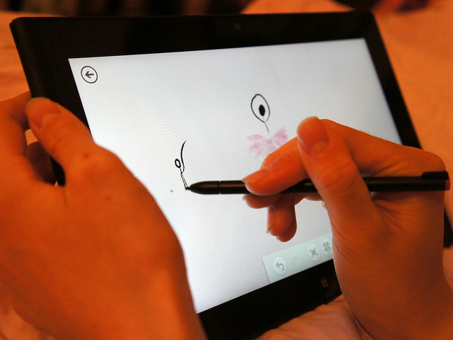
Essential
CC BY-SA 2.0 by intelfreepress
Notes:
ask audience: Drawing apps?
App to teach touch typing (this is from Understanding document)
Security – use keyboard for entering password rather than speech input

Slide 75
Who Benefits?
Notes:
people with tremors, repetitive stress injuries, speech input - switch between different modalities

Slide 76
Summary
Support multiple modalities.
Allow user to switch between input mechanisms.

Slide 77
Low
Vision

Slide 78
1.4.10 Reflow – Level AA
Content can be presented without loss of information or functionality, and without requiring scrolling in two dimensions for:
Vertical scrolling content at a width equivalent to 320 CSS pixels;
Horizontal scrolling content at a height equivalent to 256 CSS pixels;
Except for parts of the content which require two-dimensional layout for usage or meaning.
NOTE
Note: 320 CSS pixels is equivalent to a starting viewport width of 1280 CSS pixels wide at 400% zoom.
For web content which are designed to scroll horizontally (e.g. with vertical text), the 256 CSS pixels is equivalent to a starting viewport height of 1024px at 400% zoom.
NOTE
Examples of content which require two-dimensional layout are images, maps, diagrams, video, games, presentations, data tables, and interfaces where it is necessary to keep toolbars in view while manipulating content.

Slide 79
1280
320
1
256
1024
Notes:
320 and 256 selected because they line up with small device sizes
Don’t let the note confuse you, it is just Math:
Zooming by 400% makes the content 4 times bigger but we have the same area to display it within. We are taking ¼ of the content (1280/4 = 320) and expanding it to fit the screen. It is the same in the other direction 1024/4 = 256.
Animation zooming a 1280x1024 divided into 4x4 array of squares. When it is zoomed to 400% one square takes up the entire 1280X1024 space.

Slide 80
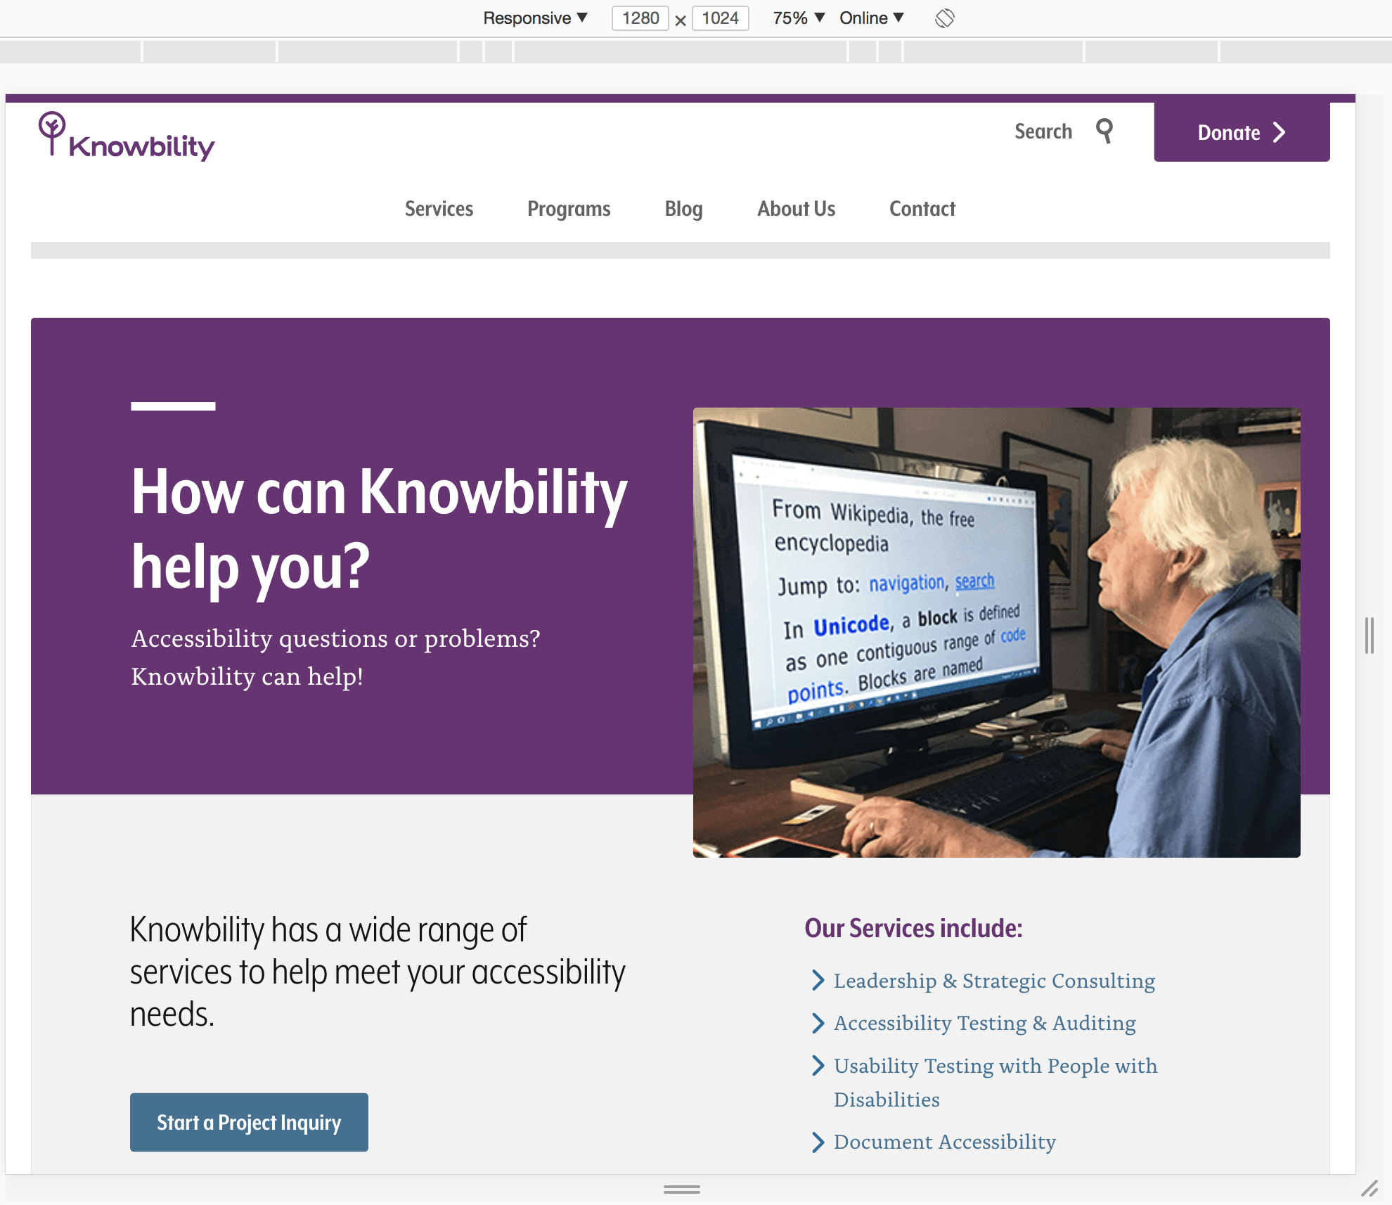
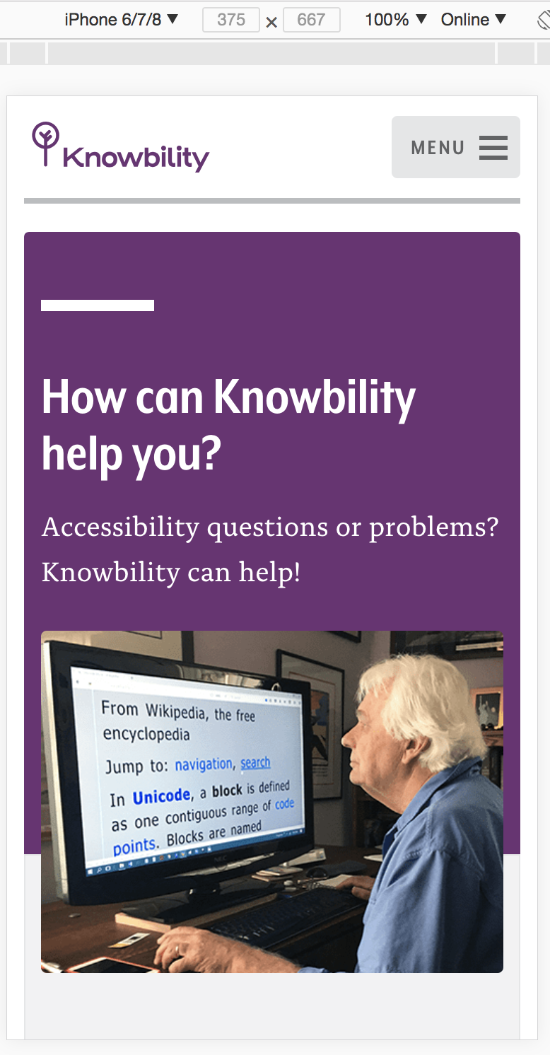
Notes:
Viewing Knowbility site in Chrome inspect at various sizes.
this is not zooming - it is reflowing based on CSS Media queries.
The easiest way to achieve this is via responsive design (what the Knowbility site does) Most web applications/site are already doing that to support various screen sizes. An alternative for legacy sites is to provide an alternative rendering for 320px wide mobile devices.

Slide 81
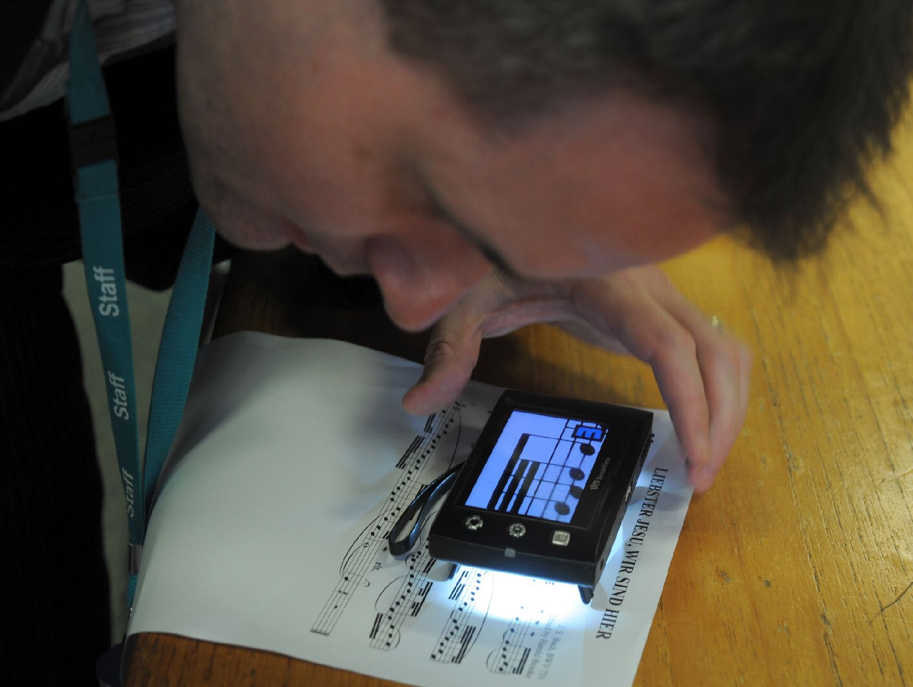
Who Benefits?
Photo CC BY SA-2.0 museScore
Notes:
low vision - From the understanding document:
Of the 285 million people worldwide who are visually impaired, 14% are blind and 86% have low vision according to the World Health Organization (WHO). A significant proportion of people with low vision need more than a 200% increase in the size of content. From the WebAIM survey 25% of low vision users indicated needing magnification to 400% or more.

Slide 82
Summary
The easiest way to achieve this is via responsive design

Slide 83
1.4.11 Non-Text Contrast – Level AA
The visual presentation of the following have a contrast ratio of at least 3:1 against adjacent color(s):
User Interface Components: Visual information used to indicate states and boundaries of user interface components, except for inactive components or where the appearance of the component is determined by the user agent and not modified by the author;
Graphical Objects:Parts of graphics required to understand the content, except when a particular presentation of graphics is essential to the information being conveyed.

Slide 84
#4AA59D 1.2
Example
Fail
Example
#225352 - 3.4
Example
Pass
#A9A9A9
Notes:
Examples of text edit fields with both poor contrast and passing contrast borders.
It there is a border, the border must have sufficient contrast against the background – unless the item has text and the text meets the contrast requirements.
Also applies to selected states, not just focus
So, can use color to show focus and state if meet contrast ratio guidelines - BUT don’t forget the background colors

Slide 85

Background: #59A0D5
Foreground: #FFFFFF
Ratio: 2.8
Social Icons
Notes:
Buttons with text/letters would fail 1.4.3 – text contrast. If button has text and text meets contrast ratio, the border does not have to. Thus, since some of these are letters (ie text) making the contrast of the text against the background would be enough, don’t have to have the border, also. Also, logos are exempt.

Slide 86


Fail
Pass
Grey against white background - 2.8

Slide 87
Exceptions
Inactive Components
Logos
Photos of real life scenes
Representations
  medical diagrams
  screen shots
  heat maps

Slide 88
Who Benefits?
Notes:
low vision, color blind

Slide 89
1.4.11 Summary
Ensure contrast ratio of at least 3.1 between background and foreground (including borders) for all states of user interface components.

Slide 90
1.4.12 Text Spacing – Level AA
In content implemented using markup languages that support the following text style properties, no loss of content or functionality occurs by setting all of the following and by changing no other style property:
Line height (line spacing) to at least 1.5 times the font size;
Spacing following paragraphs to at least 2 times the font size;
Letter spacing (tracking) to at least 0.12 times the font size;
Word spacing to at least 0.16 times the font size.
Exception: Human languages and scripts that do not make use of one or more of these text style properties in written text can conform using only the properties that exist for that combination of language and script.

Slide 91
User Requirements
User provides custom stylesheet
Site must work with custom stylesheet
Site does not have to provide controls for modifying style
Notes:
Stylish chrome extension - W3C has a stylesheet for testing text spacing (perhaps demo)

Slide 92

Exceptions
Video captions
Images of text
Logos with text
Text in Canvas is considered to be images of text
Note: This SC can not currently be achieved in PDF
Notes:
Understanding document examples: https://www.w3.org/WAI/WCAG21/Understanding/text-spacing.html
live example:

Slide 93
Examples and Testing
See W3C Understanding Document(s)
Text Spacing Technique
Notes:
https://www.w3.org/WAI/GL/wiki/Allowing_for_Spacing_Override
Go to a page and then apply Knowbility->WCAG 2.1 Text Spacing bookmark (runs a saved script)
Use BBC as an example of failure
http://www.lflegal.com - as pass

Slide 94
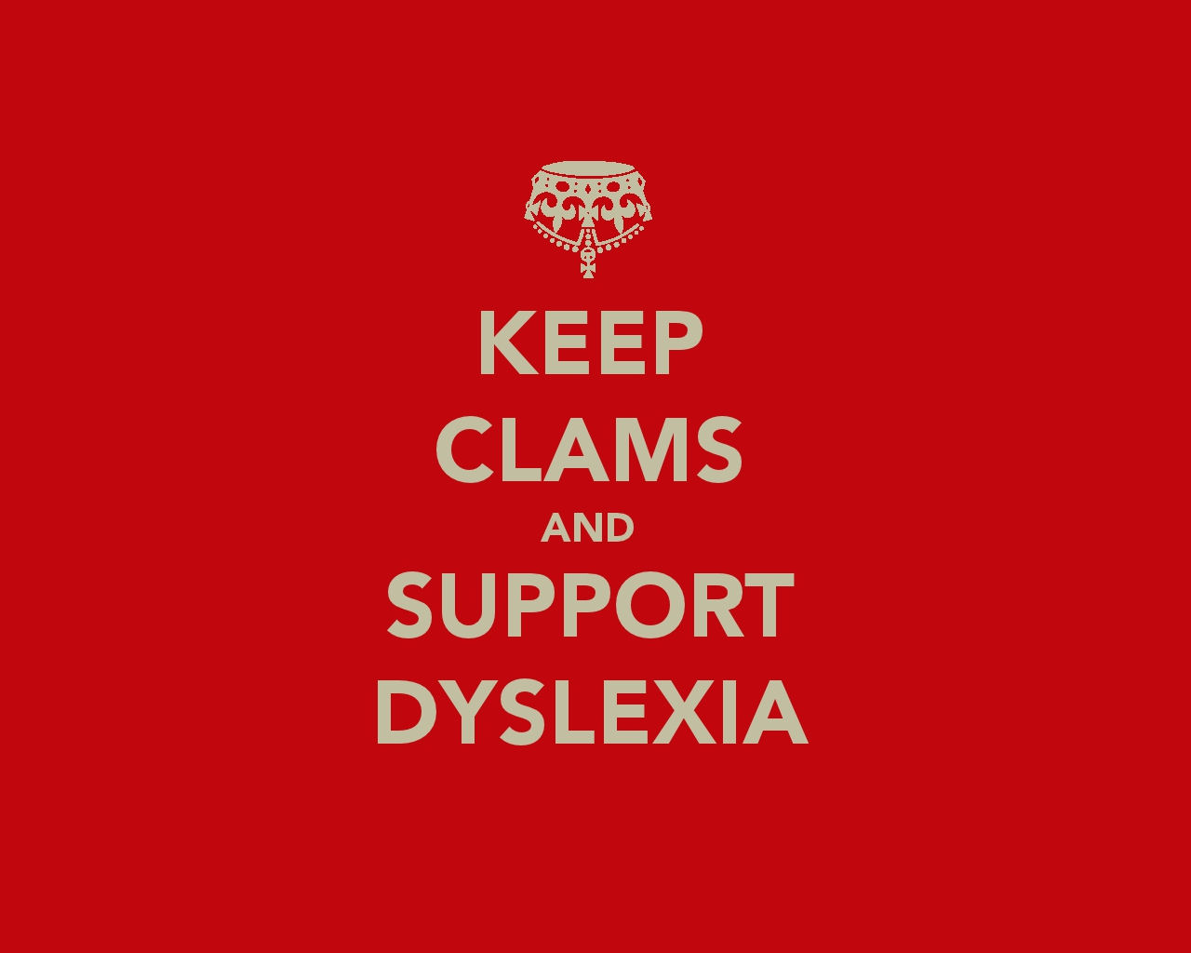
Who Benefits?
CC BY-SA 3.0 by The Drof
Notes:
no disrespect intended - hard to find images to represent cognitive issues
low vision, dyslexia,

Slide 95
1.4.12 Summary
Again, responsive design is your friend. Avoid fixed spacing and layouts.

Slide 96
1.4.13 Content on Hover or Focus – Level AA
Where receiving and then removing pointer hover or keyboard focus triggers additional content to become visible and then hidden, the following are true:
Dismissable: A mechanism is available to dismiss the additional content without moving pointer hover or keyboard focus, unless the additional content communicates an input error or does not obscure or replace other content;
Hoverable: If pointer hover can trigger the additional content, then the pointer can be moved over the additional content without the additional content disappearing;
Persistent: The additional content remains visible until the hover or focus trigger is removed, the user dismisses it, or its information is no longer valid.
Exception: The visual presentation of the additional content is controlled by the user agent and is not modified by the author.
NOTE
Examples of additional content controlled by the user agent include browser tooltips created through use of the HTML title attribute.
NOTE
Custom tooltips, sub-menus, and other nonmodal popups that display on hover and focus are examples of additional content covered by this criterion.

Slide 97
Dismissable
Need a method to get rid of the content that works for Assistive technology
  Screen reader users
  Magnification / zoom users
  Keyboard users
  Users with tremors or motion issues
Basically add a keyboard method (escape or button) to close the content.
Unless it represents an error or doesn’t obscure or add content
Notes:
demo: https://a11y.nicolas-hoffmann.net/simple-tooltip/ (near bottom)

Slide 98
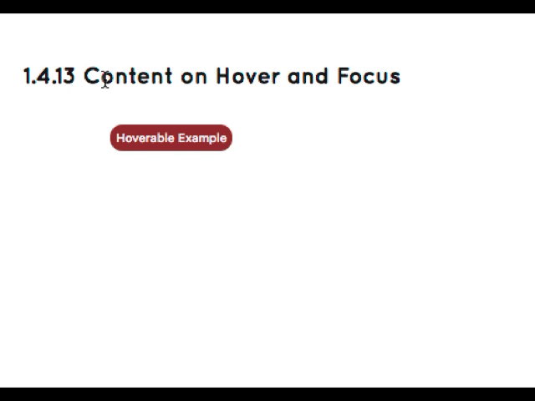

Hoverable & Persistent
Notes:
If the content is triggered on pointer hover, the pointer can be moved off of the trigger without the content disappearing. The new content remains visible until the pointer leaves the new content or it is dismissed (if it obscured other content). Demo video available at: https://knowbility.org/blog/2018/WCAG21-1413ContentHoverFocus/
Remains Visible until dismissed or no longer valid
Dismissed by moving pointer off of the trigger and the content
Dismissed by mechanism provided via dismissable requirement above

Slide 99
Exceptions
controlled by the user agent - title attribute
skip link since it is not added content
dialog since focus is trapped
Notes:
Therefore, a non-visible component, like a Skip to Main link, that is made visible on keyboard focus (with no additional content beyond the trigger becoming visible) is not covered by the SC.

Slide 100
Who Benefits?
Notes:
screen magnification users - they can find an move to content without it disappearing
tremors - They may inadvertently trigger the content on hover – need a mechanism to dismiss it
They cannot keep the pointer over the trigger due to tremors – thus the requirement to hover over the content itself (this assumes content is larger than trigger)
cognitive - need more time to read and comprehend

Slide 101
1.4.13 Summary
Make sure additional content can be found and accessed by all users. They should have a mechanism to take extended time to view and understand the content. They can easily dismiss the content

Slide 102
4.1.3 Status Messages – Level AAA
In content implemented using markup languages, status messages can be programmatically determined through role or properties such that they can be presented to the user by assistive technologies without receiving focus.
Notes:
Note: Primarily for screen reader users. But also helpful for people with cognitive issues - can use extensions that provide notification to them in a preferred manner, flash, spoken, focus based on a user preference.
Notify of new information that is NOT a change of context but is important to users
Notify without total interruption

Slide 103
Examples
Covered - add content
  completion of a task – “added to cart,”
  additional information – 5 results returned, error messages, # of errors
    modification or removal of status text
  progress updates – progress bar, busy notification
Not Included - don’t add content
  info intended for AT users only
  info that receives focus
Notes:
Key is that information is added to the screen. Implemented via ARIA - role=alert, log, progress bar,
examples - time out for ticket purchase, error messages

Slide 104
Who Benefits?
Notes:
screen reader user, magnification user - if they can set a notification mechanism within their magnification tool. Cognitive users with an additional plugin/extension to notify then in a preferred manner - focus, flash, spoken, etc.

Slide 105
4.1.3 Summary
Make certain that all users are notified of status messages in a way that doesn't unnecessarily interrupt their work.

Slide 106
Cognitive

Slide 107
1.3.6 Identify Input Purpose – Level AA
The purpose of each input field collecting information about the user can be programmatically determined when:
The input field serves a purpose identified in the Input Purposes for User Interface Components section; and
The content is implemented using technologies with support for identifying the expected meaning for form input data.
Notes:
https://www.w3.org/TR/WCAG21/#input-purposes - bring up in browser. Note that, “The list of input type purposes is based on the control purposes defined in the HTML 5.2 Autofill field section,”
Basically the start of personalization

Slide 108
Beginning of Personalization
Provides help completing forms via autocomplete
  Use of HTML autocomplete attribute is the current method to meet
Allows for tools to transform information requests into a more understandable / “personalized” format
Notes:
The intent of this success criteria is to help people better recognize and understand the intention of form inputs by attaching additional information (metadata) to the identified form inputs. This allows for additional machine-processing for personalization and other automation, such as identifying and applying familiar terms or symbols to the inputs, which are needed for users with cognitive disabilities to be able to use the web.

Slide 109
Who Benefits?
Notes:
Cognitive: provide a familiar interface for users having trouble with understanding forms.
The autocomplete function of user agents is able to support people by the filling in predetermined data.
Motor issues - less typing since browser can autocomplete

Slide 110
1.3.5 Summary
Use HTML 5.2 autocomplete attribute values on input fields to programmatically identify input purpose.

Slide 111
1.3.6 Identify Purpose – Level AAA
In content implemented using markup languages, the purpose of User Interface Components, icons, and regions can be programmatically determined.
Notes:
Advanced personalization beyond just input fields

Slide 112
Enable Further Personalization
Adaptation of content to user needs
  symbols
  limited / simplified vocabulary
  additional information and explanation
How to meet
  Adding context using personalization vocabulary (under development)
  Adding context using schema.org
  Adding context using Microdata and the ARIA ePub vocabulary
Notes:
extending roles beyond a description of UI elements but to further clarify content for individuals through that help of assistive technology
roles on ui elements allow screen readers to identify those to non-visual users; this will allow customized AT to provide more, customized information for

Slide 113
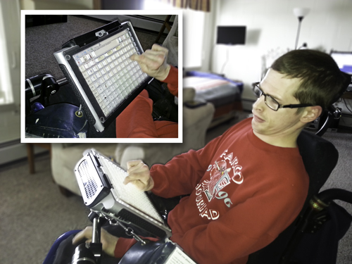
Who Benefits?
Notes:
AAC - Augmented and Alternative Communication users
Cognitive disabilities - limited vocabulary
learning a new language?

Slide 114
1.3.6 Summary
Add Personalization metadata (when specification is completed).

Slide 115
2.2.6 Timeouts – Level AAA
Users are warned of the duration of any user inactivity that could cause data loss, unless the data is preserved for more than 20 hours when the user does not take any actions.
NOTE
Privacy regulations may require explicit user consent before user identification has been authenticated and before user data is preserved. In cases where the user is a minor, explicit consent may not be solicited in most jurisdictions, countries or regions. Consultation with privacy professionals and legal counsel is advised when considering data preservation as an approach to satisfy this success criterion.
Notes:
Allow people to take breaks; warn of timing requirements before a task starts and not at every step of the way

Slide 116
How to Meet
Save data so user can complete a task in steps over time
Store data more than 20 hours (with security caveats)
Enable user to extend the time allocation
Warn users of timed activities and time limits
Notes:
when extending time allocation give sufficient warning to read the message and respond
auctions are an example where notification of a time limit is needed

Slide 117
Who Benefits?
Notes:
language-related disabilities;
memory-related disabilities;
focus-and-attention-related disabilities; and
disabilities that affect executive function and decision making.

Slide 118
2.2.6 Summary
Allow completion of tasks in steps over time without loss of data or warn users at the start if a task has time limits.

Slide 119
2.3.3 Animation from Interactions – Level AAA
Motion animation triggered by interaction can be disabled, unless the animation is essential to the functionality or the information being conveyed.
Notes:
Examples: menu that follows the user as they scroll
slide shows that use animation to turn pages.

Slide 120
Motion Animation
“addition of steps between conditions to create the illusion of movement or to give a sense of a smooth transition”
Notes:
quoted from the WCAG 2.1 proposed spec.
Does not include blurring, opacity change, or change in color
Examples: ask audience. menu that follows the user as they scroll
slide shows that use animation to turn pages.

Slide 121
How to Meet
Identify the motion and trigger(s)
Provide a mechanism to disable the motion before the interaction
Provide a setting to disable all motion animation

Slide 122
Who Benefits?
Notes:
people who get motion sickness - nausea;
People who are distracted
those with vestibular disorders (disturbance of balance)

Slide 123
2.3.3 Summary
Avoid motion animation or provide a mechanism to disable it before it occurs.

Slide 124
Summary
Continue supporting WCAG 2.0. Begin implementing new 2.1 Success Criteria to expand the reach and usability of your sites and applications.
DONE!

