Slide 1
Web Accessibility plus WordPress
The Ease of Accessibility with WordPress
Presented by Sumner Davenport
At John Slatin AccessU 2019
May 15, 2019

Slide 2
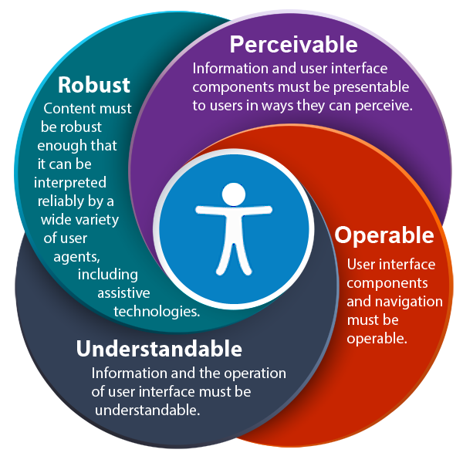
POUR

Slide 3
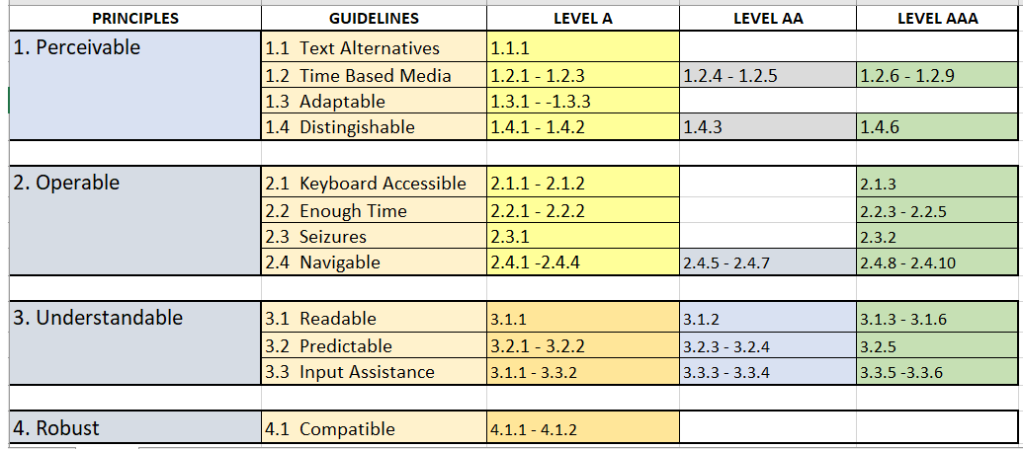
Web Accessibility Checklist
Notes:
https://www.w3.org/WAI/WCAG21/quickref/?versions=2.0

Slide 4
It may only seem confusing … where to start?

Slide 5
To get to where you want to be: Accessible. You need to know where you are, your starting point.

Slide 6
Step 1: Easy Manual Checks
1. Page titles,
2. Headings,
3. Basic Structure Check,
4. Image text alternatives,
5. Contrast ratio ("color contrast"),
6. Hyperlinks,
7. Forms, labels, and errors,
8. Resize Text and Reflow,
9. Multimedia (video, audio) alternatives,
10. Keyboard access.

Slide 7
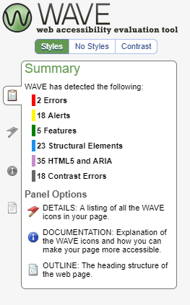
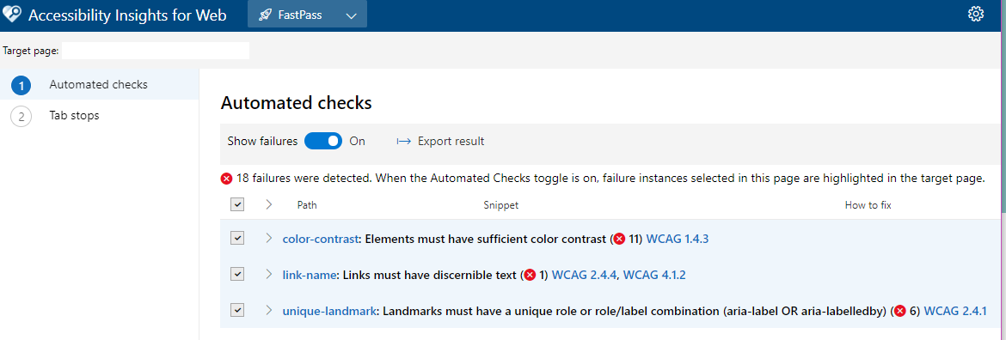
Step 2: Audit/Testing
Automatic Accessibility Checkers:
WAVE Toolbar Online (http://wave.webaim.org/) and Browser Add-on.
(Microsoft + AXE) Accessibility Insights for the Web Chrome Browser add-on.
AXE (Online and Browser Add-on).
Chrome Accessibility Developer Tools.
AInspector – Firefox Add-on.
Plugins.

Slide 8
Step 3: Audit/Testing (continued)
Screen Readers
All product names, logos, and brands are property of their respective owners.

Slide 9
Ultimate Tester
The native user of the assistive technology

Slide 10
Remediation

Slide 11
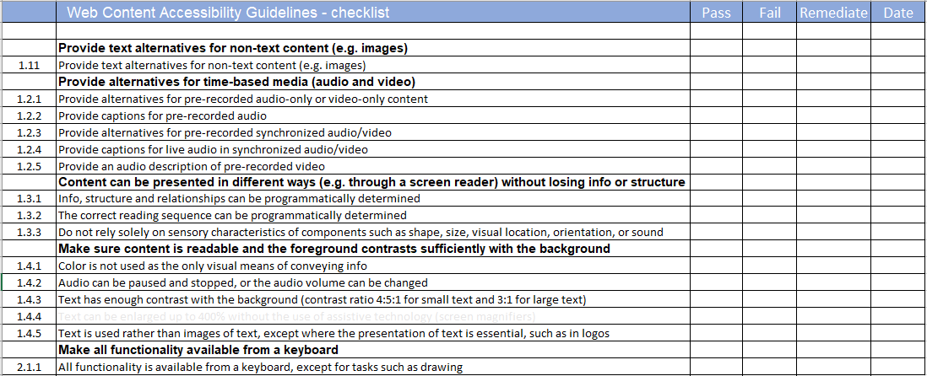
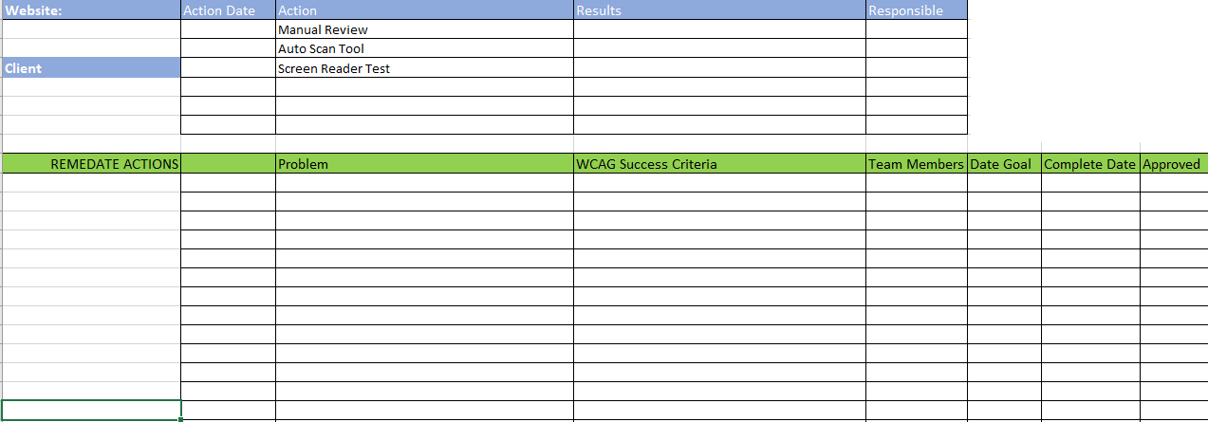
Remediation Accountability

Slide 12
Starting Fresh

Slide 13
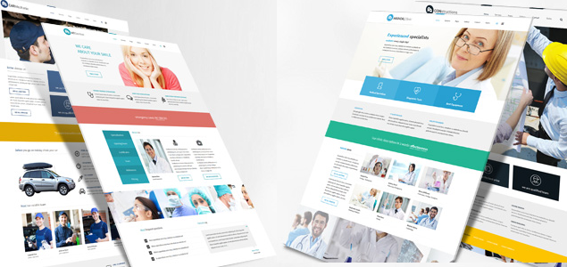
Themes
Starting with an Accessible theme saves time on remediation.
Free themes (https://wordpress.org/themes/tags/accessibility-ready)
Premium/fee (https://colorlib.com/wp/accessible-wordpress-themes)
Premium/fee (https://www.pixelemu.com/wordpress-themes/i/3-business/8-services)

Slide 14
Page Builders
We found no Page Builder that is completely Accessible.

Slide 15
PLUGINS - The Good, the Bad and the Ugly

Slide 16
Plugin Categories
Good – does what they advertise, adds minimal code to do it, direct support or plugin community, and plays well with others.
Bad- doesn’t do what they say, slows down your site, limited support, can crash your site and doesn’t play well with others.
Ugly – accomplishes very little positive changes, no support, crashed your site, overcharges and doesn’t keep promises. Read T&C before buying.
Plugins not always the answer.
Sometimes a simple line of code will do it.

Slide 17
Plugin Recommendations
We make no negative comments, only positive recommendations.
Plugins we’ve tested and encountered good results.
No affiliate links or kickbacks received for recommending.

Slide 18
Accessibility Plugins
WP Accessibility (https://wordpress.org/plugins/wp-accessibility/) WP ADA Compliance Check Basic (https://wordpress.org/plugins/wp-ada-compliance-check-basic/) WP tota11y (https://wordpress.org/plugins/wp-tota11y/)
Divi Accessibility (https://wordpress.org/plugins/accessible-divi/) for Divi Theme only.

Slide 19
Skip Links
WP Accessibility (https://wordpress.org/plugins/wp-accessibility/) Divi Accessibility (https://wordpress.org/plugins/accessible-divi/) developed to work with Divi theme.
Genesis Accessible (https://wordpress.org/plugins/genesis-accessible/) developed to work with Genesis theme.
(WCAG Success Criterion 2.4.1,Bypass Blocks)

Slide 20
Text Alternatives
When remediating a site where Text Alt had not been added to several images: Use plugin to find images, download the list, remediate, then uninstall plugin. Accessibility Tools & Alt Text Finder (https://wordpress.org/plugins/tool-for-ada-section-508-and-seo/)
Indicates empty “alt” feature included: Yoast SEO Pro (https://yoast.com) WP ADA Compliance Check Basic (Pro Version) (https://wordpress.org/plugins/wp-ada-compliance-check-basic/)
(WCAG 1.1.1 Non-text Content
Level A)

Slide 21
Text Sizing - Zoom
Provides clickable button for users:
Zoom (Free to $40 annual)
(https://web-dorado.com/products/wordpress-zoom.html)
Zeno - Free (https://wordpress.org/plugins/zeno-font-resizer/)
Test your fonts at 400% enlargement.
Check the reflow.
(WCAG 1.4.1 Resize Text, Reflow)

Slide 22
Image Sizing - Zoom
WPB WooCommerce Image Zoom PRO ($29 to $249)
(https://wpbean.com/downloads/woocommerce-image-zoom-pro/)
Image Zoom Pan ($16) (https://codecanyon.net/item/image-zoom-pan-wordpress-plugin)
(WCAG 2.1.)

Slide 23
Menus - Accessible
Max Mega Menu – Open Source (https://wordpress.org/plugins/megamenu/)
QuadMenu (https://wordpress.org/plugins/quadmenu/)

Slide 24
Forms
Free- Contact 7 + Accessibility Addon (https://wordpress.org/plugins/contact-form-7/) (https://fr.wordpress.org/plugins/contact-form-7-accessible-defaults/)
Gravity Forms + Accessibility Addon ($59 to $259) (https://www.gravityforms.com/)
(https://wordpress.org/plugins/gravity-forms-wcag-20-form-fields/)
Formidable Forms ($49 to $399)
(https://formidableforms.com)
(WCAG 3.3.2.)

Slide 25
Color
WP Accessibility (https://wordpress.org/plugins/wp-accessibility/)
WebAim.org – Online Contrast Checker (https://webaim.org/resources/contrastchecker/)
(WCAG 1.4.1 - 1.4.33.)

Slide 26
Video files
Accessible Video Library*
(https://ve.wordpress.org/plugins/accessible-video-library/)
(WCAG 1.2.1 – 1.2 .9
1.4.2, 1.4.7.)
Notes:
Curb effect: Closed captions were created for people with hearing impairments, but they are also great for watching videos in a noisy environment.
. If you have media on your site, check for captions, transcripts, and other possible alternatives. Wherever you have media:

Slide 27
USER EXPERIENCE
Design for the user. Test from your user perspective.

Slide 28
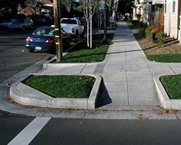
Talking to Clients
Increased Value
Curb cut effect

Slide 29
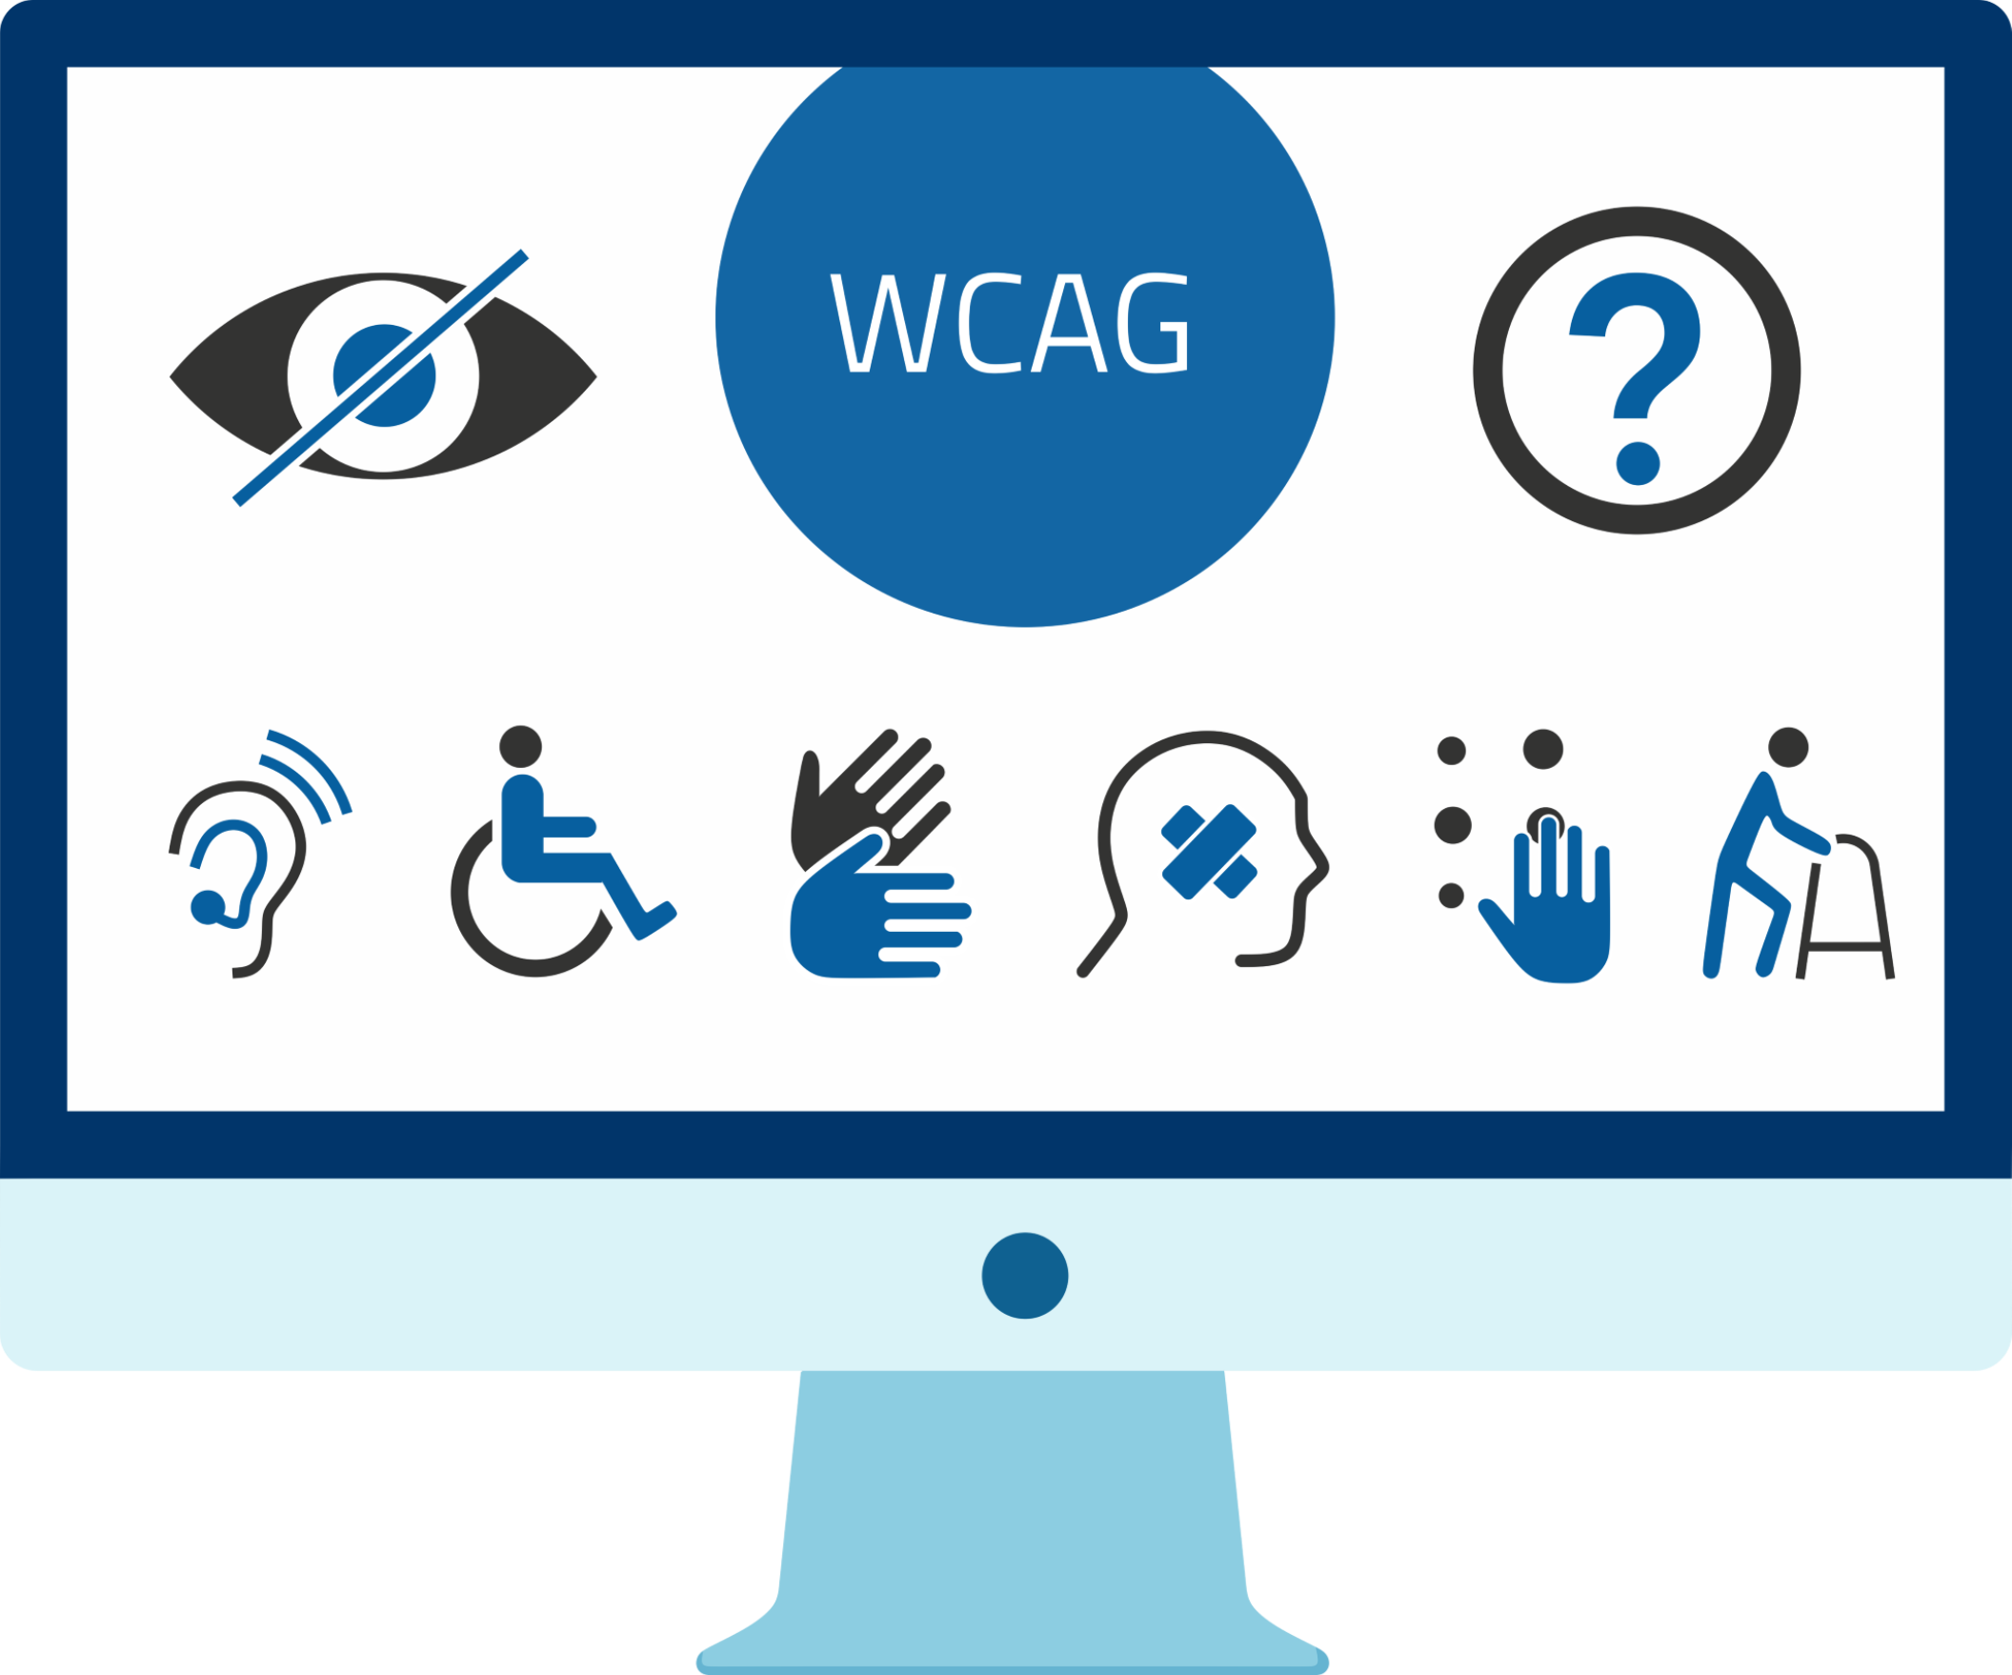
Thank You.
Resources.
wA11ywp.org
@sumnerdavenport
#wA11y Inclusive, Accessible, User Experience Design

