Slide 1
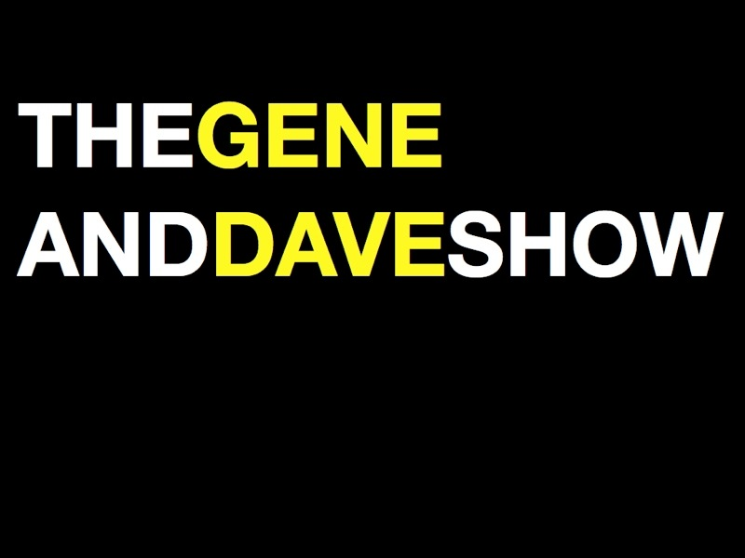
Video Captioning Fun
Presented by…
Gene Rodgers & Dave Dauber
of
The Gene & Dave Show

Slide 2
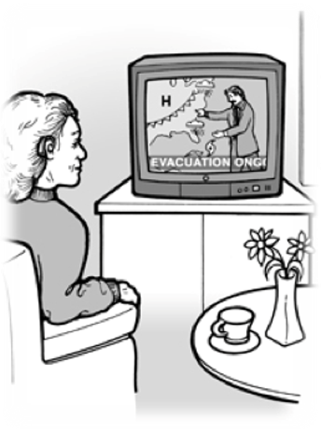
Why should I Close Caption my videos?
  Make accessible for hearing impaired.
  Assist those in noisy, crowded areas enjoy your video.
  Make your video searchable on the internet.

Slide 3
Video Captioning Fun 2
Presented by…
Gene Rodgers & Dave Dauber
of
The Gene & Dave Show

Slide 4
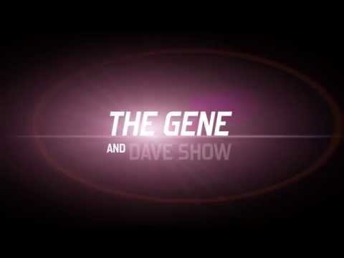
The Gene And Dave Show Action Preview
Notes:
See The Gene And Dave Show Action Preview online: https://youtu.be/cMbYksRnAts

Slide 5
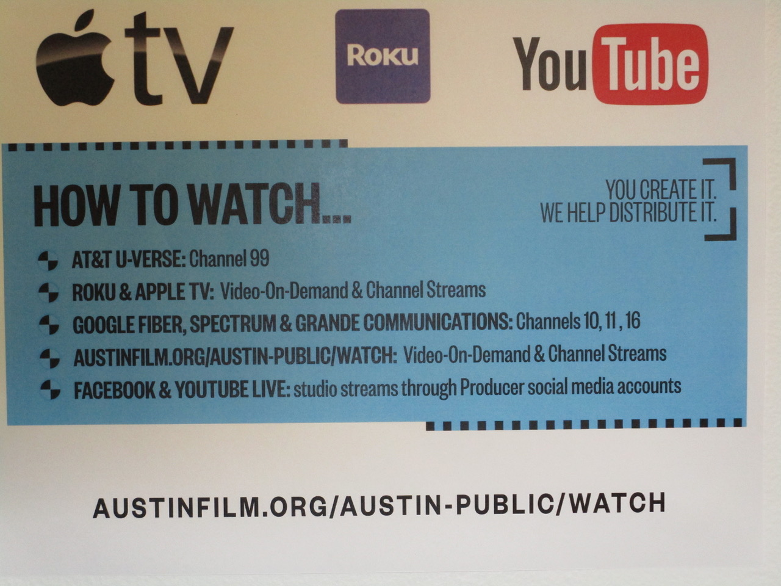
Where can you see The Gene and Dave Show?
How to watch…
(You Create It. We Help Distribute It.)
AT&T U-Verse: Channel 99
Roku & Apple TV: Video-On-Demand & Channel Streams
Google Fiber, Spectrum & Grande Communications: Channels 10, 11, 16
Austinfilm.org/austin-public/watch: Video-On-Demand & Channel Streams
Facebook & YouTube Live: studio streams through Producer social media accounts
Notes:
How to watch…
(You Create It. We Help Distribute It.)
AT&T U-Verse: Channel 99
Roku & Apple TV: Video-On-Demand & Channel Streams
Google Fiber, Spectrum & Grande Communications: Channels 10, 11, 16
Austinfilm.org/austin-public/watch: Video-On-Demand & Channel Streams
Facebook & YouTube Live: studio streams through Producer social media accounts

Slide 6
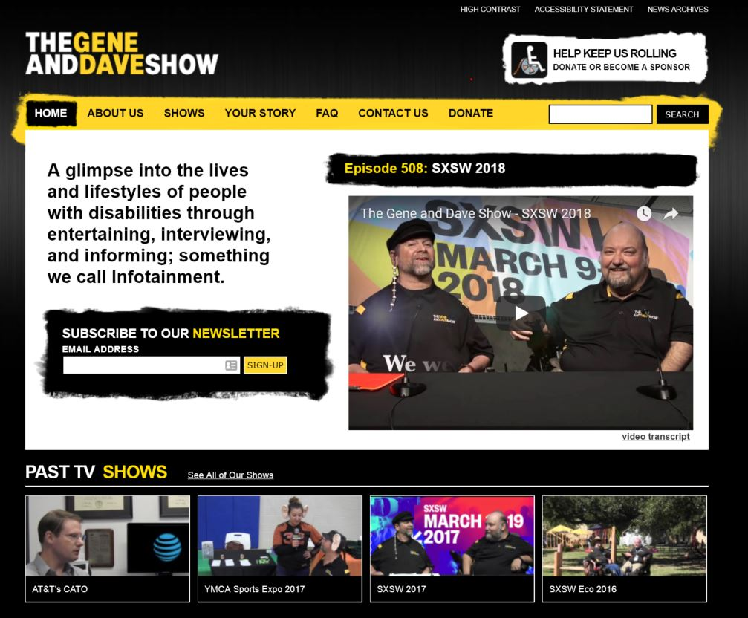
And of course:
www.TheGeneAndDaveShow.com

Slide 7
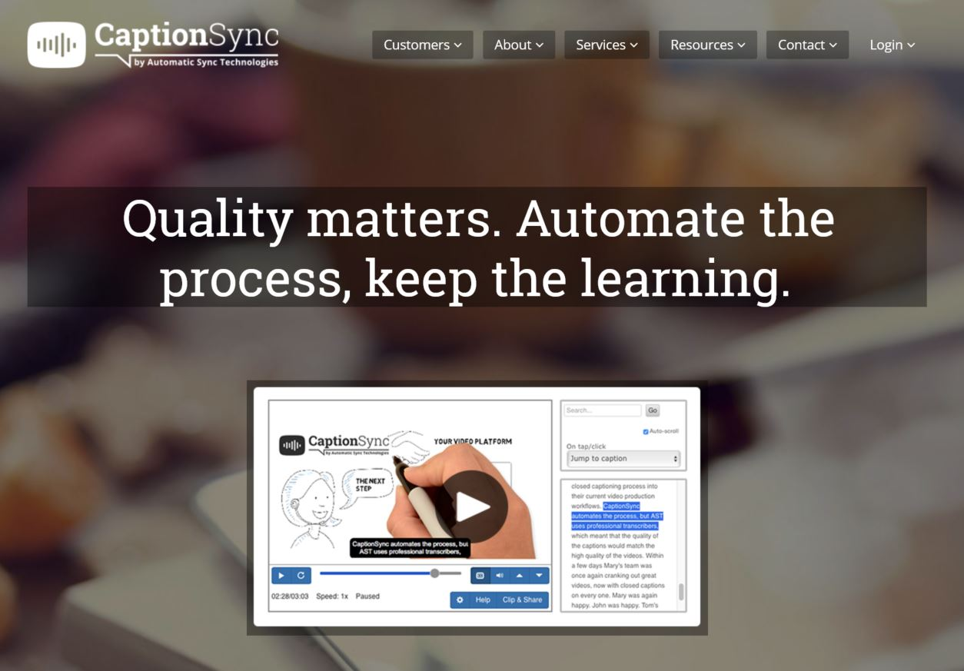
Hire a full-service captioning service.
www.automaticsync.com

Slide 8
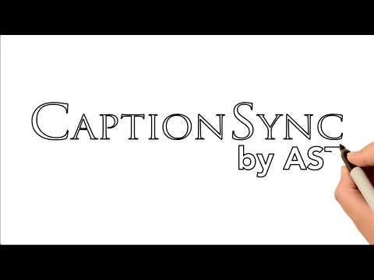
CaptionSync Promotional Video
Notes:
Watch the CaptionSync Promotional Video at https://youtu.be/2I1P04F6FtU.

Slide 9
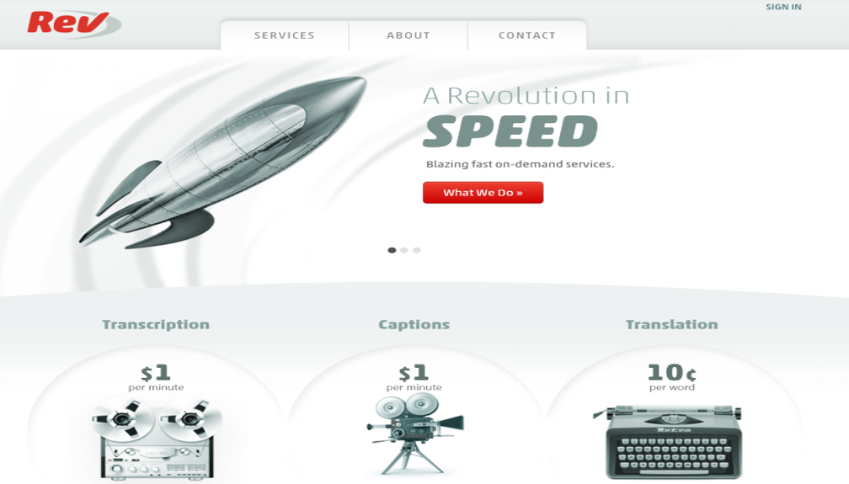
Hire a freelancing captioning service.
http://www.rev.com

Slide 10
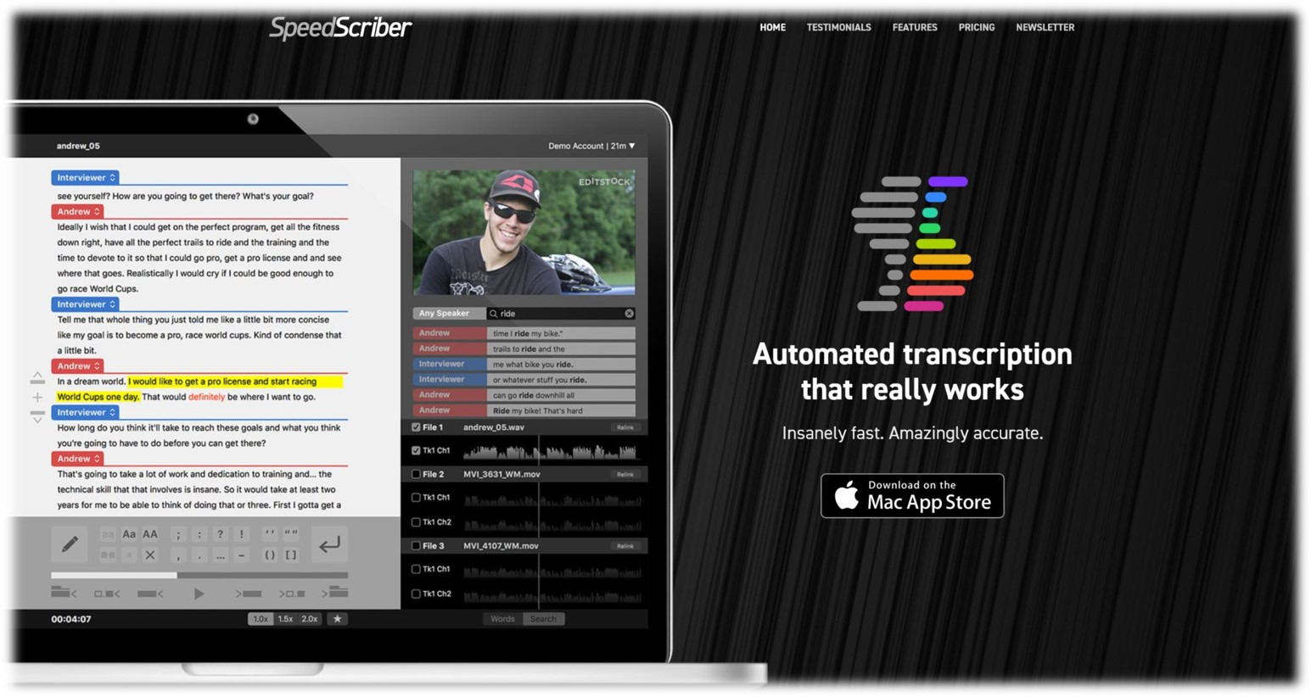
Download an automated transcription service application.
https://www.speedscriber.com
Notes:
They charge $.50 a minute

Slide 11
Use Free YouTube Captioning

Slide 12
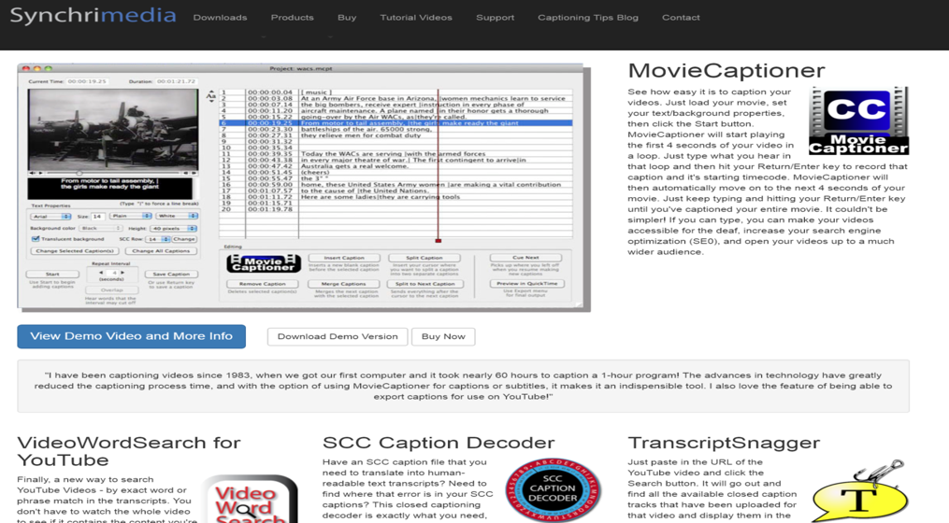
DIY with MovieCaptioner
www.synchrimedia.com

Slide 13

Gene using MovieCaptioner
Notes:
You can see the video of Gene using MovieCaptioner at https://youtu.be/vuVYJVLx7Qw

Slide 14
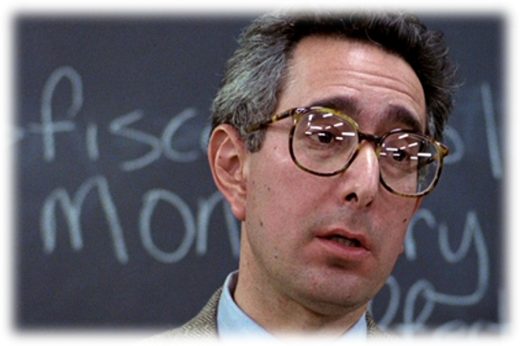
What is the difference between Subtitle & Caption?
Anyone?
  Anyone?
    Anyone?

Slide 15
Subtitle Definition
Subtitles are meant to be translations of the feature's dialogue and assume that audiences can hear.

Slide 16
Subtitle Example
Notes:
To see the subtitle example video visit: https://youtu.be/jX_22IjhWG4

Slide 17
Caption Definition
Closed Captioning Not only includes dialog, but also includes Atmospherics or typed descriptions of non-dialogue sounds. They allow viewers to understand important sound effects or what may be happening in a video when there is no dialogue.

Slide 18
Lessons for writing effective Closed Captioning

Slide 19
Break caption groups at logical places so the text is easily readable by the audience.
Punctuation , ! ?
Pronouns, adverbs, and prepositional phrases such as: that, who, in order to, not only, as we, in which, where, with, what, how, for, through, until, to, as, of, yet, so, by
Conjunctions such as: and, nor, but, or, because

Slide 20
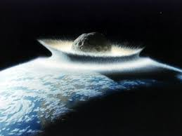
This is an example of incorrect caption breaking. These breaks make for awkward reading:
hit the earth. Or this kind of

Slide 21
This is an example of incorrect caption breaking. These breaks make for awkward reading:
meteorite, this is the current theory that the meteorite

Slide 22
This is an example of incorrect caption breaking. These breaks make for awkward reading:
hit the earth, and mass extinction occurred. So we think

Slide 23
This is an example of incorrect caption breaking. These breaks make for awkward reading:
that happened 65.5 million years ago.

Slide 24
This example reads much better because it follows the rhythm of speech, breaking at slight pauses:
hit the earth.

Slide 25
This example reads much better because it follows the rhythm of speech, breaking at slight pauses:
Or this kind of meteorite,

Slide 26
This example reads much better because it follows the rhythm of speech, breaking at slight pauses:
this is the current theory that the meteorite hit the earth,

Slide 27
This example reads much better because it follows the rhythm of speech, breaking at slight pauses:
and mass extinction occurred.

Slide 28
This example reads much better because it follows the rhythm of speech, breaking at slight pauses:
So we think that happened 65.5 million years ago.

Slide 29
More Lessons for writing effective Closed Captioning
Break caption groups so they are under 60 characters long.
Do not include text that is already on the screen. E.g., a movie or chapter title.

Slide 30
Atmospherics to Include:
A sound effect which is integral to the story or message of a video.
Background music sets a specific mood as part of the story telling.
Music with clearly audible lyrics that are part of the story telling.
Notes:
#1-(Only include significant sounds effects that help tell the story. Use your best judgment.)
If a character reacts to a sound, e.g., “(gun bangs)”, “(plane engine roars)”, or “(car honking)”.
-If a sound is the main focus point, e.g., a group of children playing, use “(children laughing)”.
-Include sounds made by the speaker, e.g., “(laughs loudly)”.
#2 - Only include a background music atmospheric if there’s a significant gap in speech and the music seems important. E.g., “(dramatic orchestral music)”. Introductory music is a common atmospheric. E.g., “(gently chiming bells)”
#3 - If the music lyrics add content to the story, e.g., TV theme songs or when a character puts on a song and dances to it. You need to include the music note symbol. E.g., “♪ We will, we will, rock you”

Slide 31
Atmospherics Format
Atmospherics are put in parentheses and are always in lowercase, e.g., “(loud snoring)”, unless a proper noun is used, e.g., “(Gene snores loudly)”
  Parentheses can only be used for atmospherics, never dialogue.
  Atmospheric-only captions do not need a dash or speaker ID.

Slide 32
Atmospherics Format (continued)
Atmospherics must always be present tense, e.g., “(laughs loudly)”, never past tense, e.g., “(laughed loudly)”.
Always describe with an action verb. E.g., “(frogs croaking)”, never with an onomatopoeia of a sound, e.g., “(ribbit, ribbit)”.

Slide 33
Speaker differentiation for effective Closed Captioning
Use a dash and a space “- ” to indicate a speaker change.
- I’m Gene.
- I’m Dave. And we are
- [together] The Gene and Dave Show.

Slide 34
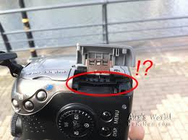
Speaker CANNOT be visually identified (off screen)
- [Gene] I forgot to put the SD card in the camera.
Notes:
If the speaker CANNOT be visually identified or Multiple people are shown on-screen and the viewer can’t tell who is speaking, identify the speaker with a speaker ID.

Slide 35
The other speaker is also off screen
- [Dave] You’re a dumbass.
Notes:
If the speaker CANNOT be visually identified or Multiple people are shown on-screen and the viewer can’t tell who is speaking, identify the speaker with a speaker ID.

Slide 36
Where are you displaying video?
Creating DVDs
Streaming from company/personal website.
Embedding or playing from YouTube, Vimeo, Facebook, or other.
Podcast through iTunes.
Downloading video files.

Slide 37
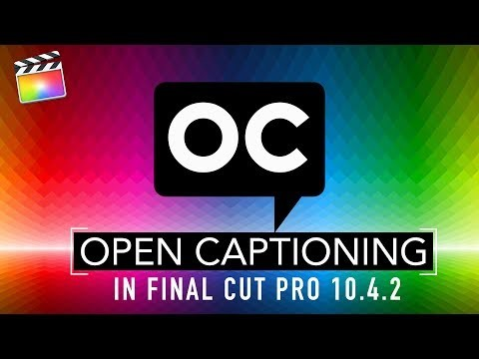
Closed Captioning using Final Cut Pro X
Notes:
Watch the full versions of these videos at:
https://youtu.be/aKZelGihd2g

Slide 38
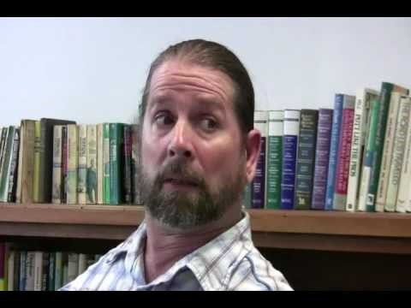
Who Works Monday?
Notes:
Watch “Who Works Monday?” online at: https://youtu.be/sQlKpL3srqU

Slide 39
Video Captioning Fun
Presented by...
Gene Rodgers & Dave Dauber
of
http://www.thegeneanddaveshow.com

