Slide 1
Accessibility Testing With Screen Readers
Dan Brown
Sr. Quality Assurance Engineer, Blindness Technologies
Dan.brown@pearson.com

Slide 2
Agenda
Introduction
Screen Reader Overview
Downloading and Installing NVDA
Using the Keyboard
NVDA User Interface
Reading Modes
Headings and Lists
Form Fields
Links
Graphics
Q and A

Slide 3
Who Is Dan Brown?
I’ve written a few books you may have heard of …

Slide 4
Introduction
1994-1996: University of Texas at Austin,
Assistive Technology Trainer
1996-2001: Texas Commission for the Blind,
Adaptive Technology Trainer
2001-2003: Lampert and Company,
Director of Training
2003-2015: HumanWare,
Blindness Product Specialist Regional Account Manager
2015-Present: Pearson,
Senior Quality Assurance Engineer for Blindness Technologies

Slide 5
Presentation Website
http://accessibility.pearson.com/assessment/conferences/accessu2019.htm

Slide 6
Availability
There are now screen readers available for all major software platforms.
Mac and iOS: VoiceOver
Android: TalkBack, BrailleBack (Speech and braille access handled separately.)
Chrome OS: ChromeVox
Amazon Fire: VoiceView
Windows: Microsoft Narrator

Slide 7
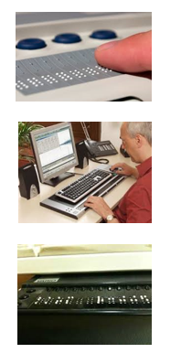
Braille Displays
Many braille readers also read screen reader output using a braille display.
Braille displays are electro-mechanical devices that display braille characters.
The characters are formed by pins that are alternately raised and lowered through holes in a flat surface.
Displays also have braille keyboards, allowing users to navigate and enter braille that is translated into text.

Slide 8
Braille Display Advantages
The use of braille displays provide several advantages to a speech-only approach:
Reduced reliance on speech output in noisy environments.
Improved spelling.
Enhanced ability to detect text attributes such as capitalization, punctuation, font changes, and indents/out-dents.
Increased ability to navigate and manipulate spatial data, such as in tables.

Slide 9
Microsoft Narrator, A Brief History
In the past, Narrator was only used when no other screen reader was available, or to install a 3rd party alternative.
Microsoft partnered with Ai Squared to offer the Window-Eyes screen reader free for customers who purchased Microsoft Office.
Narrator received a major upgrade with the Windows 10 Anniversary Update in 2016.
Now boasts many of the same benefits as full-featured 3rd party screen readers

Slide 10
3rd Party Windows Screen Readers
And then there were two …
Jaws for Windows: http://www.freedomscientific.com/
NonVisual Desktop Access, NVDA: http://www.nvaccess.org/
June 14, 2016: VFO Group purchased Ai Squared, makers of Window-Eyes
May 15, 2017: VFO Group ends sales for Window-Eyes in the U.S.

Slide 11
Downloading and Installing NVDA
Go to NV Access: https://www.nvaccess.org/
Choose the Download link
Choose the Download button, and save the file in a familiar location
Run the install file, and follow the on-screen instructions (WARNING: You must have admin rights to successfully install the application!)

Slide 12
Keyboard Access
Screen reader users can only navigate a webpage by using the keyboard.
All content functionality should be available through the keyboard.
Content should be presented in a logical order.
Useful if content has been divided into structural blocks.
Beware creating a Keyboard Trap! When focus cannot navigate away from a particular element.
Keyboard Compatibility | Web Accessibility Initiative: https://www.w3.org/WAI/perspective-videos/keyboard/

Slide 13
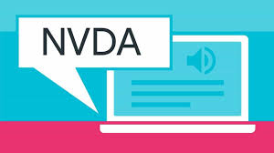
NVDA Welcome Dialog Exercise
Launch Dialog: NVDA+N, H, L
Reread Dialog: NVDA+B
Move forward/backward by dialog tabs: Ctrl+Tab/Ctrl+Shift+Tab
Move forward/backward by dialog fields: Tab/Shift+Tab
Navigate through combo boxes, list boxes, and radio buttons: Up/Down Arrow
Toggle checkboxes: Spacebar
Press button with focus: Enter
Cancel dialog: Escape

Slide 14
Keystroke Categorization
When trying to remember a keyboard command, use the following categories:
Insert/Capslock: Screen reader modifier key
Alt: Activates menus and pushes buttons
Control: Accesses commands inside menus (Ctrl+O = Open, Ctrl+N = New, etc.)
Shift: Selects text when combined with navigation keys
Windows: Windows commands (Windows = Start Menu, Windows+D = Desktop, etc.)

Slide 15
Basic Navigation
Navigate by character – Left/Right Arrow
Navigate by word – Ctrl+Left/Ctrl+Right Arrow
Navigate by line –
Up/Down Arrow
Navigate by paragraph – Ctrl+Up/Ctrl+Down Arrow
Beginning and end of line – Home/End
Beginning and end of document – Ctrl+Home/Ctrl+End

Slide 16
Miscellaneous Commands
Silence Speech: Control
Keyboard Help: Insert+1
Read title of current application: Insert+T
Open Start Menu: Windows
Go to Desktop: Windows+D
Switch in-between applications: Alt+Tab
(Hold down Alt and continue pressing Tab to switch between multiple apps.)

Slide 17
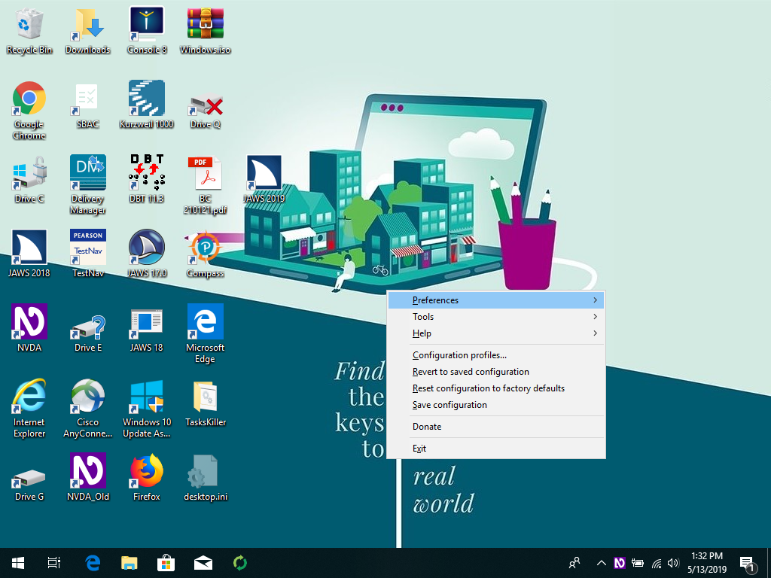
NVDA User Interface
Press NVDA+N to activate
Press Up/Down Arrow to navigate the menu
Press Enter to select a menu option
Press Escape to exit

Slide 18
Document Navigation Exercise
Open the Practice Document on the presentation website, and follow its instructions.

Slide 19
Reading Modes
Screen readers typically have two reading modes:
Review mode: Content is readable, but not available for editing.
Single letter mnemonics provide quick access to document elements. H, Heading; L, List, etc.
Interactive Mode: Keystrokes are passed through to the active application.
Screen readers automatically switch modes based on context.

Slide 20
What’s Your Name?
These two concepts can have very different names.
JAWS for Windows
Review Mode = Virtual PC Cursor
Interactive Mode = Forms Mode
NVDA
Review Mode = Browse Mode
Interactive Mode = Focus Mode
Windows Narrator
Review Mode = Scan Mode
Interactive Mode = (Not Specified)

Slide 21
Mode Handling
“Why won’t that command work here?”
Screen readers try to figure out what you want to do based on context.
Interactive Mode: In Microsoft Word, you’ll almost certainly type something.
Review Mode: In Adobe Acrobat, you’ll probably read something.
Automatic Mode Switching: In a web browser or e-mail program, you’ll need to do both.

Slide 22
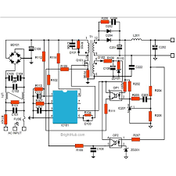
Switch That Mode
The following commands allow you to manually
switch in-between modes.
JAWS for Windows: Insert+Z
NVDA: Insert+Space
Windows Narrator: Capslock+Space

Slide 23
What Makes A Document Accessible?
The elements that provide structure and meaning in webpages perform the same function in other documents as well.

Slide 24
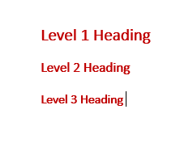
Headings
Headings provide structure to a page:
HTML allows up to six levels of headings, <h1> to <h6>
Pages should be structured in a hierarchical manner.
A single page title at level one, major headings at level two, subheadings at level three, etc.
Do not skip heading levels, <h2> to <h4>
Do not use text formatting—large fonts, bold print—to give a visual appearance of headings without markup.

Slide 25
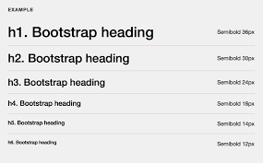
Heading Commands
H/Shift+H: Move forward/backward by headings.
1-9/Shift+1-9: Move forward/backward at the designated heading level.
Insert+F6: (JAWS/Narrator) Headings List.
Insert+F7: (NVDA) Elements List.

Slide 26
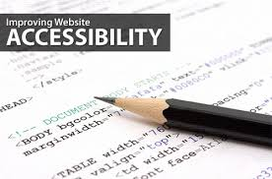
Lists
HTML lists can also provide hierarchical structure on a page:
Definition list, <dl>:
A structure for definitions.
Ordered list, <ol>:
Items in a sequence.
Unordered list, <ul>:
No order of sequence.
Do not use to indent or layout text.
WebAIM, Semantic Structure: http://webaim.org/techniques/semanticstructure/

Slide 27
List Commands
Currently not supported by Narrator.
L/Shift+L: Move forward/backward by list.
I/Shift+I: Move forward/backward by list item.

Slide 28
Heading … Nowhere
Centers for Disease Control and Prevention: https://www.cdc.gov/
Microsoft Official Home Page:
https://www.microsoft.com/en-us/

Slide 29
Forms
Forms allow us to interact with web content.
They contain elements such as edit fields, buttons, check boxes, radio buttons, and list/combo boxes.
Just as with headings, forms should be organized in a logical manner.
Form elements should always be labeled, and some indication given if input is required.
Ensure that all form fields are keyboard accessible.
Include important cues or instructions in associated labels or at the beginning of the form.
WebAIM, Creating Accessible Forms: http://webaim.org/techniques/forms/

Slide 30
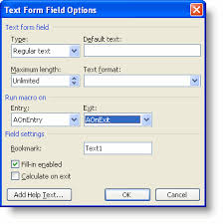
Form Field Commands
Tab/Shift+Tab: Move forward/backward by links and form elements.
F/Shift+F: Move forward/backward by form fields.
Insert+F5: (JAWS/Narrator) Forms List
Insert+F7: (NVDA) Elements List.

Slide 31
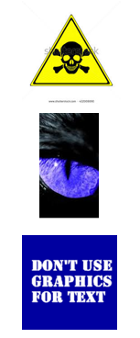
Forms Exercise
Southwest Airlines: https://www.southwest.com/

Slide 32
Links
Hypertext links work with all technologies.
Users must be able to navigate to and select each link from the keyboard.
Tab and Shift+Tab for navigation, Enter to select.
Screen readers already identify links with the word “link,” so do not add it to alt text.
Link names should make sense out of context.
Create links with distinguishing information first, and explanatory information second.
Use link names that are unambiguous and can be intuitively organized.
WebAIM, Links and Hypertext: http://webaim.org/techniques/hypertext/

Slide 33
Link Commands
Tab/Shift+Tab: Move forward/backward by links and form elements.
K/Shift+K: (Narrator/NVDA) Move forward/backward by link.
Insert+F7: Links List.

Slide 34
Link Exercise
The Verge: https://www.theverge.com/
Zilker Park Visitors Guide | Austin, TX: http://zilkerpark.org/

Slide 35
Images
Images can be separated into several categories:
Informative: Graphically represent concepts and information. Alt text description should convey all relevant information.
Decorative: If the only purpose served by an image is visual decoration, use a null text alternative. (alt=“”)
Functional: The alt text should describe the function, not the visual image. (Print)
Text: Images of readable text should be avoided, except in cases of a logo. If used, the alt text should contain the same words that appear in the image.

Slide 36
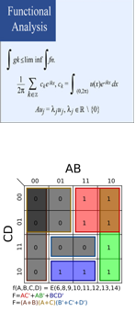
Images (Continued)
Complex, graphs and diagrams: Ideally, other elements such as data tables should be used.
Groups: When multiple images convey one piece of information the alt text for each image should also convey that information.
Image Maps: Alt text for images with multiple clickable areas should describe the overall context for the links, as well as providing specific alt text for each link.
WAI, Web Accessibility Tutorial, Images: https://www.w3.org/WAI/tutorials/images/

Slide 37
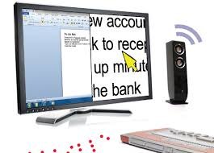
Image Commands
Currently not supported by Narrator.
G/Shift+G: Move forward/backward by graphic.

Slide 38
A Picture Is Worth…
Greyhound: https://www.greyhound.com/en/
Features | USAGov: https://www.usa.gov/features?page=2?
Boy Scouts of America | Prepared. For Life.™: https://www.scouting.org/

Slide 39
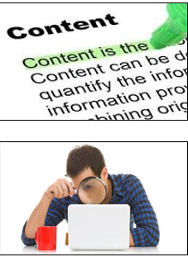
Resources
Web Accessibility Initiative: https://www.w3.org/WAI/
WebAIM – Web Accessibility In Mind: http://webaim.org/
Complete Guide to Narrator: https://support.microsoft.com/en-us/help/22798/windows-10-complete-guide-to-narrator
JAWS Screen Reader Documentation: http://www.freedomscientific.com/Products/software/JAWS/
NVDA V2019.1.1 User Guide: https://www.nvaccess.org/files/nvda/documentation/userGuide.html

Slide 40
Q and A
If you have any questions, please ask them now!

